Slide 1
NXDN
THE FUTURE IS NOW!

Slide 2
THE NETWORK IS LARGER and more robust

Slide 3
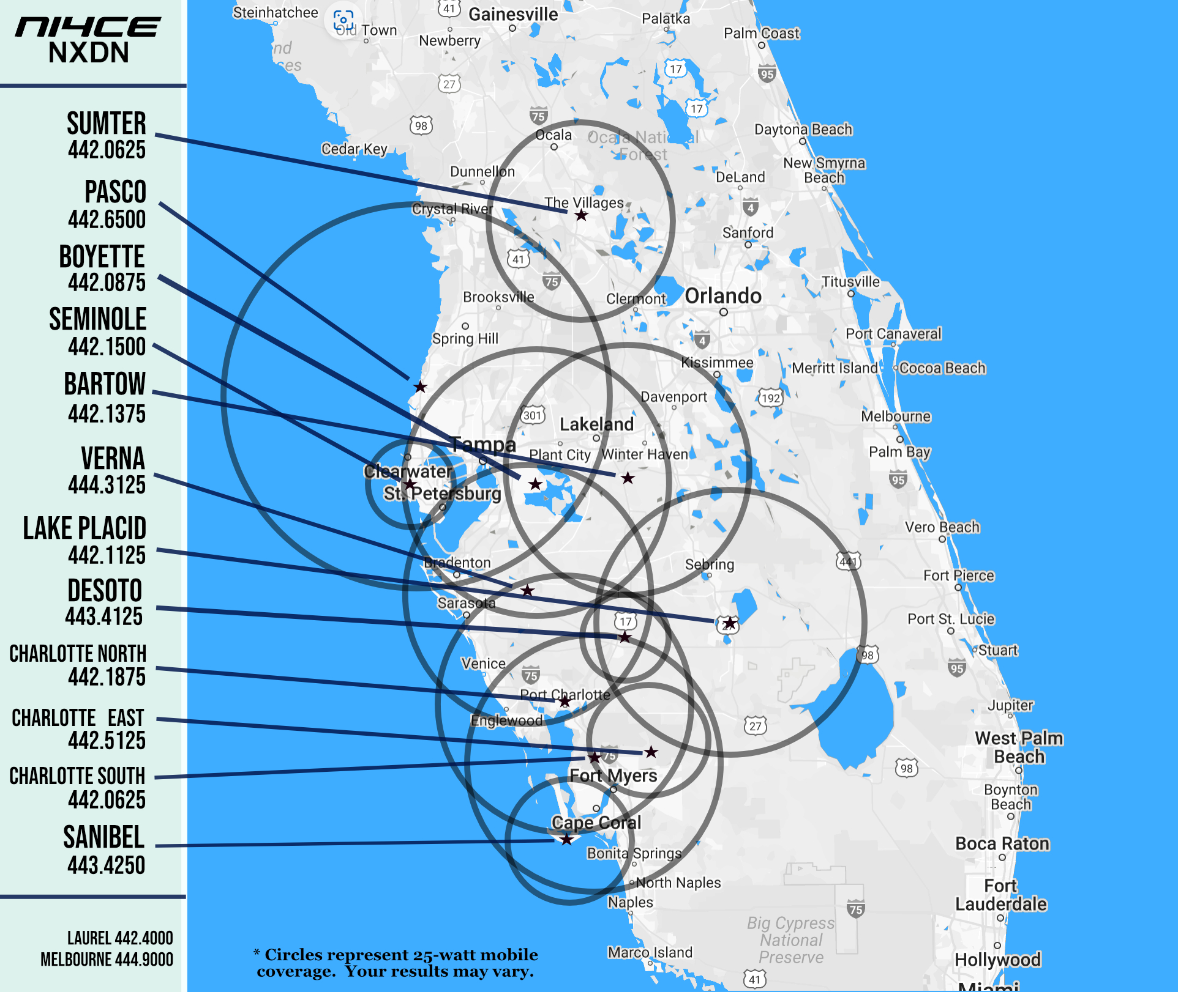
NEW
DeSoto Co. Repeater in Arcadia
In The Works:
Hardee Co Repeater near
Wauchula

Slide 4
V P N
A Secure Network Within A Network

Slide 5
Other network improvements
Fiber Optics Connections
More Throughput & Resiliency
Lower Latency
Fewer Retries

Slide 6
Other network improvements
Better Monitoring
Individual Component Monitoring
Improved Uptime

Slide 7
Other network improvements
Beaconing
Radio Auto Channel Steering
Enabled in YOUR Radio
Uses RSSI To Determine Best Repeater
New Beacon Every Ten Seconds

Slide 8
END USER RADIOS

Slide 9
BASIC Models
F2100DS
F6130D / OPC2078
128 Memory CH
8 Zones
8 CH Display
5-2-1 Watts
OTAA
Conventional / Voting
100 Char Messages
Inc. Rapid Charger
128 Memory CH
8 Zones
8 CH Display
45-5-5 Watts
OTAA
Conventional / Voting
100 Char Messages
Inc. Rapid Charger

Slide 10
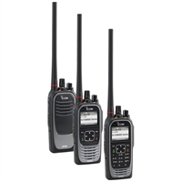
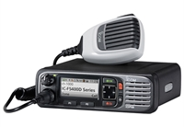
ADVANCED Models
F4400 DS/DT
F6400D
1024 Memory CH
Color LCD Display
GPS Receiver
Bluetooth Audio/Data
USB Micro
Up to 32 GB sdRAM
Custom Announcements
OTAA
100 Char Messaging
5-2-1 Watts
45-25-5 Watts

Slide 11
NXDN Programming & features

Slide 12
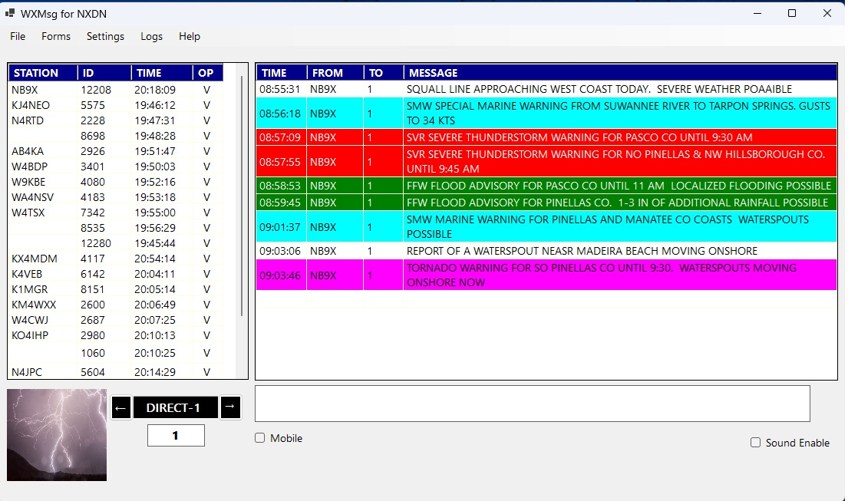
WXMsg for NXDN
Real-time Text Messaging
Station List of all Voice and Data Stations Heard
Colorized Weather Warning Messages
Capture GPS Coordinates for Tactical Operations
NTS Message Form
Download from NI4CE.org Digital Webpage

Slide 13
Memory Channel → ZONE Operation To Set ZONE Type

Slide 14
SCAN → Vote Setting
FAST VOTE = -90
VOTE (L2) = -110
Re-VOYE = -114
FAST VOTE ON
Re-VOTE ON

Slide 15
DOUBLING & TRIPLING

Slide 16
LOCKOUT FIELD
Set to BUSY
Prevents Transmitting When a RF Carrier it Detected
Prevents Doubling with Other Stations
Instills Some Patience

Slide 17
RX Group
Turn ON to enable Talkgroup Scanning when
SQL Type is SEL

Slide 18
RX Group
Turn ON to enable Talkgroup Scanning when
SQL Type is SEL
Scan up to 8 Talkgroups Simultaneously

Slide 19
Radio Firmware
F2100 Series Version 1.9 just released
F6130D Version 1.5
F4400/F6400 Version 3.3

Slide 20
Later Today . . .

Slide 21
Paul Toth-NB9X
WCF ASM-Digital ptoth@nb9x.us

