Slide 1
The Alachua County “Arduino WINKEYER”
Gordon Gibby KX4Z

Slide 2
Why do CW Field Day ops need a WINKEYER?
Applications (N3FJP etc) can send “Morse” via serial ports – but code is JERKY, JUMPY because Windows pre-empts timing
Radios like ICOM7300 have PADDLE INPUT
Can send “canned-text”
Cannot insert callsign, from logging N3FJP
Cannot change speed instantly / directly from a physical KNOB (without menu effort)

Slide 3
BIG ADVANTAGE for CW ops
N3FJP provides almost all CW SENDING with perfect timing through WINKEYER – via canned text usually!
No errors! No time wasted!
Touch-typist fingers remain on keyboard continuously
In hours of Field Day, only a small number of paddle-CW actually required, generally when other operator confused.

Slide 4
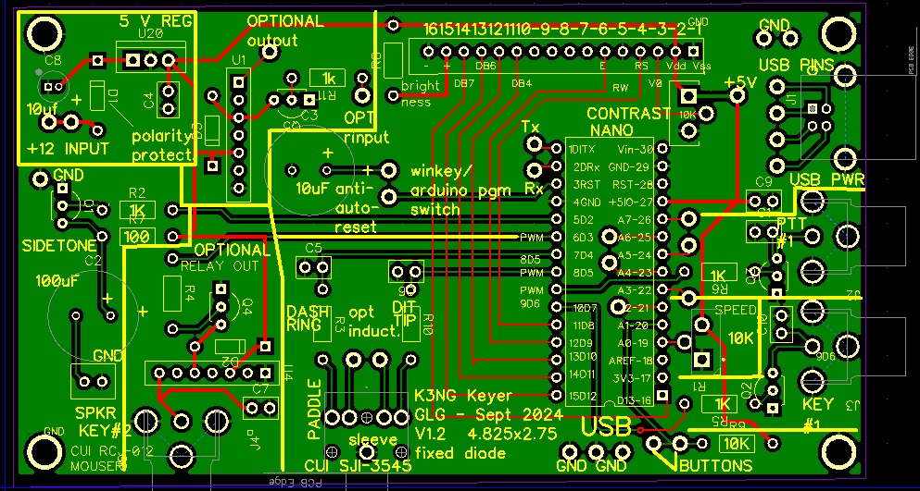
Commercial Product

Slide 5
Commercial Product
Steve K1EL’s product works WELL and is utilized by many, many operators.
Accepts 1200 baud USB connections from computers, multiple logging systems (N1MM, N3FJP, others)
Provides solid-state keying for low-positive-voltage straight-key radio inputs
Does not provide relay output suitable for older radios with high negative voltage (e.g. many vacuumtube radios using grid-block keying (Heathkit etc)
BIGGEST ADVANCE by Steve might be his WINKEYER PROTOCOL which has been adopted by major logging systems.

Slide 6
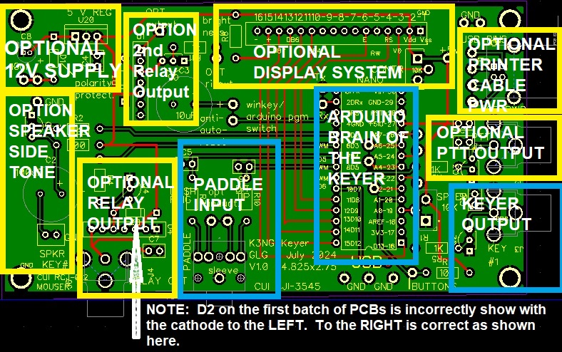
K3NG’s contribution
https://blog.radioartisan.com/arduino-cw-keyer/
Some years ago, K3NG wrote freely-available code for an Arduino-based keyer using the WINKEYER protocol.
Multiple commercial products exist using this codebase.

Slide 7
North Florida Amateur Radio Club NF4RC / NF4AC
Most of our members don’t do Morse Code.
We DO teach, experiment, and BUILD THINGS in our “LabNLunch” meetings throughout the year – a way of further training our volunteers
Rather than BUY an off-the-shelf item, we wanted to give our volunteers a LEARNING EXPERIENCE

Slide 8
FCC Part 97.1
§97.1 Basis and purpose
The rules and regulations in this part are designed to provide an amateur radio service having a fundamental purpose as expressed in the following principles:
(a) Recognition and enhancement of the value of the amateur service to the public as a voluntary noncommercial communication service, particularly with respect to providing emergency communications.
(b) Continuation and extension of the amateur's proven ability to contribute to the advancement of the radio art.
(c) Encouragement and improvement of the amateur service through rules which provide for advancing skills in both the communication and technical phases of the art.
(d) Expansion of the existing reservoir within the amateur radio service of trained operators, technicians, and electronics experts.
(e) Continuation and extension of the amateur's unique ability to enhance international goodwill.

Slide 9
Perfect Kind of Project for Ham Club
Printed circuit board greatly reduces time and errors
No tricky RF wiring
Not very RF sensitive either!
12V or USB powered
Relatively few components
Emphasizes connectors / connections

Slide 10
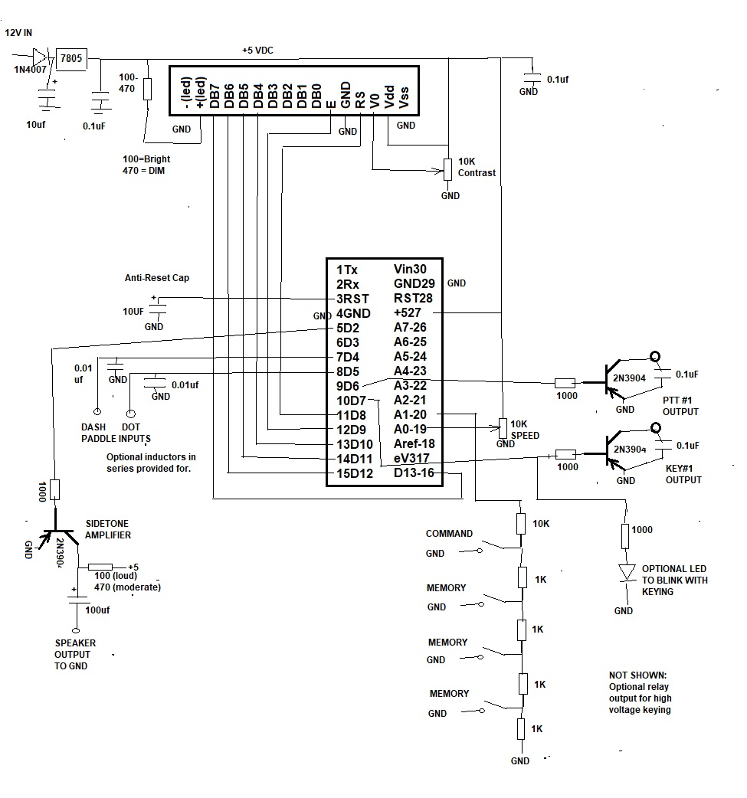
Schematic

Slide 11
ADDITIONS
Add 2N3904 control of a reed-relay to handle high volage / negative voltage radios
Provide square wave sidetone output
Power either via USB or 12V input / 3-terminal regulator

Slide 12
Double-Sided PCB

Slide 13
Sections

Slide 14
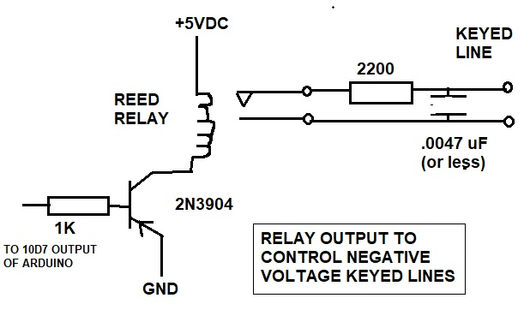
Relay Output Correction

Slide 15
Documentation
Keyer Building & Use Manual
https://www.nf4rc.club/how-to-docs/arduino-k3ng-winkeyer-emulator-locally-developed-morse-code-keyer-manual/
Packaging Manual
https://www.nf4rc.club/how-to-docs/arduino-winkeyer-packaging-instructions/

Slide 16
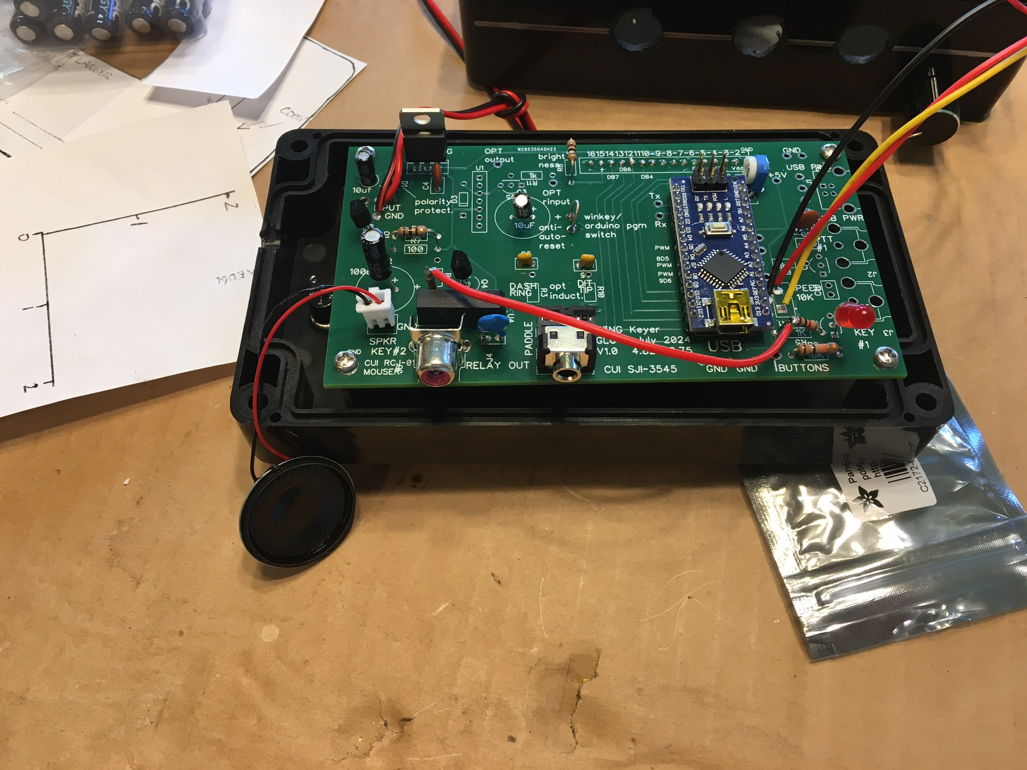
Example Versions

Slide 17
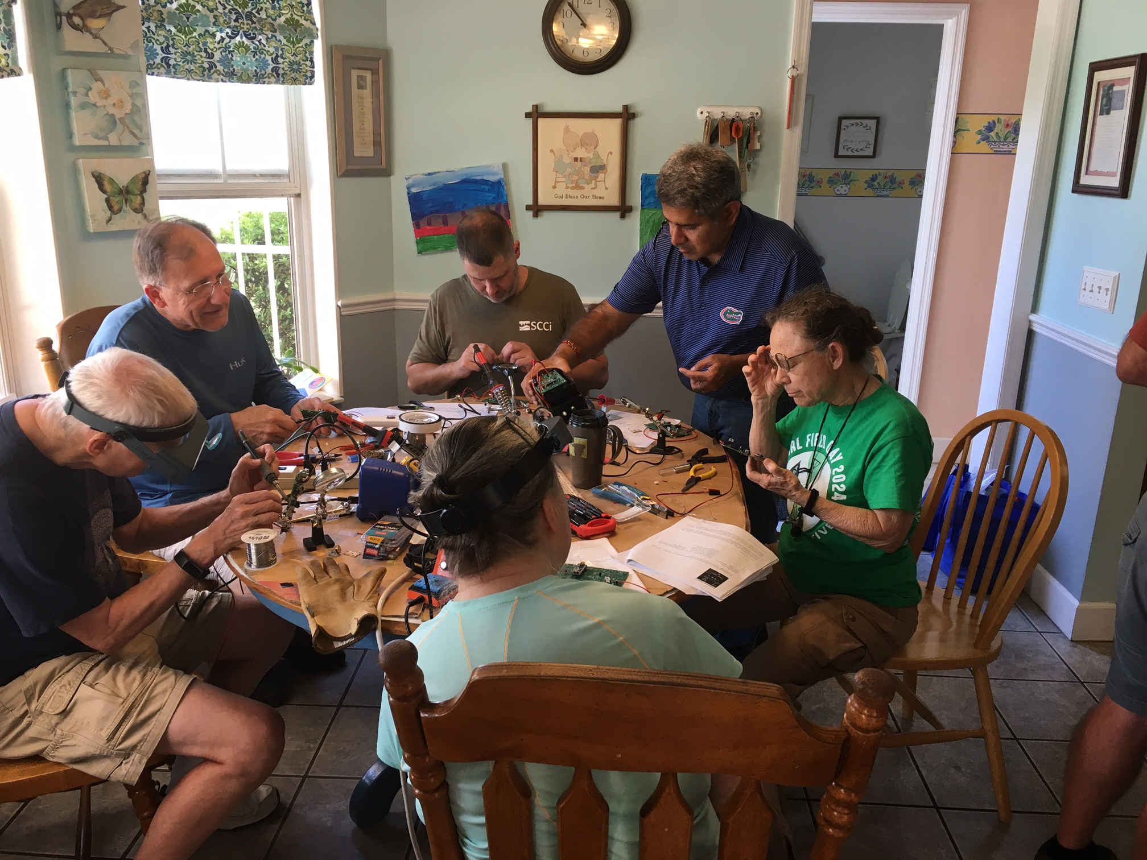

Slide 18
Mechanical Skills Developed
Use of brass standoffs to mount printed circuit board
Understanding of common connector types
Drilling holes at prescribed location
Dremel rotary cutter to make square openings
Mounting potentiometer

Slide 19
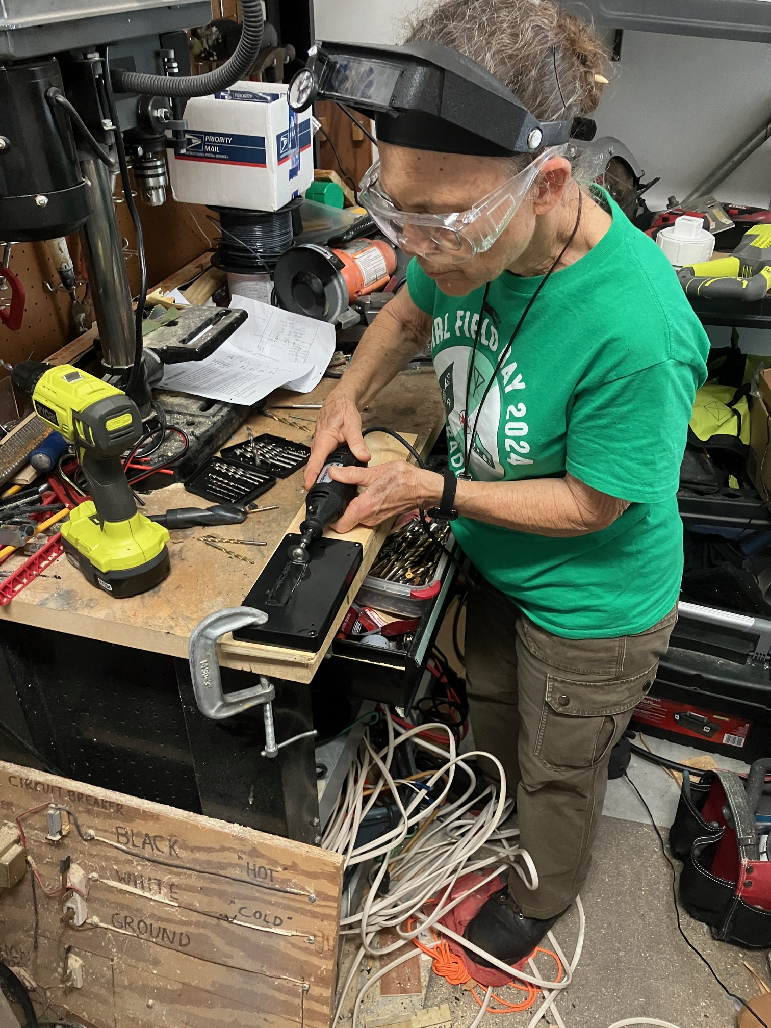
Mechanical Build

Slide 20
Keyer Operation
Command Mode versus operating
Entering and exit command mode by BRIEF press on command button
Tailored set of commands to fit Arduino Memory

Slide 21
Commands
Note – when using N3FJP you don’t need these memories!
P1 <send messge> Fill Memory #1
P2 <send message> Fill Memory #2
P3 <send message> Fill Memory #3
N Swap dot/dash paddles
O Cycles the sidetone between none, paddle, all
Y Sets time delay between memory repeat
T Very useful TUNE mode (dot dash different)

Slide 22
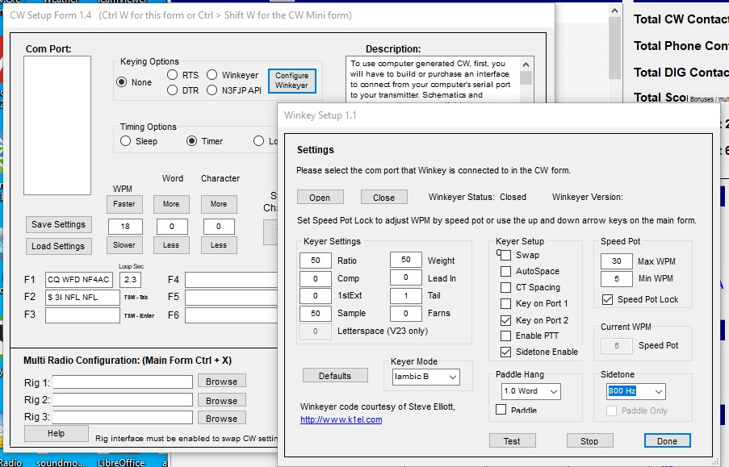
N3FJP configuration
BE CERTAIN to set the Windows Port Defult for that COM PORT to 1200 Baud!

Slide 23
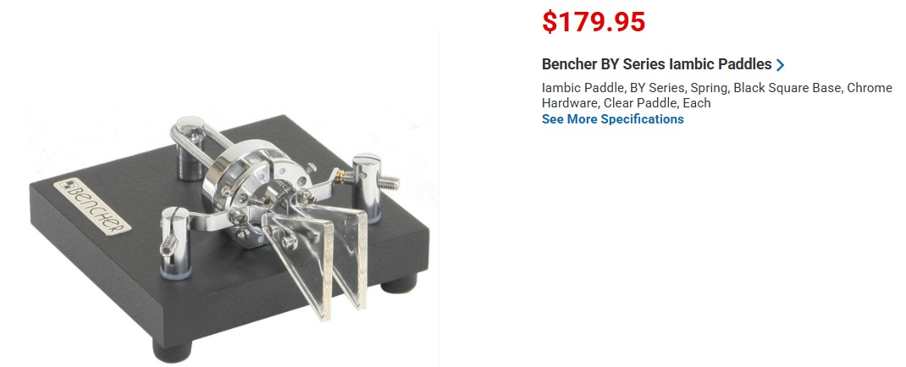
Paddle Prices Prohibitive!

Slide 24
Add-On Project: Paddles
CW keyer PADDLES are another high-priced item, out of reach of many hams
Turns out – easy to build!
Solid state inputs like Arduino work FINE with simple screw/metal contact closures
Simple hardware products provide the spring-action and needed flexibility

Slide 25
Paddle Parts Readily Available
Stainless steel right-angle brackets
https://www.amazon.com/gp/product/B08BZPG7ZM?th=1
Zinc-plated Steel Tie Plate (20-gauge galvanized 1-1/4” x 9” tie $0.88)
https://www.homedepot.com/p/Simpson-Strong-Tie-LSTA-1-1-4-in-x-9-in-20-Gauge-Galvanized-Strap-Tie-LSTA9/202255804

Slide 26
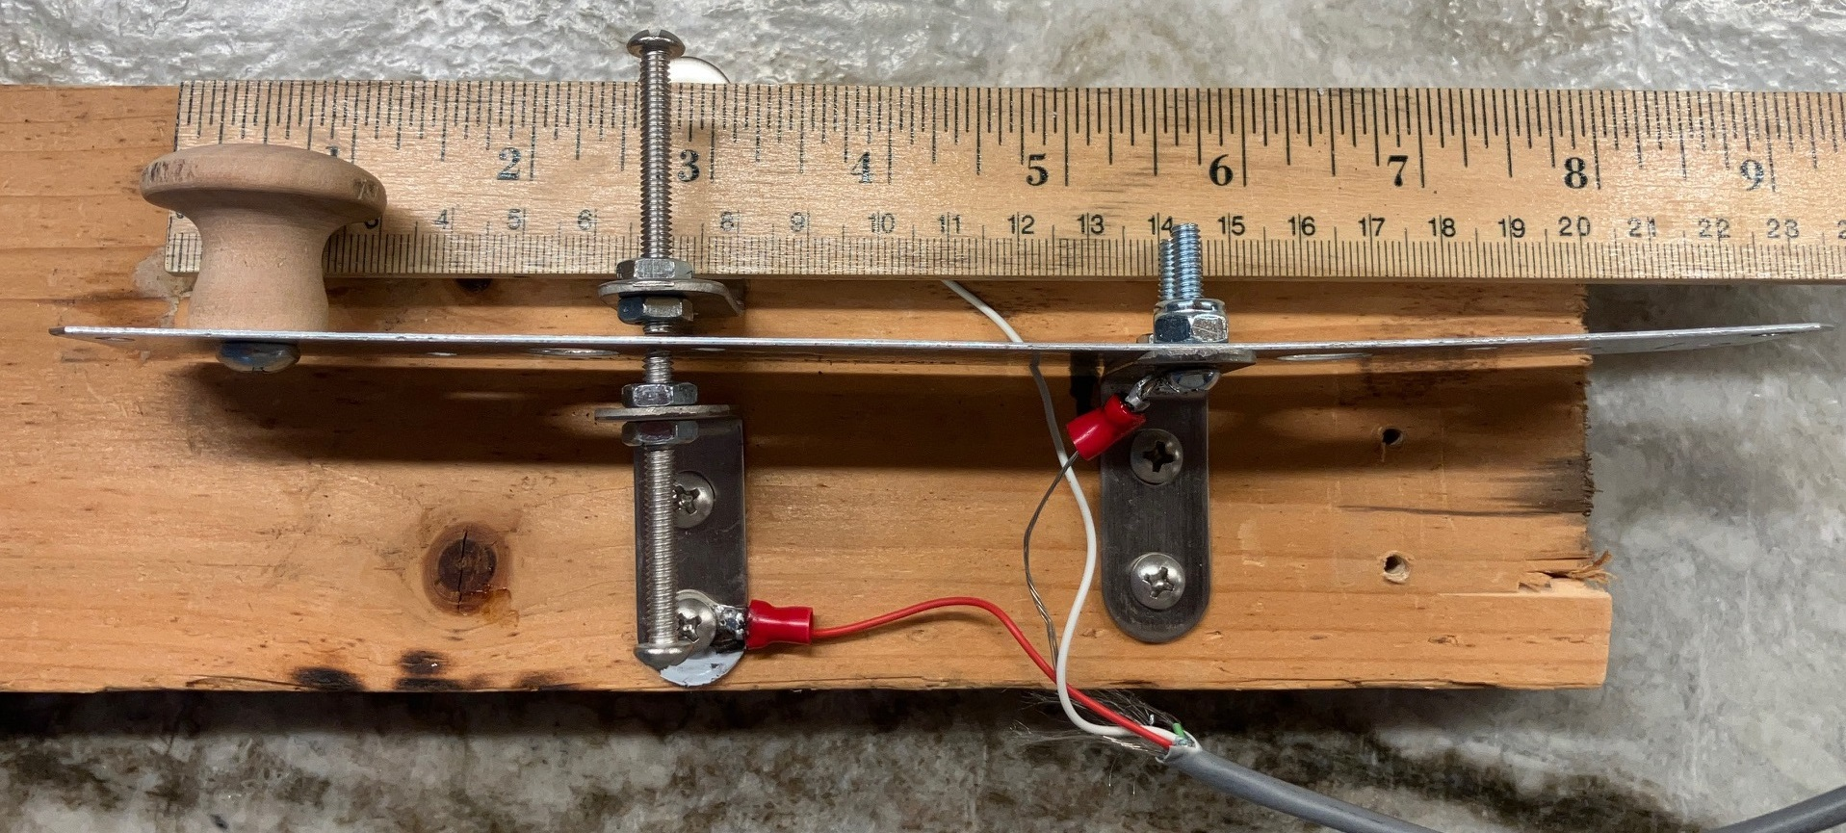
Homebrew $7 Paddle

Slide 27
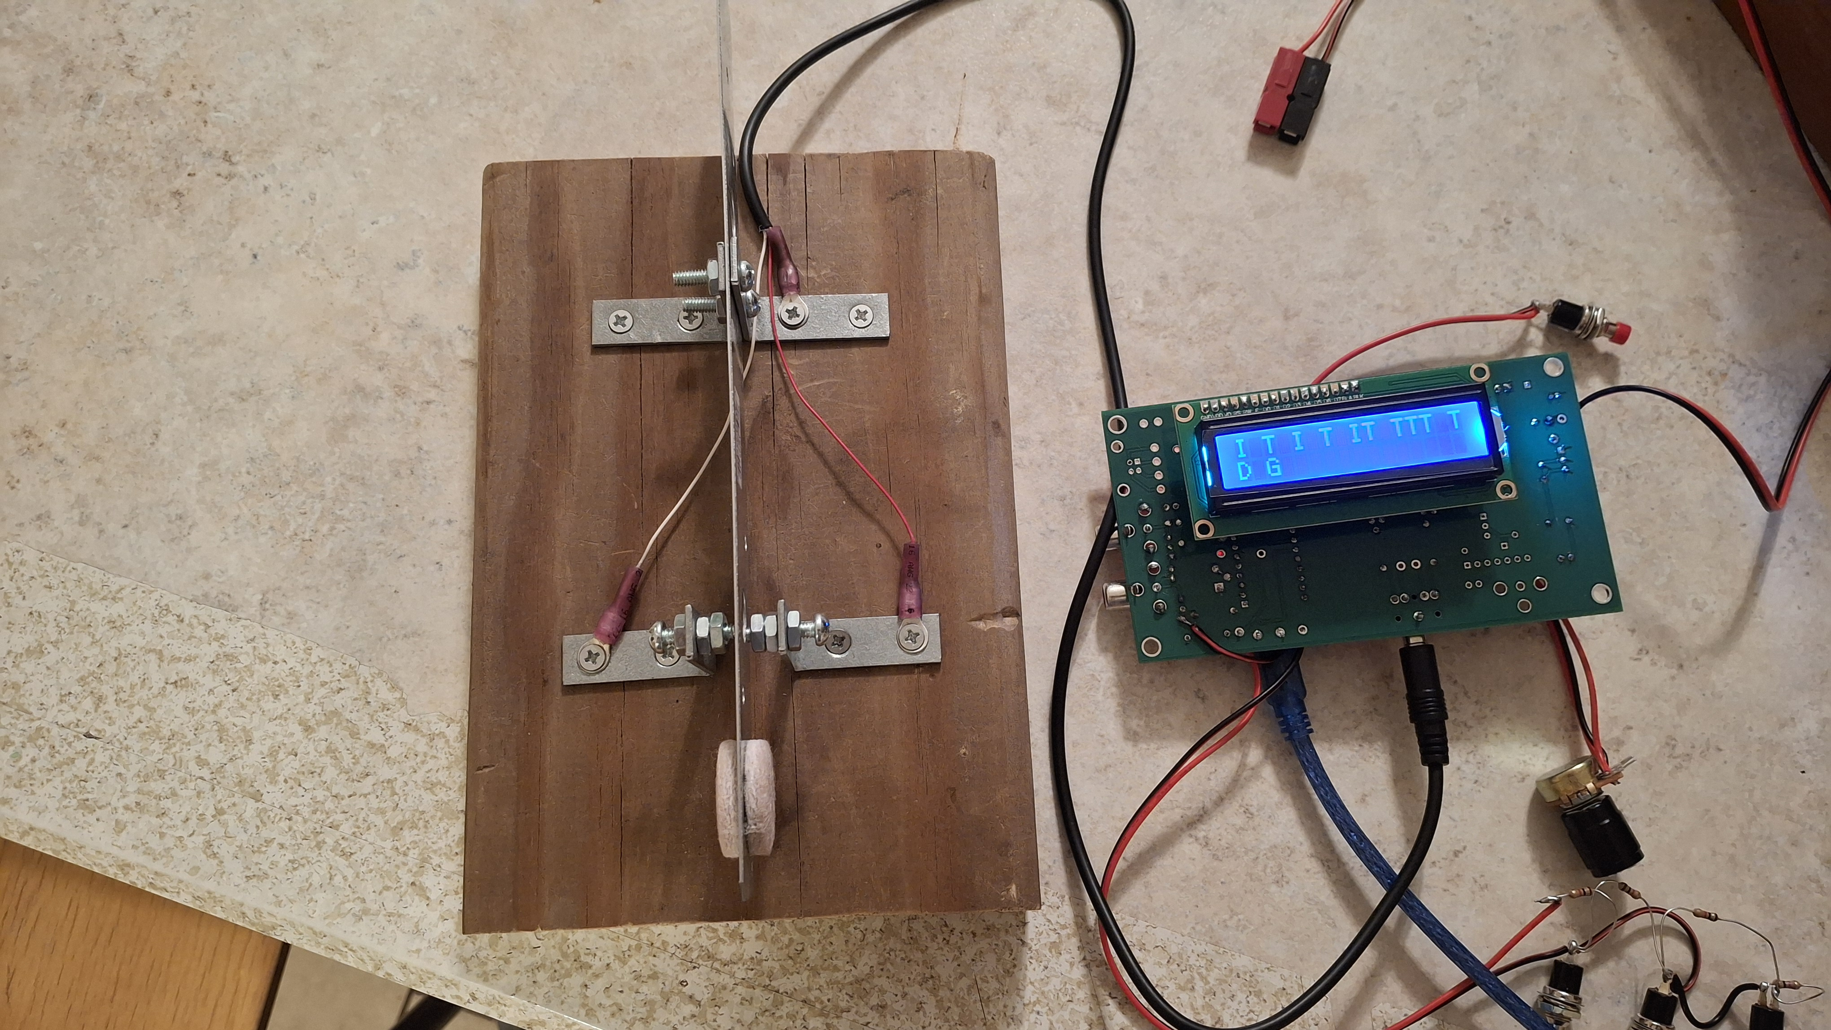
Hugh Minnich Paddle

Slide 28
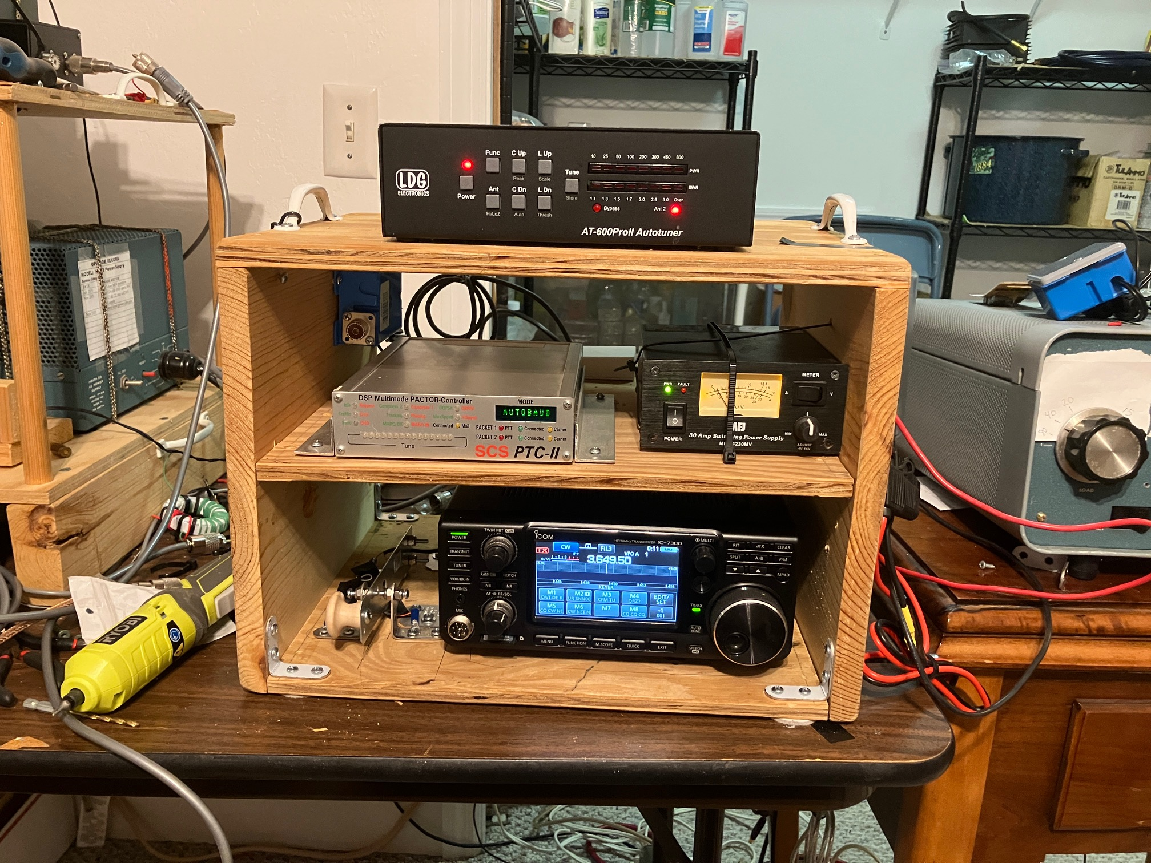
Cheap to add to go-box!

