Slide 1
Building a Portable sdr scanner
Kyle Condon – KC4ALE

Slide 2
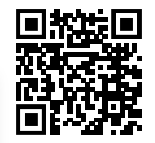
Youtube Video

