Slide 1
Introduction to Microwaves
Buddy Morgan WB4OMG
TS WCF, since Day One
Lakeland, FL
beamar@aol.com

Slide 2
Introduction to Microwaves
I will primarily be talking about Weak Signal applications for the microwave Bands
I will only briefly mention Data transmission, Wide Band Digital Voice and FM operation
Weak Signal Work is using CW, SSB and Narrow Band Digital Modes (WSJT), for communications
Weak Signal Work is mostly Terrestrial, but includes EME and Meteor Scatter modes
Most of my comments will be about Terrestrial communications

Slide 3
Introduction to Microwaves
In the past, microwaves were considered the frequencies above 3000 MHz (3GHz)
Now the official definition seems to be 300 MHz to 300 GHz
Most people - including Amateur Radio Operators - refer to microwaves as the frequencies above 432 MHz and below Infrared Light

Slide 4
Introduction to Microwaves
One common characteristic of all the Amateur Bands above 432 MHz, is that there is almost no impulse noise or static crashes
All these bands are shared with other services and Amateur Radio is secondary to these other services and there is interference from these services.
There is no known ionospheric propagation, on these bands
GPS frequency stabilization is highly desirable and gets even more desirable as you go higher in frequency
You can’t talk very far on these bands – right?

Slide 5
Introduction to Microwaves
One common characteristic of all the Amateur Bands above 432 MHz, is that there is almost no impulse noise or static crashes
All these bands are shared with other services and Amateur Radio is secondary to these other services and there is interference from these services.
There is no known ionospheric propagation, on these bands
GPS frequency stabilization is highly desirable and gets even more desirable as you go higher in frequency
You can’t talk very far on these bands – right?

Slide 6
Introduction to Microwaves
Everybody Knows: With distance d in meters and frequency f in Hz, Free Space Path Loss increases 20 dB per decade of frequency (i.e., 6 dB per doubling of f), all else equal.

Slide 7
Introduction to Microwaves
The statement on the previous slide is misleading
It takes into account the changing size of an Isotropic Antenna, with frequency
If the Antenna physical size stays the same, with increasing frequency, then the signal is not attenuated
That’s why 440 MHz repeaters work about as well as Two Meters

Slide 8
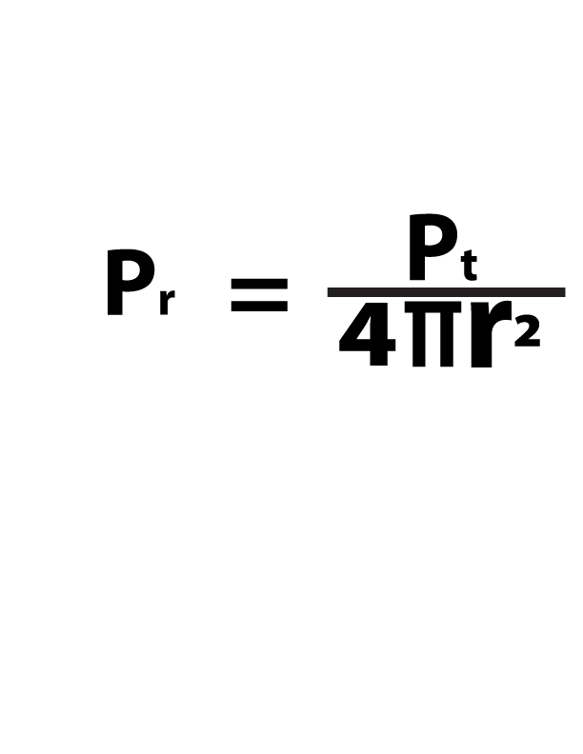

Slide 9
Introduction to Microwaves
It’s called the Inverse Square Law
Please note that the equation on the previous slide does not include a frequency term
First noticed by Sir Issac Newton back in 1785
A physical law established by God, at the Beginning of Time
There are other losses, that do increase with frequency
But, the Free Space Path Loss does not

Slide 10
Introduction to Microwaves
Let’s talk about some of the bands

Slide 11
902 MHz (33 cm)
For repeater type operation, 902 is very similar to 70 cm.
For weak signal work, contacts are a little more difficult, than the lower bands – losses in the Troposphere are higher.
Obstructions are more of an obstruction – your antenna needs above the trees and other local obstructions.
Feedline loss is high – LMR 400 has ~4 db/100 feet of loss
Interference, from non Amateur stations is a huge problem.

Slide 12
902 MHz (33 cm) continued
Radios for weak signal work are not available for 900 MHz.
You will need a Transverter.
The usual IF, for a Transverter is 144 MHz. An IC 705 makes a great IF radio.
Commercial Power Amplifiers and Yagis are available, at reasonable prices.
Loop Yagis work better than Linear Yagis
Not a very active band.
The SSB/CW Calling Frequency is 902.1 MHz.

Slide 13
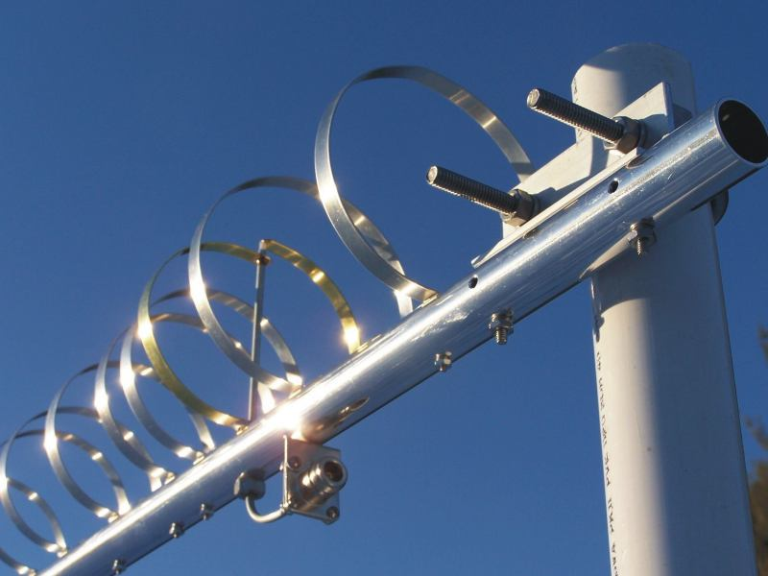
Loop Yagi
Photo courtesy of Directive Systems
Notes:
Probably a new concept to most people/

Slide 14
1296 MHz (23 cm)
Very little non-Amateur interference.
An IC 9700 or an IC 905 will get you on 1296, with 10 watts.
Or you can use a Transverter.
Not quite as active as 432.
Loop Yagis work a lot better than Linear Yagis.
Broadband dishes are available and work OK.
D Star DV, D Star DD and FM work well.
800 Mile contacts are pretty common, during periods of Tropospheric enhancement.

Slide 15
1296 MHz (23 cm) continued
GPS frequency stabilization is a very good idea.
With Loop Yagi above the trees, you can work around the peninsula of Florida pretty well
Use 1 5/8” Heliax, if you can
Power is expensive
This is the easiest band for EME
1296.1 is the SSB/CW Calling Frequency

Slide 16
2304 (13 cm)
Lots of interference
A IC 905 or a Transverter are the two ways to get on 2304
Loop Yagis are the best antennas
A lot less activity than 1296
You are not going to talk as far as on 1296
SSB mobile is highly distorted, due to multipathing

Slide 17
2304 (13 cm) continued
D Star DV, D Star DD and FM work well
My wife and I use 2305.0 FM Simplex as a mobile to base Chit Chat Channel
2304.1 is the SSB/CW Calling Frequency
I can work Jacksonville, any time I want. It takes a little enhancement for me to work K4LY, Inman, SC (EM 85)
We are almost certain to lose this band under “The Big Beautiful Bill”

Slide 18
3400 MHz (9 cm)
Propagation is very similar to 2304
Loop Yagis are the best antennas
You will need a Transverter
Almost no activity
We are almost certain to lose this band under “The Big Beautiful Bill”

Slide 19
5760 (6 cm)
To operate on 5760 and above takes some dedication
You will be using a dish antenna
Feedline loss is a huge problem
Waveguide is feasible
Interference is a huge problem
Rain Scatter contacts are pretty common, during Thunderstorm Season

Slide 20
5760 (6 cm) continued
Contacts are much more difficult than on 2304
D Star DV, Star DD, FM and TV work well
You will need a IC 905 or a Transverter
I regularly make 150 mile contacts
K4VJ, Clermont, FL worked W5LUA. Allen, TX, (930 Miles) with about 200 mW into a BBQ Grill Dish
It is a great Ragchew Band
The SSB/CW Calling Frequency is 5760.1
This is another band that we are probably going to lose

Slide 21
10 GHz
A little more difficult than 5760
You will need a Transverter or a IC 905
You have to mount your radio at the dish
Most people operate portable
Trees are death on 10 GHz
50 mile contacts are easy
The Terrestrial DX record is 1000 Miles
The SSB/CW Calling Frequency is 10368.1
There are 10 GHz D Star repeaters in Japan

Slide 22
24 GHz
Considerably more difficult than 10 GHz
Very little, if any activity, in Florida
The Terrestrial DX record is 337 miles

Slide 23
47 GHz & up
No activity in Florida
Line of Sight plus a little (sometimes)

Slide 24
Introduction to Microwaves
On the bands, 902 and above, almost all of the activity is WSJT Q65 Mode

Slide 25
The release of Q65, in 2021, gave Terrestrial VHFers, a very sensitive and versatile mode. Per the Q65 Quick Start Guide, “Q65 uses 65-tone frequency-shift keying and builds on the demonstrated weak-signal strengths of QRA64.”

Slide 26
You can easily complete a contact, using Q65, with a station that you cannot hear out of the speaker or see, on the waterfall.

Slide 27
WSJTX Q65:
Supplemented FT8
Takes takes up more Bandwidth than FT8
Doesn’t seem to be as DT tolerant as FT8
Not as user friendly as FT8
There is usually some initial frustration, with new Q65 users.
Designed for a prearranged contact
Is not quite as social as FT8
The Q65-15A frequencies are xxxx.170 MHz

Slide 28
Q65 Modes:
Modes are referred to as: Q65-(Time Sequence)(Mode).
So Mode A, with a 30 second T/R sequence would be Q65-30A
There are recommended Modes and sequence lengths, for various types of contacts.
Almost all terrestrial Q65 contacts are Mode A.
Use Mode C for Rainscatter.

Slide 29
The Q65 screen has a few more controls than the FT8 screen.

Slide 30
WSJTX Q65 for Tropospheric QSOs:
The waterfall you will want to set to Q65 sync.
You also have some new controls: FTOL, Max Drift, Submode, SH and TR.
Most people have a separate “configuration” set up for Q65

Slide 31
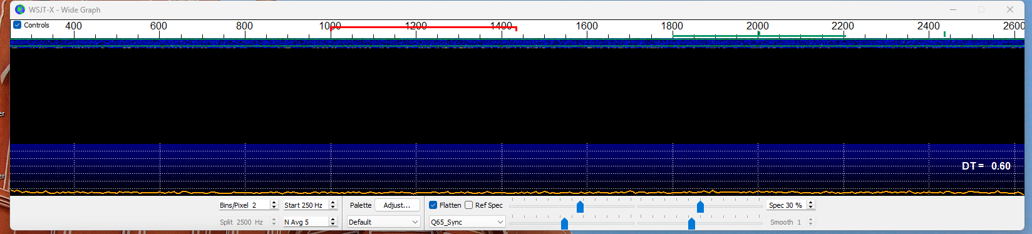

Slide 32
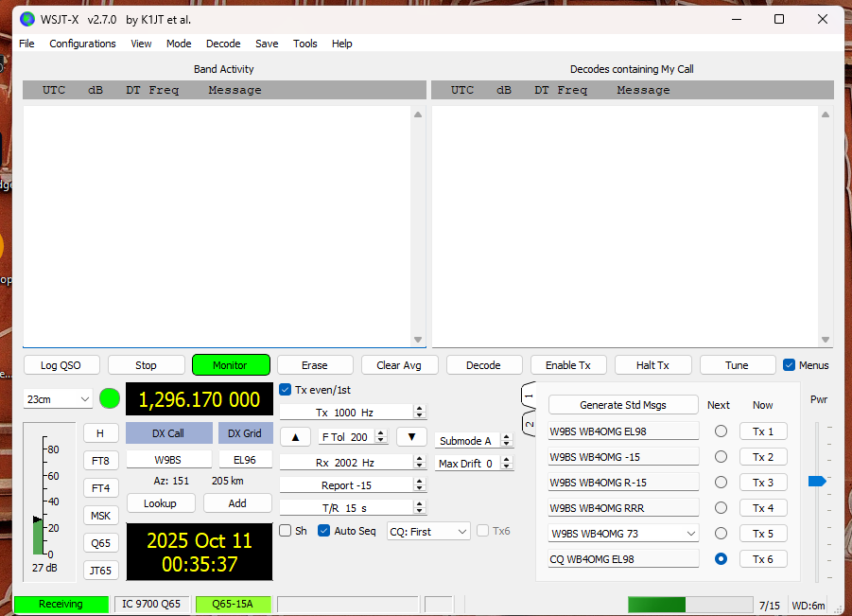

Slide 33
WSJTX Q65 for Tropospheric QSOs:
Five time sequences: 15, 30, 60, 120 and 300 seconds.
Five Modes: A, B, C, D and E.
Bandwidths from 433 to 1733 Hz vs a little over 50 Hz, for FT8.

Slide 34
Q65 Controls
FTOL – Controls the width of the Green Cursor.
Max Drift – Leave it at Zero!
SH – Don’t check it.
Submode – Select which Q65 mode you want to operate.
TR – Select the time sequence you want to operate.

Slide 35
WSJTX for Microwaves
On The microwave bands, Q65 has proved its superiority over FT8.
Q65 handles all the non-Amateur Signals, very well.
FT8 works on 902, 1296, 2304 and 5760. But, Q65 works a lot better.
If you use audio frequencies of 500, 1000, 1500, 2000 and 2500 Hz, you can get Five QSOs into your Passband

Slide 36
WSJTX on 10 GHz:
Two Facts
I have made contacts over a 200 foot path, using FT8.
Over a 30 mile path, even with strong signals, FT8 doesn’t work, at all.

Slide 37
On 10 GHz: :
A FT8 signal doesn’t look bad on the waterfall.
It doesn’t sound bad, out of the speaker.
But, it will not decode – at least in Florida.
This is probably due to water vapor, which causes multipathing, which causes frequency spreading.
All I know is that FT8 just does not work, for me, on 10 Gigs. I am told it works in drier climates.
We have used Q65 mode A, B, C and D. With 15, 30 and 60 second sequences with equal results, over a 40+ mile path.
If you really want to be sure, use Mode C.

Slide 38
WSJT Activity Night in the South East
We are on, every Monday starting on 144.174 MHz, FT8. People get on as early as 7:00 pm, Eastern Time. I have made contacts as late as 10 pm. Most participants are in Florida, Georgia, The Carolinas and Alabama. We occasionally have Cuban stations. Eden, ZF1EJ has made a few appearances. We go up the bands. We use Q65.

Slide 39
Keep track of what is happening, in the South Eastern United States, on VHF
We have an e mail reflector VHFlorida, one of the io groups.
We have a chat room, provided by Jason, K4JMX https://k4jmx.com/chat/account.php No password required.
A lot of our activity is in the mornings, starting around 6:30 am, Eastern Time.

Slide 40
Introduction to Microwaves Buddy Morgan WB4OMG

