Slide 1
NXDN
THE FUTURE IS NOW!

Slide 2
THE NETWORK IS LARGER and more robust

Slide 3
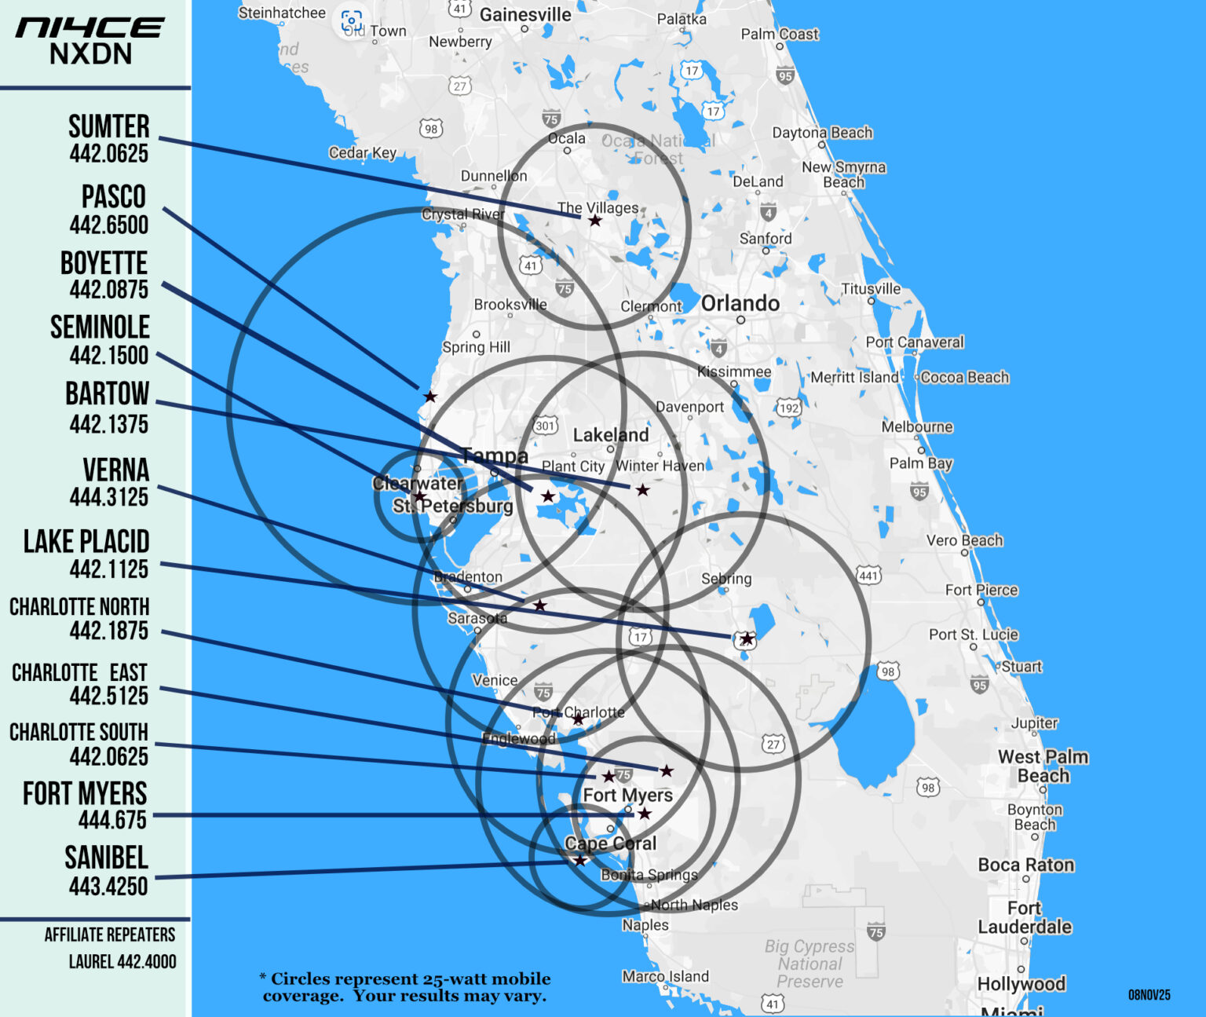
IN THE WORKS
HARDEE CO
ORLANDO
CITRUS CO

Slide 4
flxNET
NEW FEATURES
GPS Support on TG 14439
  Your POSIT on APRS.FI
DYNAMIC TALKGROUPS
  12000 – 12005 User Activated
Multi-Threaded Operation

Slide 5
Other network improvements
Individual Component Monitoring
Improved Uptime
Operational Dashboard and Logging
Site / TG Activation-Deactivation on the fly

Slide 6
VOTE SCAN
Works on the received Beacon RSSI from Each Repeater
Auto-Steers Your Radio Automatically
Uses Similar Methodology as Cell Phones

Slide 7
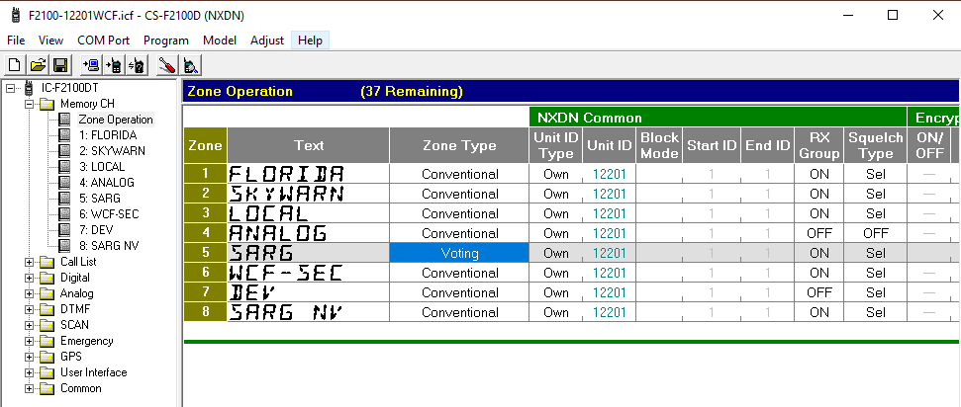
Memory Channel → ZONE Operation To Set ZONE Type

Slide 8
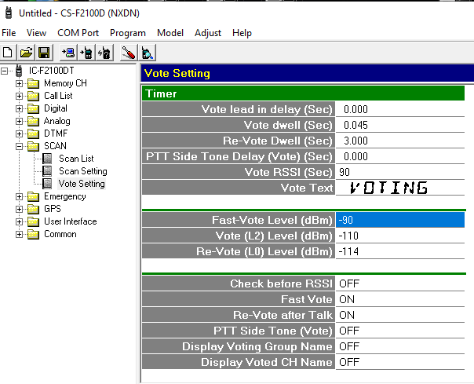
SCAN → Vote Setting
FAST VOTE = -85
VOTE (L2) = -95
Re-VOYE = -100
FAST VOTE ON
Re-VOTE ON

Slide 9
Network Resiliency
Wide Area RF Digital Network
Support NXDN Voice Stream
NXDN Data Messaging
Long Term Non-Grid Power
Support High Speed WinLINK Nodes
VPN for Security

Slide 10
END USER RADIOS

Slide 11
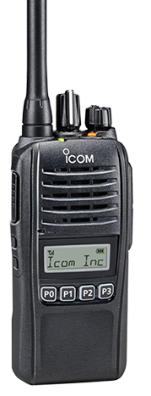
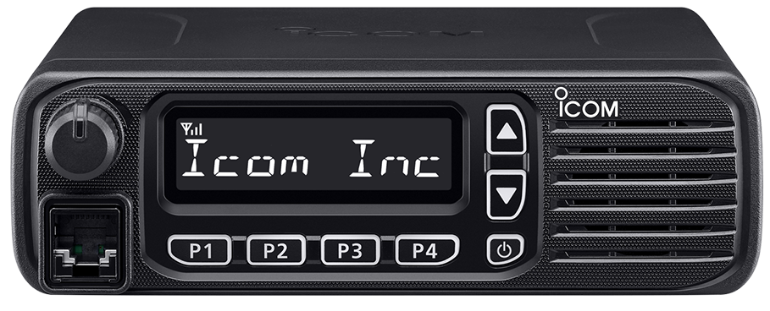
BASIC Models
F2100DS
F6130D / OPC2078
128 Memory CH
8 Zones
8 CH Display
5-2-1 Watts
OTAA
Conventional / Voting
100 Char Messages
Inc. Rapid Charger
128 Memory CH
8 Zones
8 CH Display
45-5-5 Watts
OTAA
Conventional / Voting
100 Char Messages
Inc. Rapid Charger

Slide 12
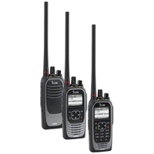
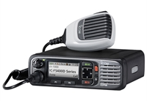
ADVANCED Models
F4400 DS/DT
F6400D
1024 Memory CH
Color LCD Display
GPS Receiver
Bluetooth Audio/Data
USB Micro
Up to 32 GB sdRAM
Custom Announcements
OTAA
100 Char Messaging
5-2-1 Watts
45-25-5 Watts

Slide 13
OTHER NXDN RADIOS
(Conventional Voice Only)
JVC-Kenwood
Alinco (Receiver only)
Anytone (and OEMs)
BTECH (and OEMs)

Slide 14
NXDN Programming & features

Slide 15
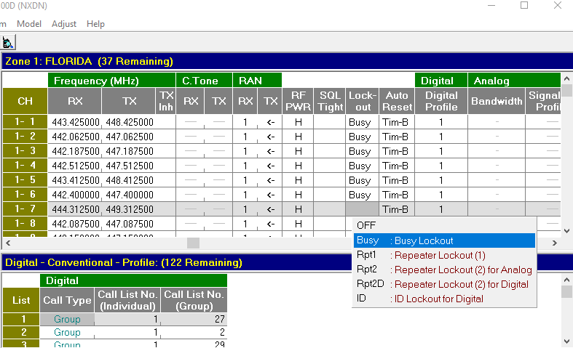
LOCKOUT FIELD
Set to BUSY
Prevents Transmitting When a RF Carrier it Detected
Prevents Doubling with Other Stations
Instills Some Patience

Slide 16
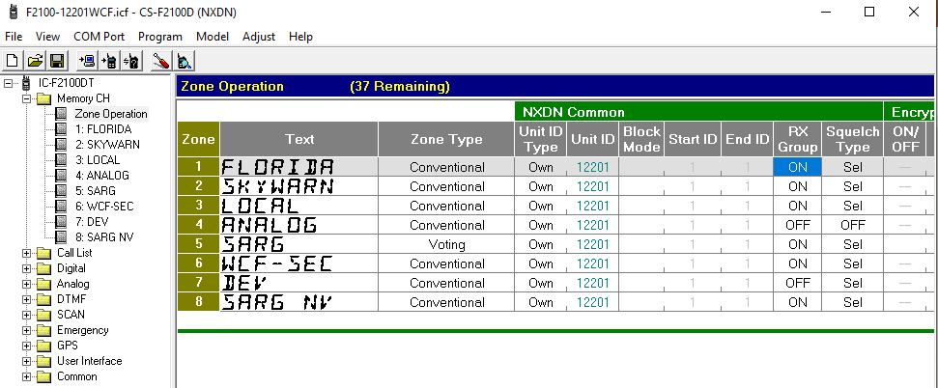
RX Group
Turn ON to enable Talkgroup Scanning when
SQL Type is SEL

Slide 17
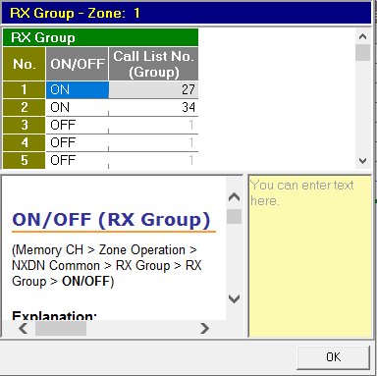
RX Group
Turn ON to enable Talkgroup Scanning when
SQL Type is SEL
Scan up to 8 Talkgroups Simultaneously

Slide 18
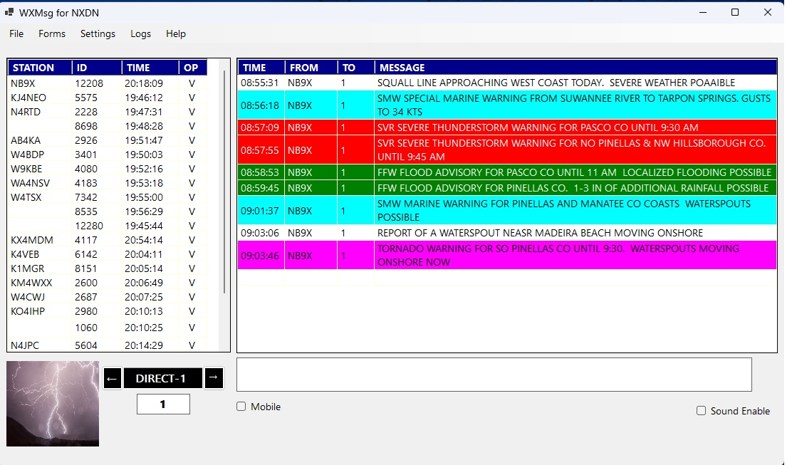
WXMsg2
Real-time Text Messaging
Station List of all Voice and Data Stations Heard
Colorized Weather Warning Messages
Capture GPS Coordinates for Tactical Operations
Weather Data Form
Supports Dynamic TG
NTS Message Form
Data Stored in SQLite DB
Download from NI4CE.org Digital Webpage

Slide 19
TALKGROUP IDs
ALL REPEATERS
SELECTED REPEATERS
1 LOCAL ONLY
1200 FLORIDA
1250 DATA
1299 SKYWARN-Ruskin
14439 GPS POSITS
1201 West Central Florida
1202 North Florida
1203 South Florida
1215 C/CFLARES – Charlotte Co.
1220 Sarasota Co
1231 Sarasota Agri-Resources Group
1232-1235 Special Events
12071 LeeLinc (Lee Co.)

Slide 20
Later Today . . .

Slide 21
Paul Toth-NB9X
West Central Florida Group, Inc.
President
ARRL: WCF Section - ASM-Digital
ptoth@nb9x.us

