Slide 1
Sweeping 2025 ARRL Field Day F-Class (EOC Entries)
Gordon Gibby KX4Z

Slide 2
ARRL Field Day – Enduring Communications Exercise
1933. ARRL Communications Manage F.E. Handy (W1BDI)
“began as a test for amateur radio operators to practice emergency, off-grid communication skills”
LARGEST ANNUAL AMATEUR RADIO EXERCISE IN NORTH AMERICA

Slide 3
F-Category (EOC) Debuts 2003
2003 W6YX 15,610 7F/30 SCV Stanford
2004 W6YX 22,694 8F/35 SCV Stanford
2005 W6YX 21,796 6F/35 SCV Stanford
2007 W6YX 17,148 4F/40 SCV Stanford
2008 W6YX 17,108 4F/40 SCV Stanford
2009 W6YX 17,448 4F/30 SCV Stanford
2010 W6YX 14,260 2F/40 SCV Stanford
2011 N4FR 8556 3F/20 TN
2012 W6YX 18,102 3F/62 SCV Stanford

Slide 4
2033 K2NJ 14,500 3F/21 NNJ
2014 K2NJ 11,330 3F/26 NNJ
2015 W6YX 17,336 5F/38 SCV (Back to STANFORD!!)
2016 W2GSB 11,316 6F/65 NLI
2017 W6YX 17,420 7F/41 SCV (Back to STANFORD)
2018 N4FR 14,290 5F/88 TN
2019 W6YX 9,230 2F/31 SCV (STANFORD AGAIN!!)
2020 W67YX 11,246 2F/6 SCV (STANFORD)

Slide 5
2021 W6YX 19,766 4F32 SCV
2022 W6YX 14,088 4F/26 SCV
2023 KC1CUE 7,199 2F/20 RI
2024 AB5EF 11,792 2F/32 AR
2025 NF4AC 9,093 4f/34 NFL ALACHUA COUNTY FINALLY!!!
FIRST FLORIDA TEAM TO EVER SWEEP THE F CATEGORY

Slide 6
What does FIELD DAY test? Worth it?
Tests your SETTING – have you optimized communications ability?
Tests your EQUIPMENT – able to operate simultaneously on multiple radios?
Tests your PERSEVERANCE – able to go for 24 hours or more?
Tests your SKILLS – your people able to actually make contacts by any and all methods?
Tests your ANTENNAS – able to use all bands / times effectively?
Tests your ORGANIZATION – able to plan and make it all work?
Tests your TEAMWORK – can you persuade people to do their best?

Slide 7
BONUS POINTS – designed to grow your group!
100% Emergency Power (EOC Waiver)
Media Publicity
Public Location
Public Information Table
Message to SM
Message Handling
Satellite QSO
Alternate Power (“Solar”)
W1AW Bulletin
Educational Activity
Elected Government Officer Visitor
Representative of Agency

Slide 8
Scoffers
Many downplay the worth of moving AHEAD in all these areas.
Perhaps they just aren’t willing to do the work?
Easy to CLAIM you could be up at the top…..
Much harder to GET THERE!

Slide 9
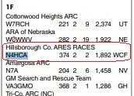
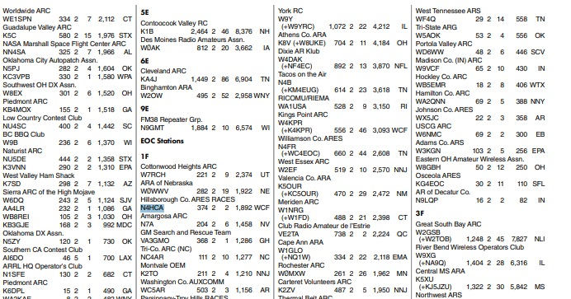
Hooray! Hillsborough County ARES – #3 in nation 1F
ARRL provides complete listings on their web page

Slide 10
ARRL Field Day / Alachua County ARES
2020 – our first participation
(Made “waves” in our county for breaking away)
Grew year over year
Huge technological hurdles
Huge personnel hurdles, too!
Huge gains in RADIO ASSETS
Huge gains in PERSONNEL CAPABILITIES

Slide 11
How to propel YOUR GROUP into #1!
Maximize your SETTING
Maximize your EQUIPMENT
Train for PERSEVERANCE
Develop your group’s SKILLS
Improve your ANTENNAS
Study ORGANIZATION
Develop TEAMWORK
YOU CAN MAKE YOUR GROUP FAR, FAR STRONGER!!

Slide 12
1) Maximize your SETTING Alachua County pitiful original SETTING
One VHF/UHF antenna mounted to a FENCE
Without a repeater, we had zilch coverage
A dual-transformer “matched” Vertical sitting on same fence for HF (famous loss leader)
A Yaesu System 600 commercial radio
300 feet of coaxial cable to get to anything
ENORMOUS NOISE ON ANY BAND BELOW 15 METERS

Slide 13
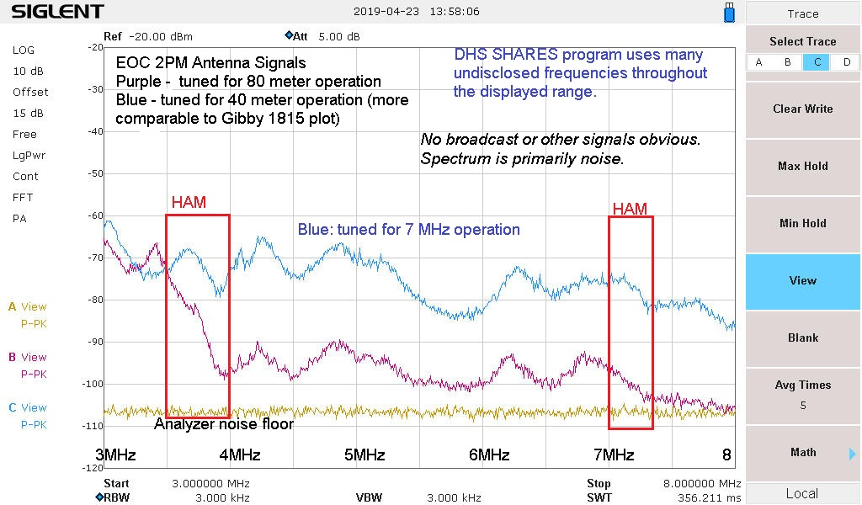
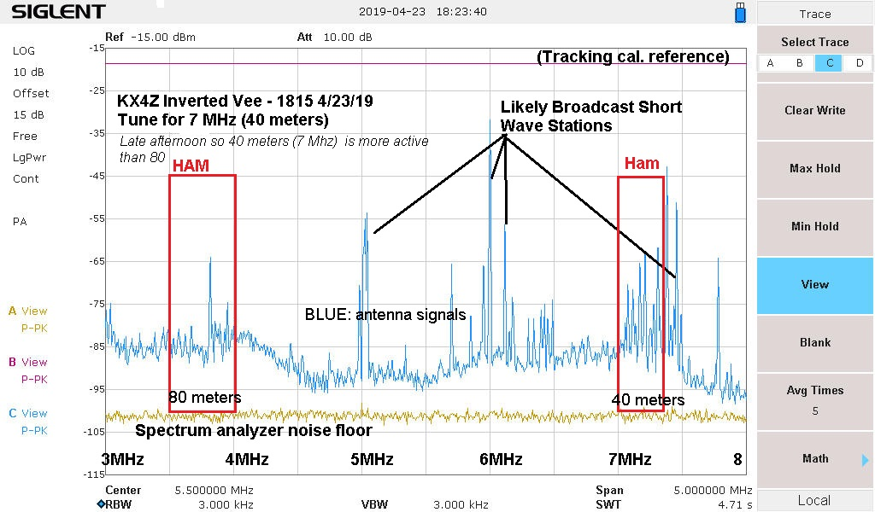
Astounding NOISE on HF
Incredibly MORE NOISE on EOC antennas than in semi-rural setting.
Virtually NO SIGNALS visible above NOISE on any Band.
Almost impossible to make contacts on HF.

Slide 14
Special EOC Impediments to Emergency Radio Communications
Protected / Limited CABLE PENETRATIONS
Severely limited ANTENNA placement possibilities.
Aesthetics over FUNCTION (Vertical least-space antennas when NVIS needed….
COMPUTER DATA CENTERS
MULTI-MULTI KILOWATT Switching Backup Power Systems
Enormous HVAC Systems

Slide 15
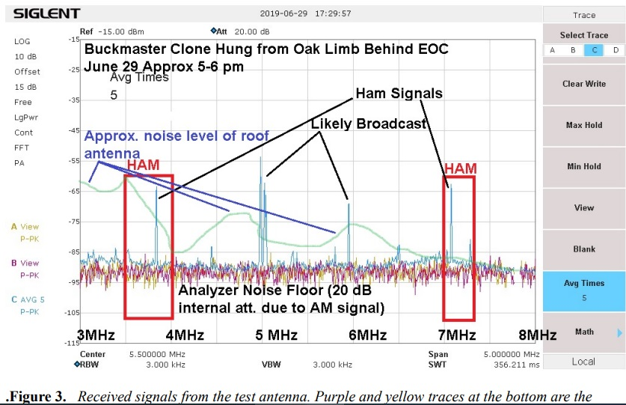
June 2019 DISCOVERY: EOC Noise NEAR FIELD
As soon as we hoisted an antenna on the other side of the EOC parking lot and connected a radio, it was OBVIOUSLY far far better with SIGNALS HEARD!!
Even with 20dB attenuator required due to Spectrum Analyzer overloading from neighborhood 10kW broadcast transmitter, it was OBVIOUS that we had SIGNALS

Slide 16
Maximize setting solution: BUILD ANTENNA IN ADJACENT WOODS!!
270 foot OCFD 160m and up antenna
135 foot EFHW 80m and up antenna
POWER GENERATION
Bought and refurbished DIESEL governor-controlled 5kW generator used on USS Cole
MIF23 Filters – 3 total owned – can dramatically clean up RFI

Slide 17
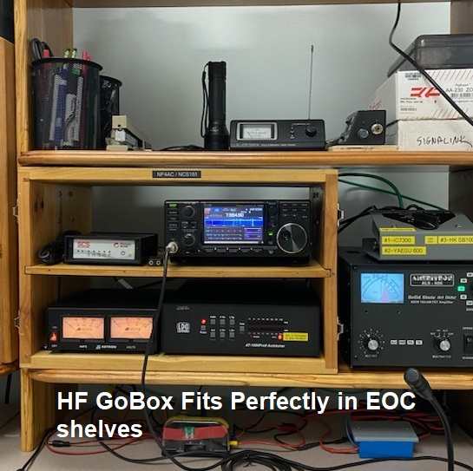
2) Maximize your EQUIPMENT Alachua County pitiful original EQUIPMENT
Sheriff Dept got us ICOM 7300
We built it into a GO BOX
Volunteers added EMP-proof Heathkit Gear (Ancient!)
Only ONE ANTENNA for HF – how to run multiple stations???
Initial solution: TRAVEL TRAILER & GENERATOR for additional station
Generator = RF NOISE!!

Slide 18
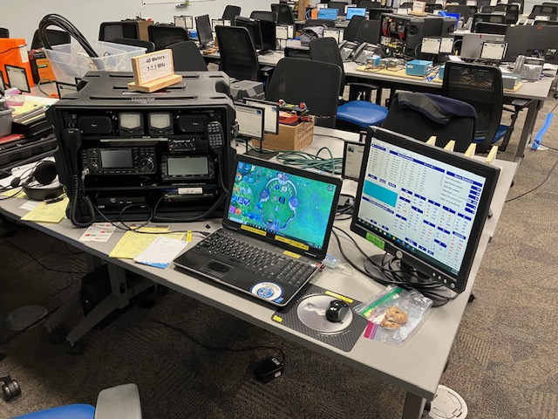
Maximize ERGONOMICS!!!

Slide 19
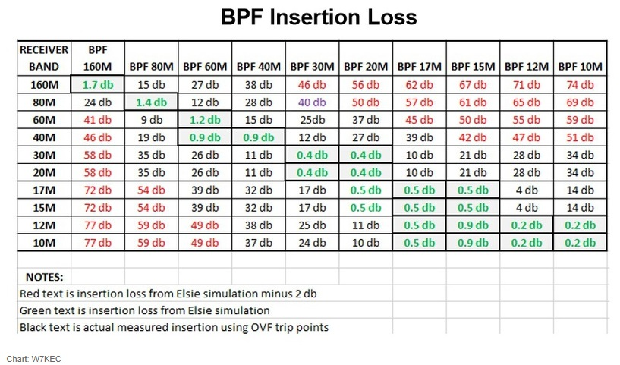
ICOM 7300 Limited BPF capabilities: QRM

Slide 20
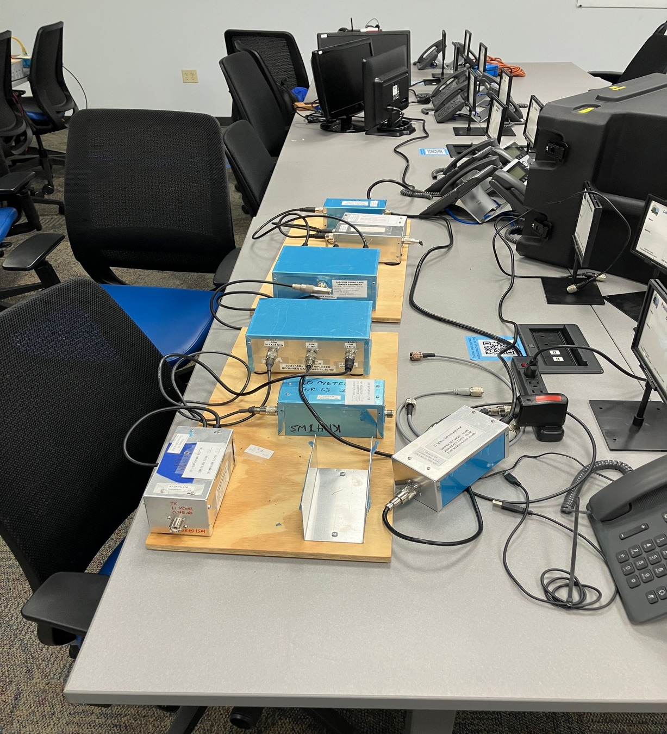
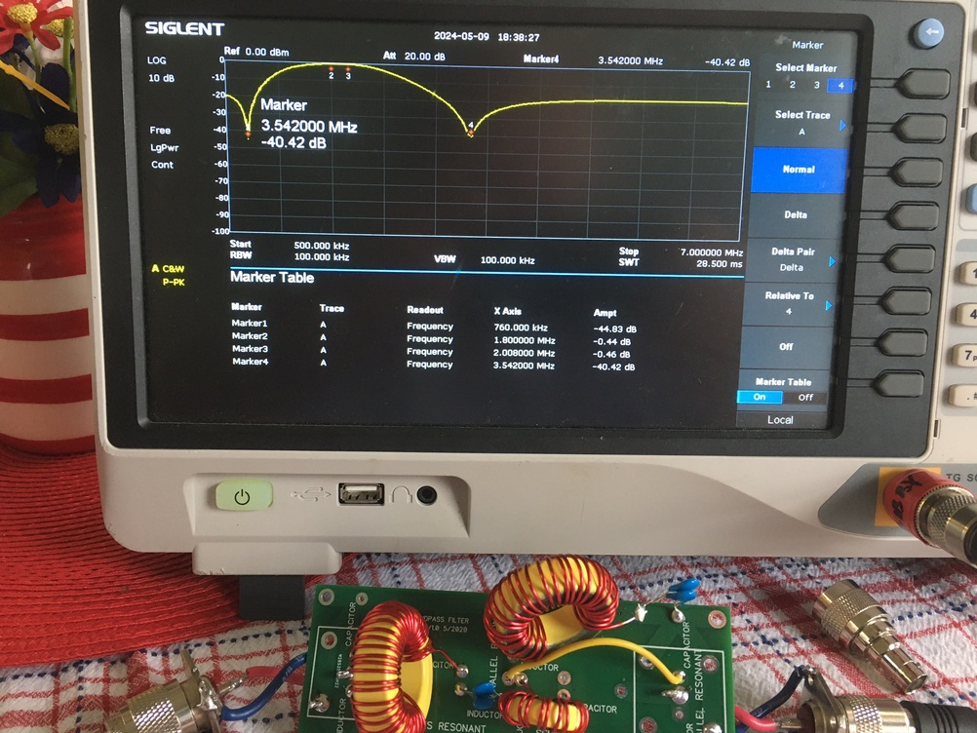
Hardware Solutions for Multi-Transmitter Entry
Using VA6AM KITS we built 3-band Antenna Multiplexer
Multiple BandPass Filters
Initial efforts (Butterworth) poor
Final efforts approx 70dB
Improved and improved over the years
Developed our own five and 6-band systems
Able to put multiple transmitters on ONE antenna
Stuck with multiband reasonable match antennas to make this work.
LOW LOSS ANTENNAS AT EVERY OPTION

Slide 21
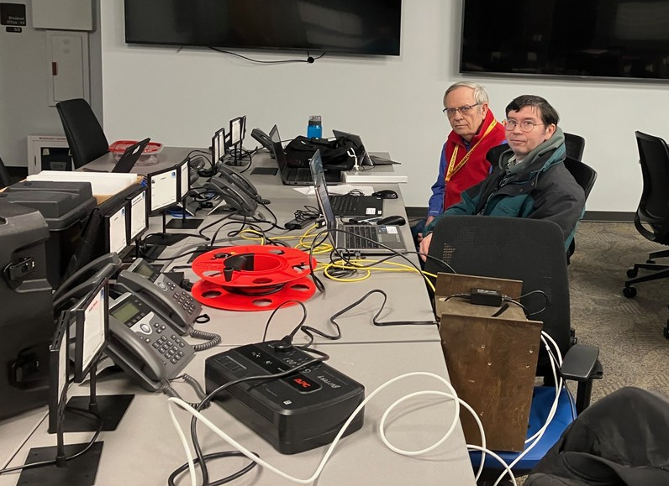
MESH NETWORK AND GPS TIMING

Slide 22
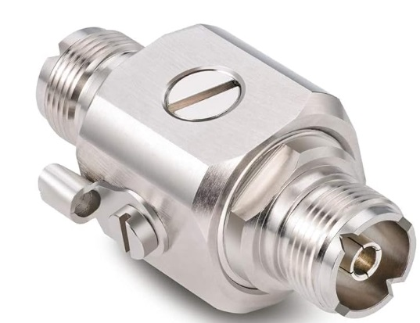
SAFETY!
No Public Hazard – keep all ends of antennas above head height; avoid TRIP hazards to public
Calculate Radiation Hazard Limits
(almost never cause any problem)
LIGHTNING PROTECTION
All products depend on Gas Discharge Tubes (GDT) (($3 ea))
Various commercial products $ - $$$$ / or make your own
https://www.amazon.com/dp/B08J81CJNF $18, uses replaceable GDT
Adequate Ground Rod Required!!

Slide 23
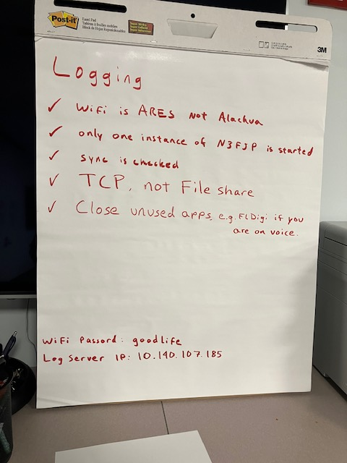

Slide 24
3) Train for PERSEVERANCE
Multiple highly committed volunteers
Attitude of WINNERS
Used to serving on floors of Shelters
Routinely run completely right through the night during Field Day

Slide 25
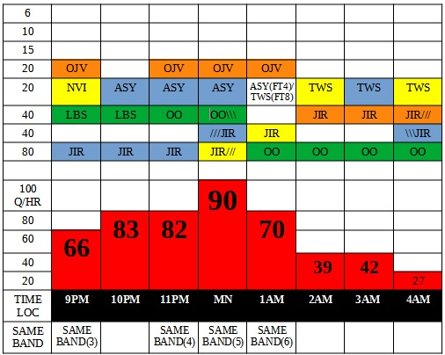
Partial 2023 FD Hour analysis – NO SLEEP!!

Slide 26
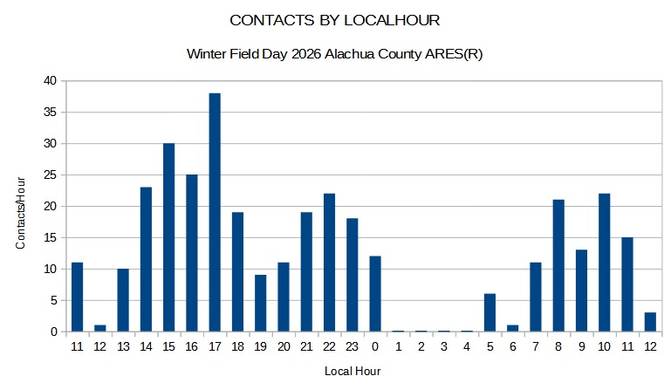
Get sleep in WINTER FIELD DAY

Slide 27
4) Develop GROUP SKILLS
Huge effort to teach DIGITAL TECHNIQUES – Winlink, FT8, PSK
Huge effort to build hardware interfaces, teach operation
Learn how to auto or semi-auto populate the N3FJP database from FT8 or PSK31 (Winter Field Day)
Developed competitive CW operators
DIGITAL AND CW GET TWICE AS MANY POINTS PER CONTACT
MOST high performance groups depend on solid CW performance
Weakest remaining area is probably VOICE – due to 300 feet of coax??Lea

Slide 28
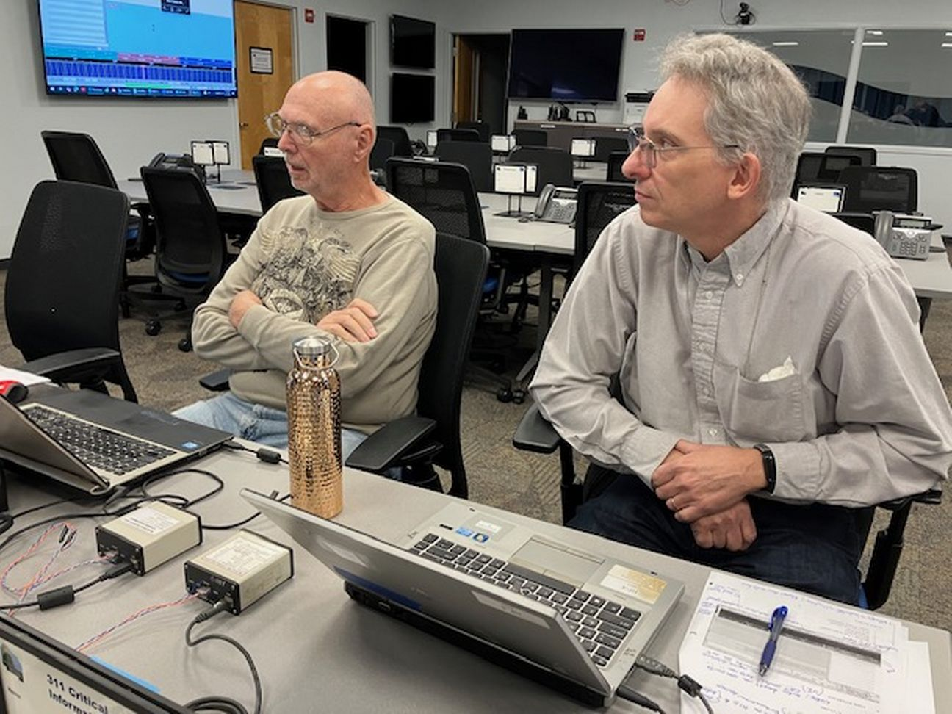
DIGITAL TRAINING
Even with FT8: learning curve!
Spot contacts (hunt & pounce) or RUN
Setup so duplicates already marked
Train users how to stay in “open” spots, keep signal LINEAR, keep power where it should be
Difficult for newbies, but 2X rewarding

Slide 29
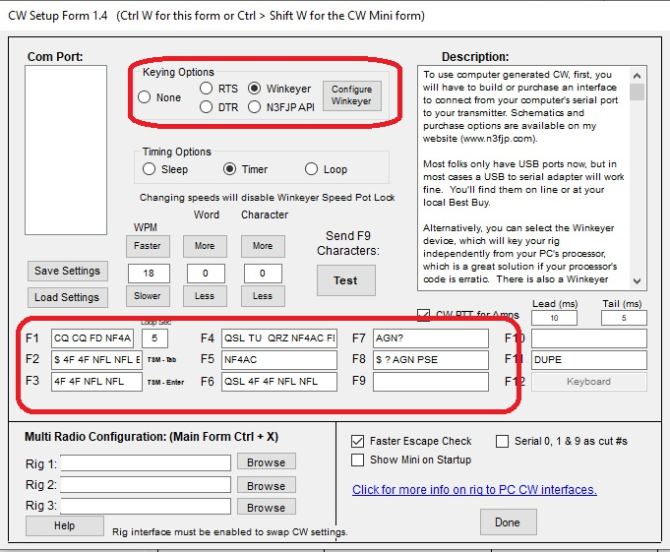
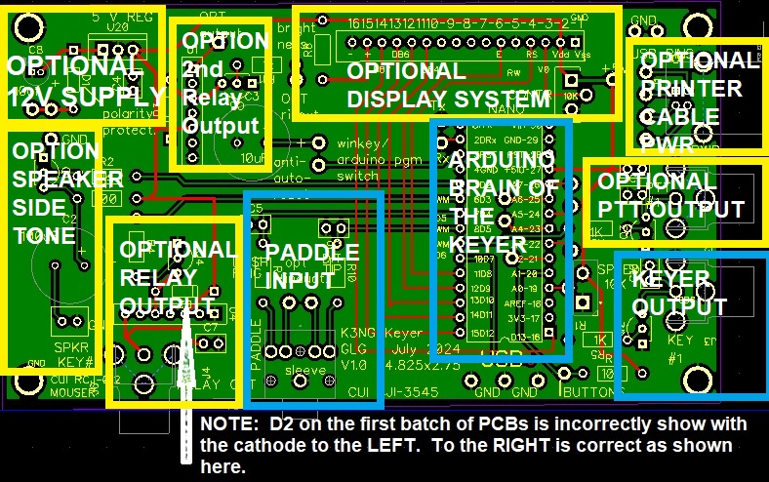
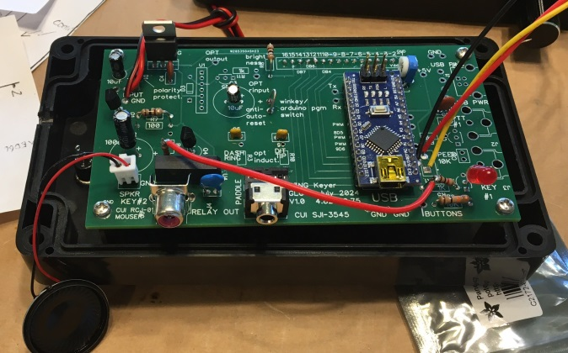
CW OPERATIONS – canned text
Greatly improve accuracy, reduce fatigue and improve scoring by using WINKEYER in conjunction with N3FJP/logging program to send CANNED TEXT interactively with contact info

Slide 30
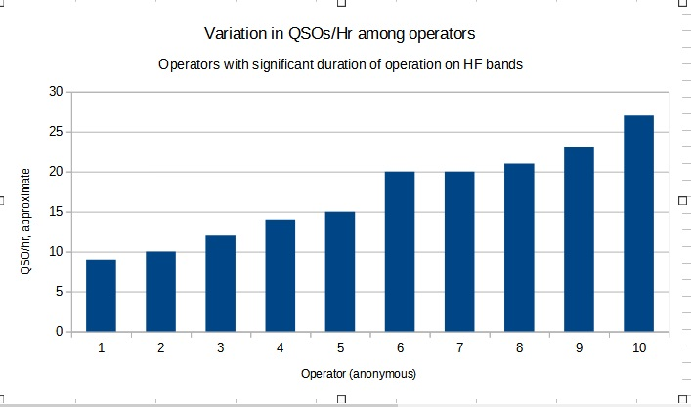
2023 Operator Comparison

Slide 31
5) Improve your ANTENNAS
Use the RIGHT ANTENNA for the necessary distance
Vertical ONLY for west coast
Horizontal for NVIS and mid-American contacts
Use LOWEST LOSS ANTENNAS possible!
Non-resonant transformer antennas documented quite high losses
EFHW losses 1.5 dB or so on 10m
Guanella OCFD fraction of dB losses
Multi-Band BEAMS
Develop Multi-band antennas to allow for simultaneous operations with less WORK to set up and tear down. (ANTENNA MULTIPLEXER)
DECREASE INTERACTIONS to allow simulateous CW/Voice on same band

Slide 32
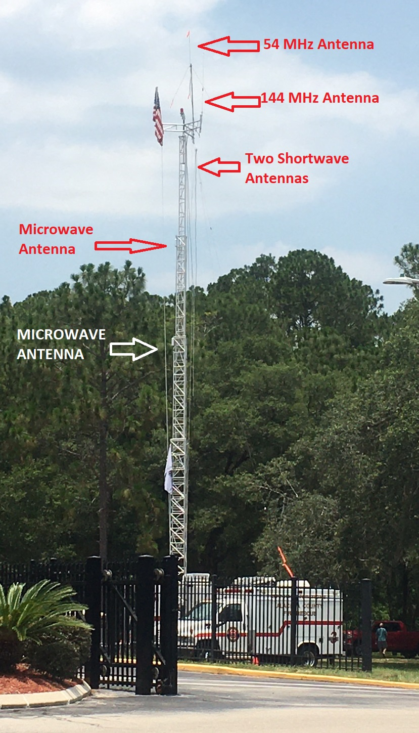
MARC Unit Help
Placed microwave unit up on tower with HF Antennas
Microwave unit completely scrambled by HF power!
Multiple MARC units available statewide and will assist with Field Day efforts!

Slide 33
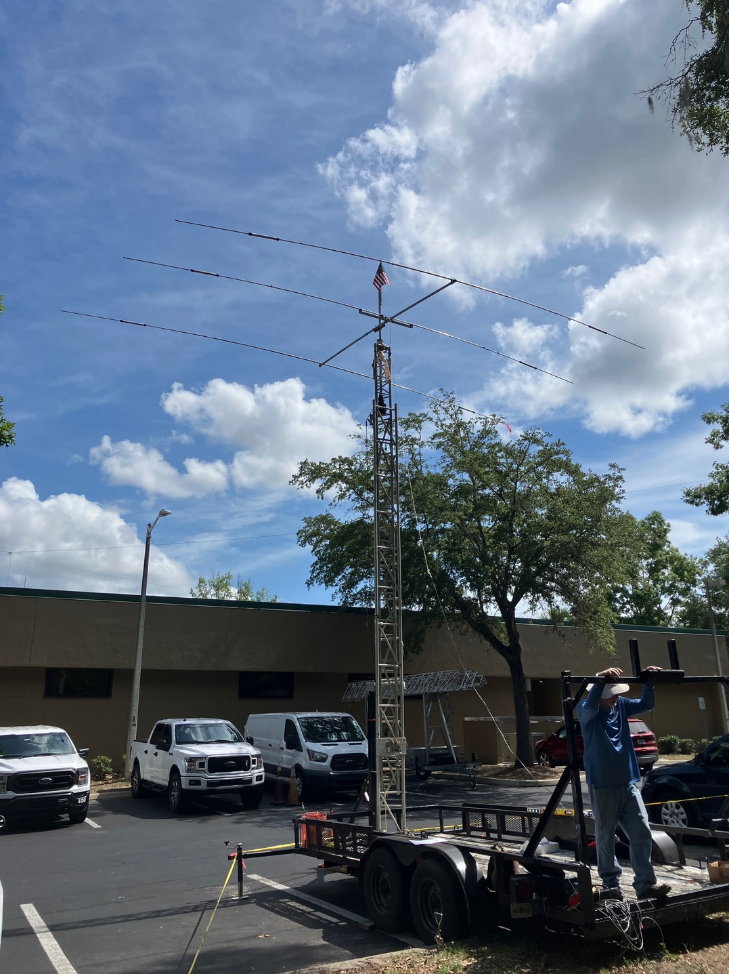
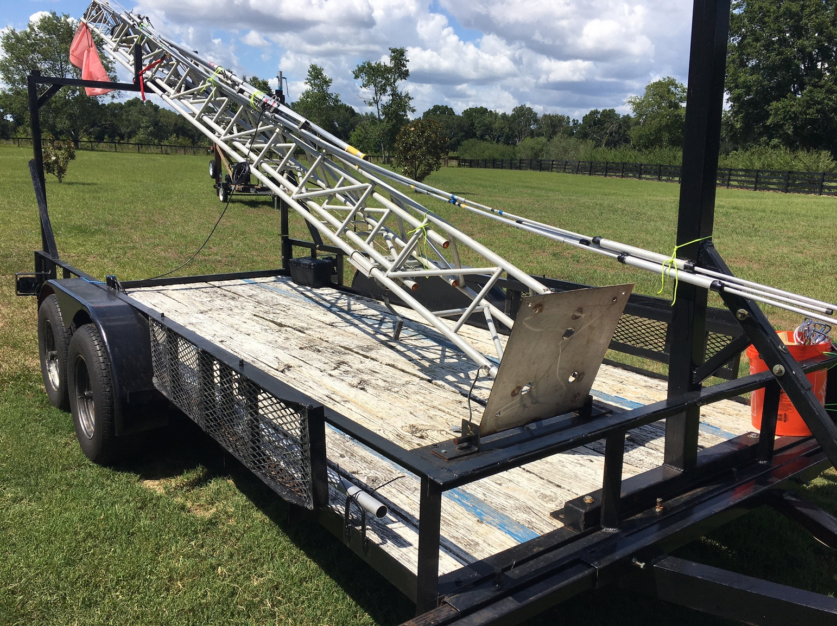
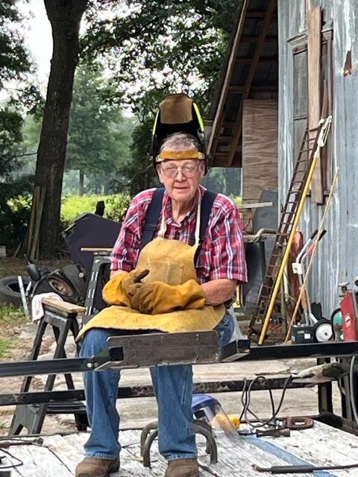
2025 Beam Effort…...
Had to learn how to refurbish/rebuild Mosely Beam….

Slide 34
Absolutely must reduce Antenna Interactions!
Tremendous wisdom on reducing interactions is readily available!
https://ka2c.com/wp-content/uploads/2023/02/Antennas-for-Field-Day-with-good-Performance-and-Isolation-Hamcation-2023.pdf
https://ka2c.com/wp-content/uploads/2022/04/Field-Day-Interference-Management-NCJ-2022-05-Sollenberger-Struharik.pdf
BASICALLY: get antennas > 300 feet apart to be able to operate on ends of same band simultaneously
High Q filters can improve (but WORK to build!!, been there, done that)
You will learn a LOT from working to get the best antennas possible…..

Slide 35
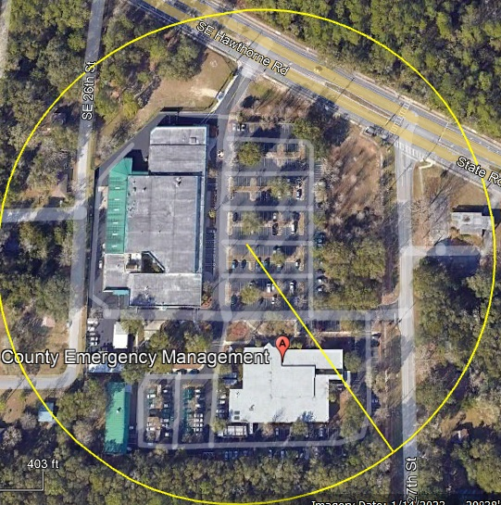
Old EOC Circle – See where to put 4th station?

Slide 36
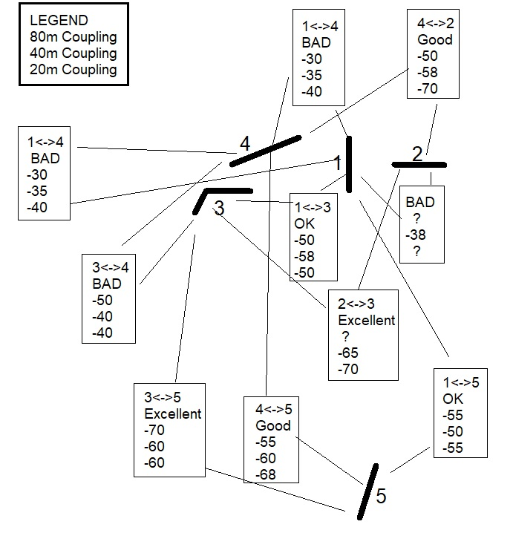
2023 Antenna Interaction Map Data Antenna 2<<-→>3 works (end-to-end and distant) Antenna 5 is golden because it is SO FAR AWAY
Interactions can be objectively measured with VNA or Spectrum Analyzer and a lot of coax!

Slide 37
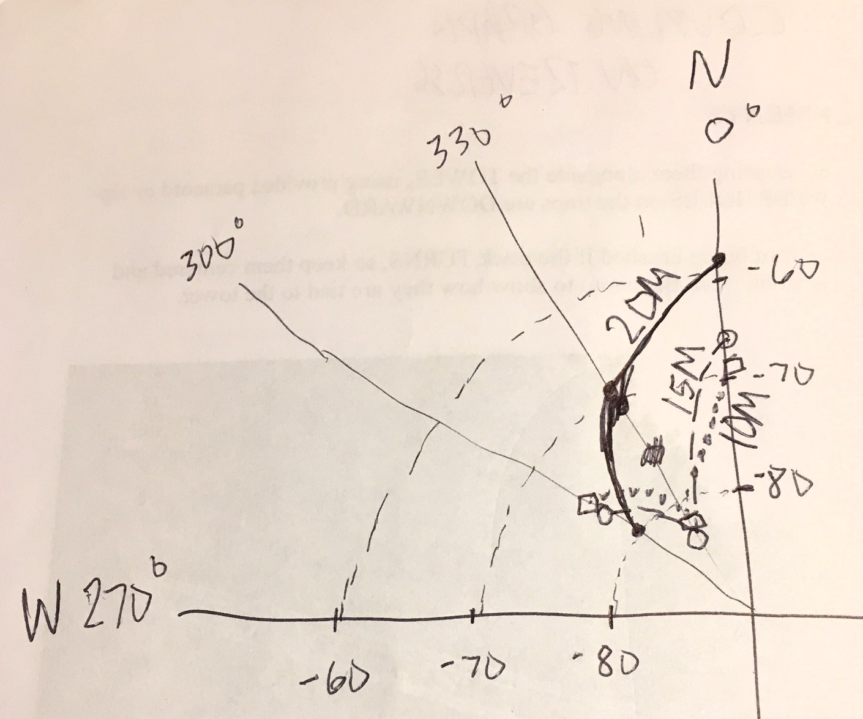
2025: Yagi to Cabin Coupling

Slide 38
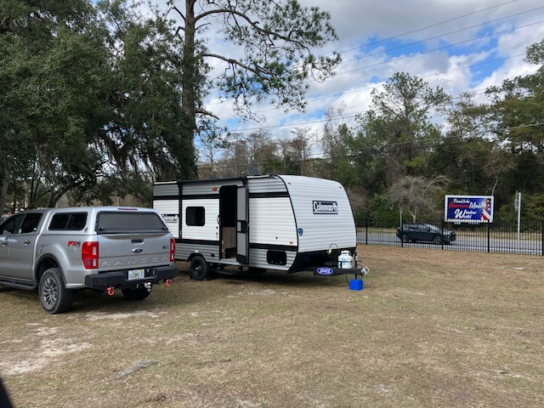
Develop remote capabilities

Slide 39
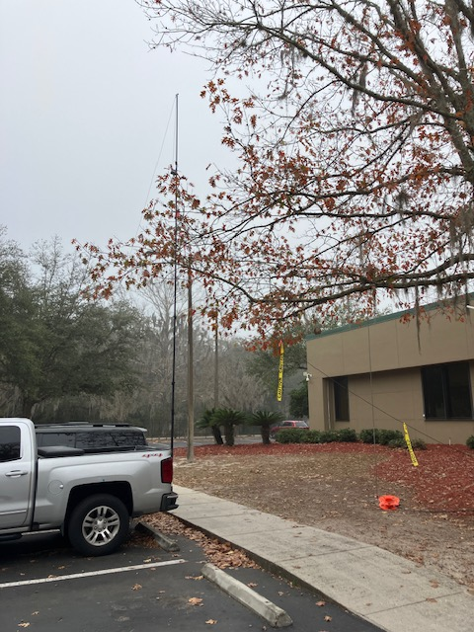
Amazing backup antenna
Guanella 4:1 OCFD antenna as inverted Vee Multiband antenna
Extremely low loss
Goes up very quickly
Also useable VERTICAL

Slide 40
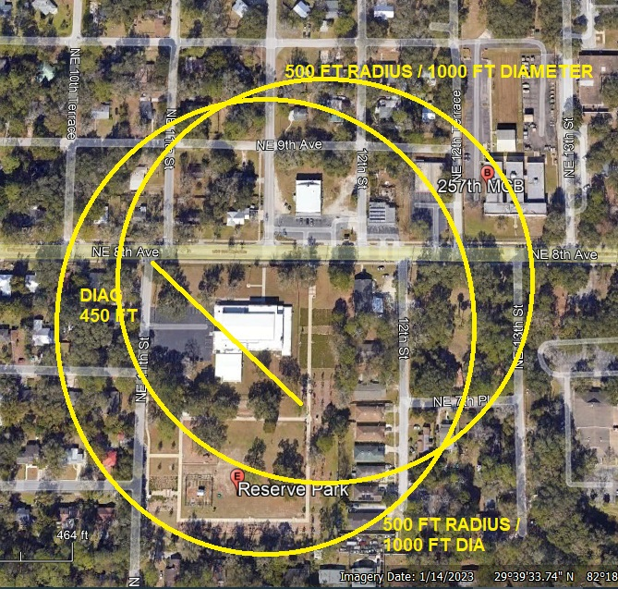
Challenges to come: New EOC Circles - more constrained area...

Slide 41
6) Study ORGANIZATION
We begin planning months in advance
We use the ICS system “somewhat” – as much as possible.
We plan out EVERYTHING and produce an INCIDENT ACTION PLAN
HOTWASH quickly afterward
Full AARIP to improve year over year.

Slide 42
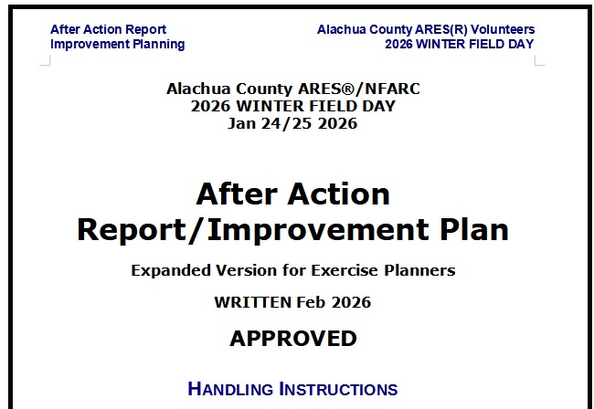
Improvement Plans in AARIP
WFD: Upper 6% despite „issues“
Improvement Items Proposed
Much better pre-event testing antennas/stations
Change RG58 to better coax on stations / avoid bending
Rebuild EOC Stn1 DC power (simplify)
Involve more people in planning
Setup over two days, 8-10 hours available
Test THOROUGHLY before event
Revive IC position / volunteers
Roughly follow the Homeland Security Exercise Evaluation Protocol (HSEEP)

Slide 43
(Improvement Plan, continued)
Better plan food & positions
Get everyone on same page before event
Plan in advance for „“extra“ stn – more flexibility
Expect smaller campus next time! (?more interference??)I
Sheets with band plans and canned text at each operating position
Consider successful inverted Vee for 2027 WFD as one of antennas
Also the $49 Amazon Vertical
Additional training session in advance – more HF training

Slide 44
(Improvement Plan, concluded)
Phone call invites get more to participate
Work for Satellite Station
PSK CQ longer to allow for easier answers
More availability of helper IC’s
More use of White Board
Continue 911 goodies
More participation by lesser engaged volunteers

Slide 45
7) DEVELOP TEAMWORK 2025 Field Day Participation (overall)
1. David Huckstep W4JIR
3. Leland Gallup AA3YB
4. Gordon Gibby KX4Z
5. Dan D'Andrea KF4OVJ
6. Jeff Capehart W4UFL
7. Mike Hasselbeck WB2FKO
8. Earl McDow K4ZSW
9. Mark McDow KN4POZ
10. Susan Halbert KG4VWI
12. Rosemary Jones KI4QBZ
13. Manish Sahni KQ4KTE
14. Brian Joy
15. Earl Sloan KI4OXD
16. Hugh Minnich KN4IIM

Slide 46
Results: Individuals get better and better and better!
My own performance dramatically improved; we learned CW can outpace FT8
One year I made > 370 contacts all by myself!
Our teams learned FT4!

Slide 47
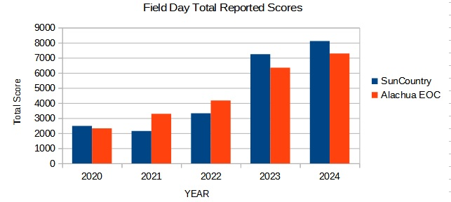
You Can Do It Too! Sun Country Great Results

Slide 48
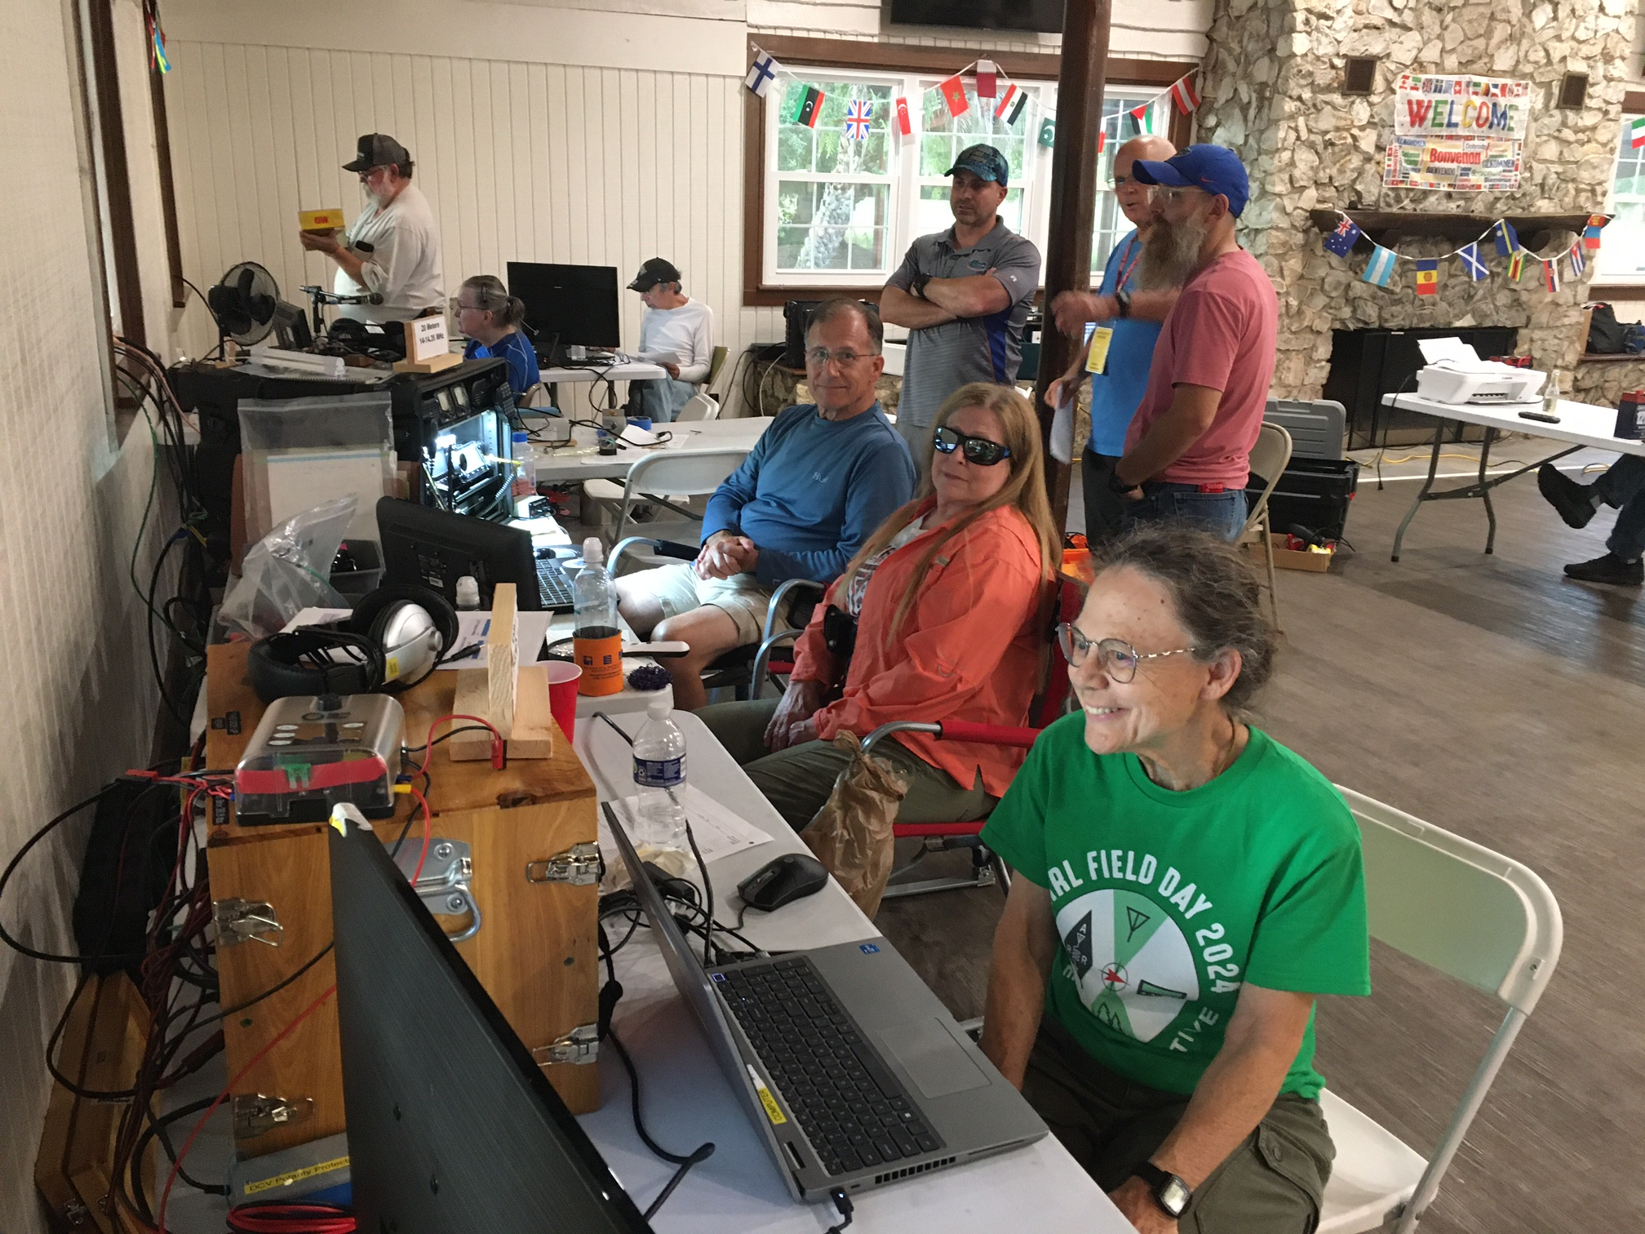
Making it FUN!!

Slide 49
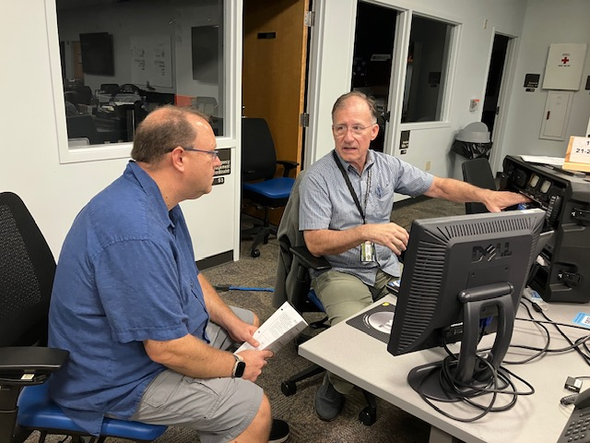
Bringing in new participants / training

Slide 50
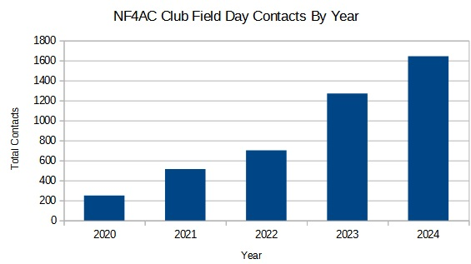
Objective Growth!

Slide 51
Questions, Comments?

