Slide 1
Poor-Man’s SATELLITE STATION
The story of trying to develop an inexpensive ground station to use amateur radio satellites
Gordon Gibby KX4Z

Slide 2

Categories
FM Satellites – powerful, “easy” but terribly over crowded
Linear Satellites – appear weaker, but much more bandwidth
Lots of PROBLEMS compared to normal ham QSO...

Slide 3

Many Hurdles
POINTING
Satellite is MOVING TARGET (orbits also change…)
Getting rotator to work
Controlling rotator
FREQUENCY
Constantly changing Uplink Doppler Shift
Constantly changing Downlink Doppler Shift
“Finding Yourself” (Offsets & Full Duplex)
TRANSMIT POWER (antenna)
RECEIVER PERFORMANCE (antenna/preamp)

Slide 4

Initial Question: Transverter?
No VHF/UHF linear transceiver @ start
5-10 W transverters available (Ukraine)
Sbitx transceiver / 7300
Seemed like too little power….

Slide 5
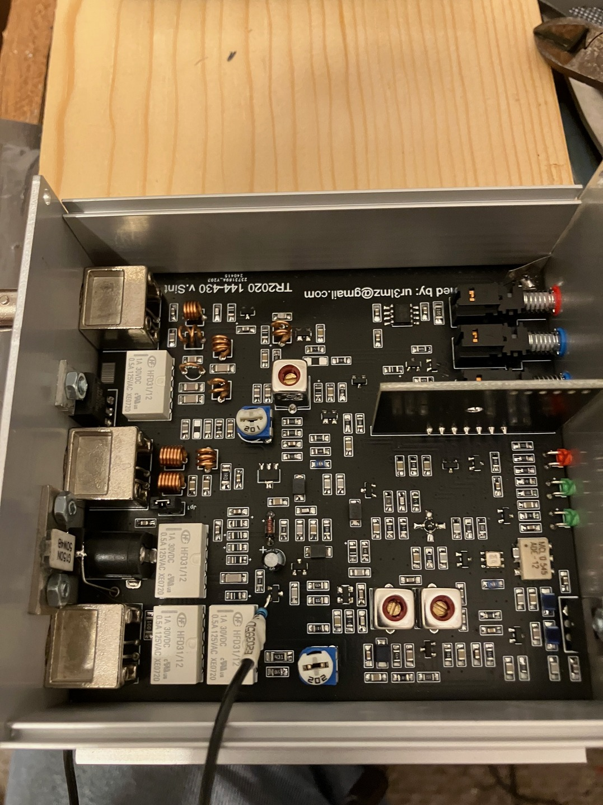
Transverter
Various models have input attenuators (or none) so attention has to be given to avoiding destroying the input with a transmitter.
Often they have “auto PTT” – but you may need much more precise result, so adding an external connection may be required.

Slide 6
1. POINTING: a) Rotator Controllers
Previously a separate hardware item that received commands from trig-based software and drove the rotator to point
CSN S.A.T. combines software and controller to drive Yaesu rotators
Now can be done much less expensively in software/micro controllers also
https://www.nf4rc.club/how-to-docs/satellite-system-part-i-overview/

Slide 7
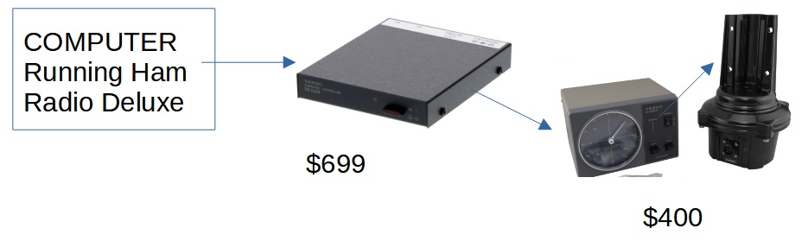
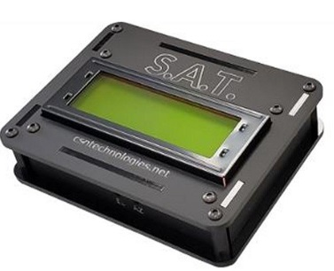
Traditional ($$$$) Rotator Control
CSN solution drives
Rotator directly

Slide 8
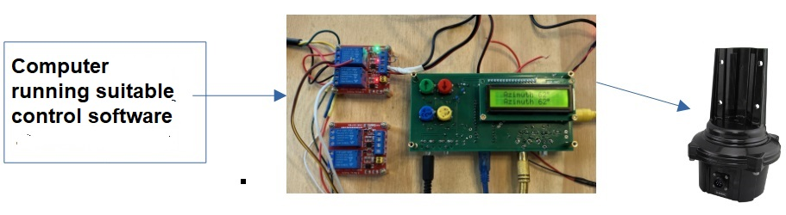
K3NG (pennies) Rotator Controller

Slide 9
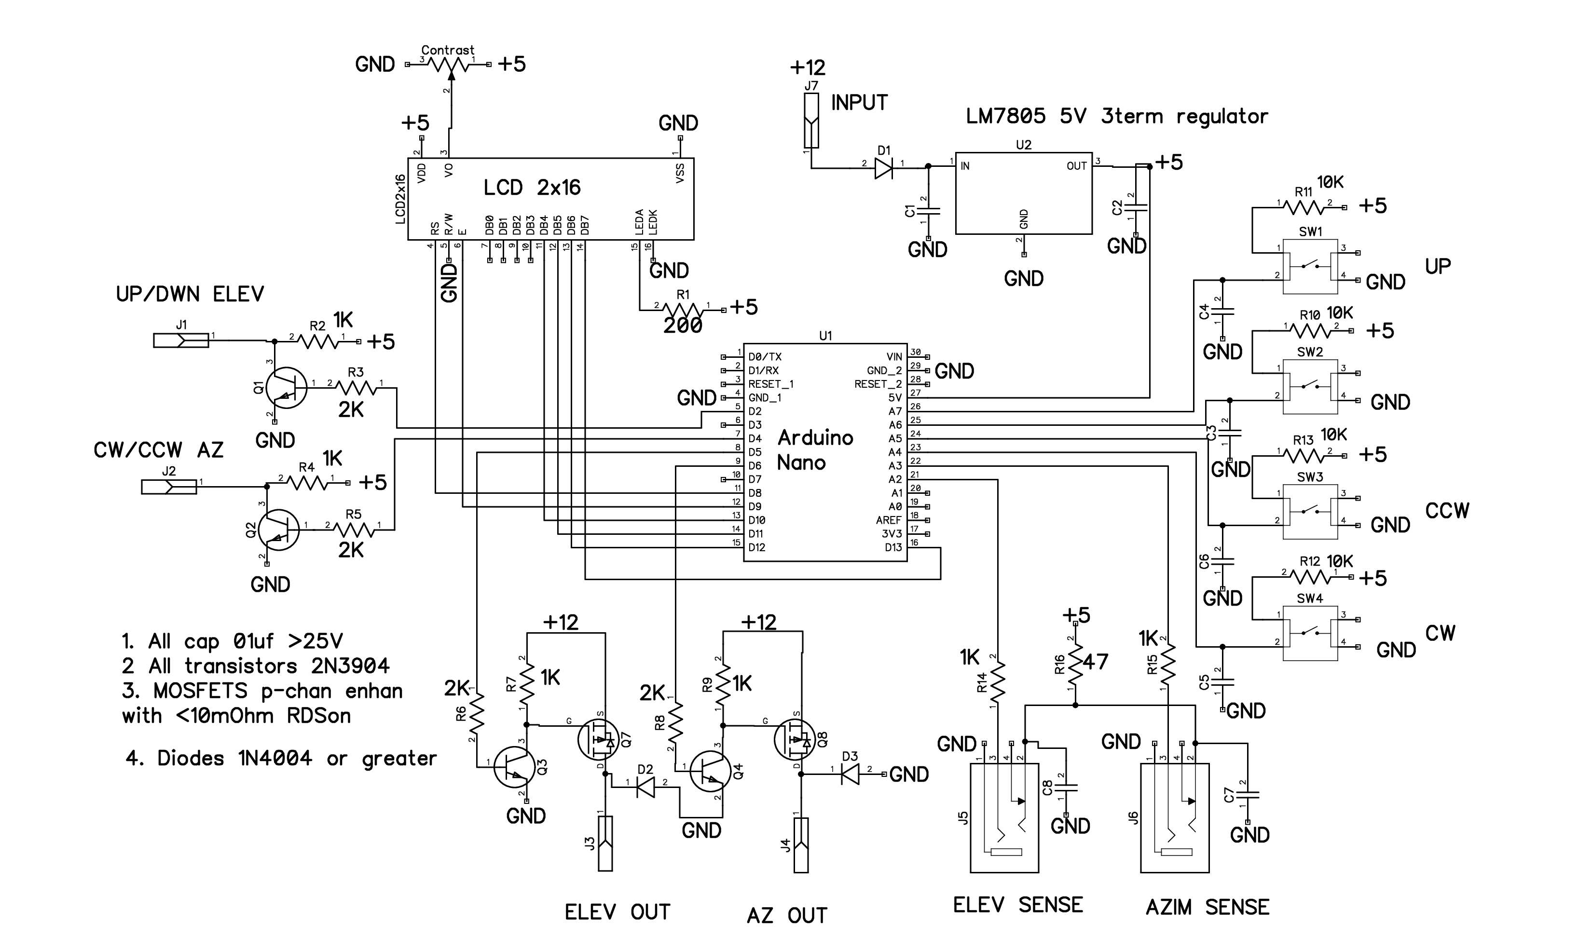
My K3NG-based Nano Controller

Slide 10
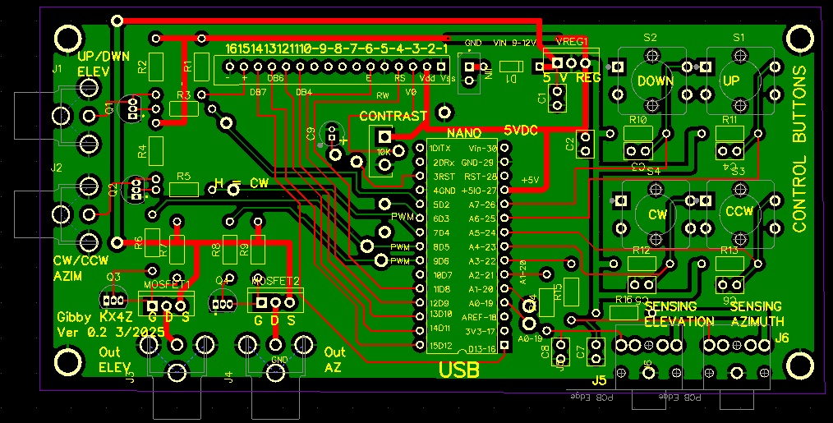

Gerbers for PCB
Control via USB port (Yaesu language) or manual
Analog potentiometer angle sense inputs
DC output controls for Yaesu DC motor rotators
LCD monitor output reads position
Shared Project on PCBWAY
https://www.pcbway.com/project/shareproject/K3NG_Rotator_Dual_Axis_Controller_Board_fd759cc2.html
https://www.nf4rc.club/how-to-docs/satellite-system-part-ii-rotator-control-board/

Slide 11
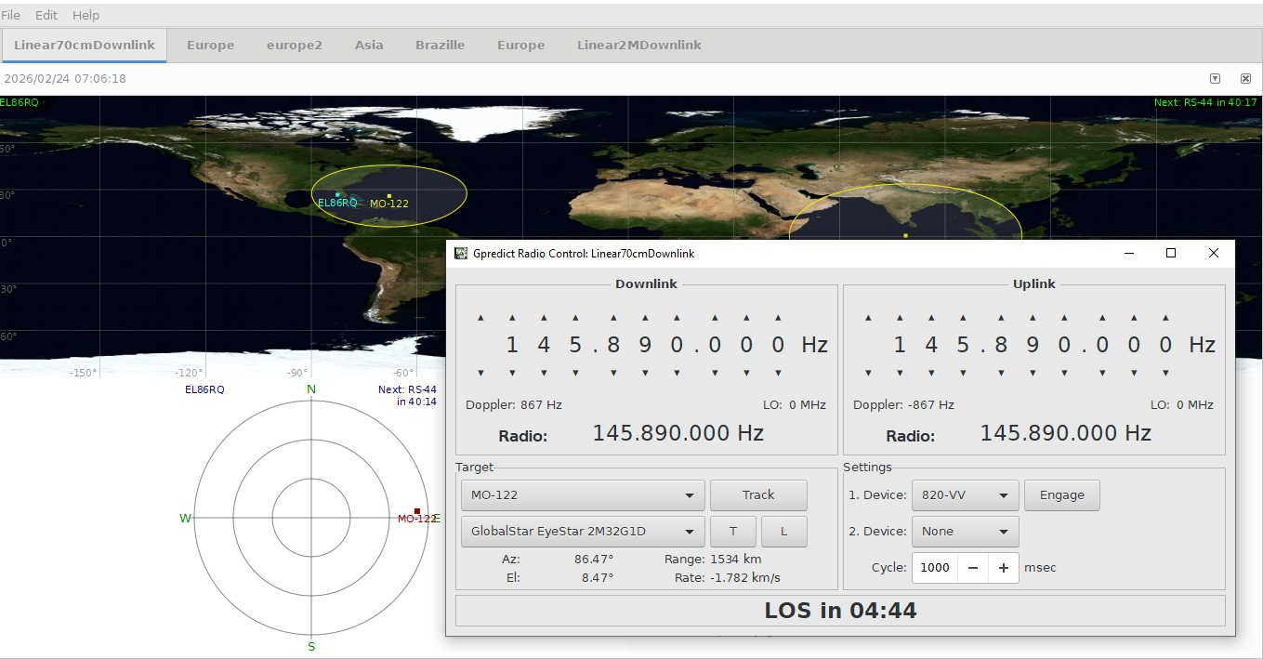
POINTING: b) Control Software: Gpredict
Nice display
TLE updates
Controls rotator via HAMLIB
Controls simple radio(s) via HAMLIB
FREE
HAMLIB: rigctld to control rig
HAMLIB rotctld to control rotator (can speak YAESU)
I got it working with the rotator,
But I could NEVER get it to properly control the ICOM 820H to link uplink and downlink with changes

Slide 12
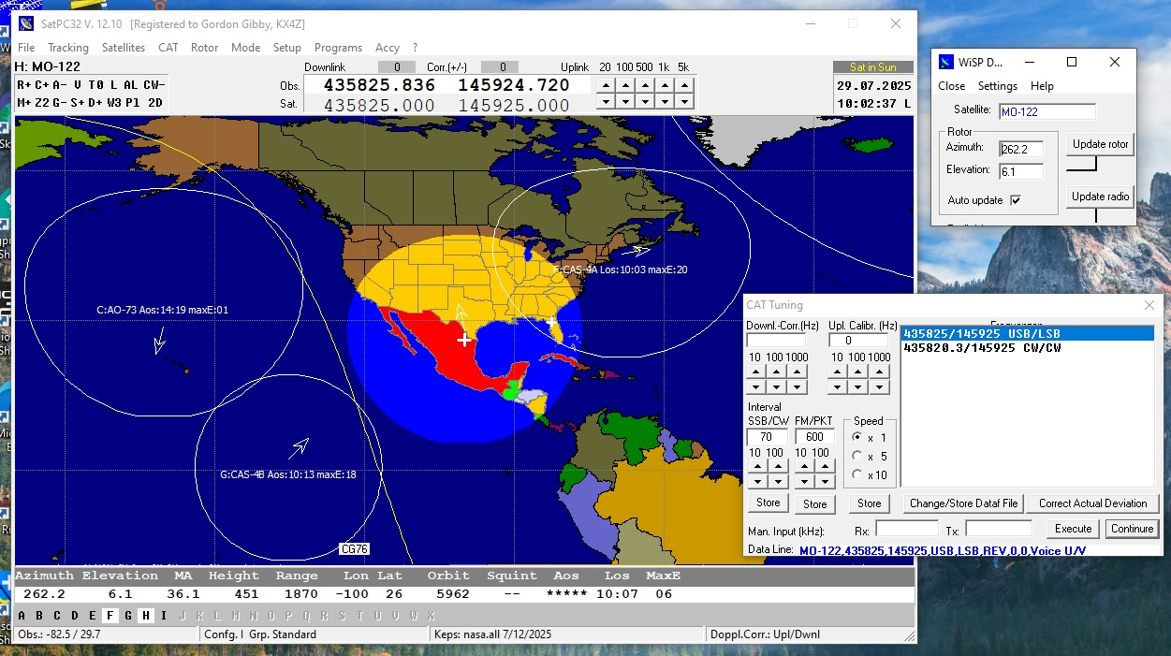

Software: SATPC32
Properly controls ICOM transceiver (CI-V)
DDE output to control rotators
3rd party WiSP reads DDE and controls Yaesu-type rotators

Slide 13
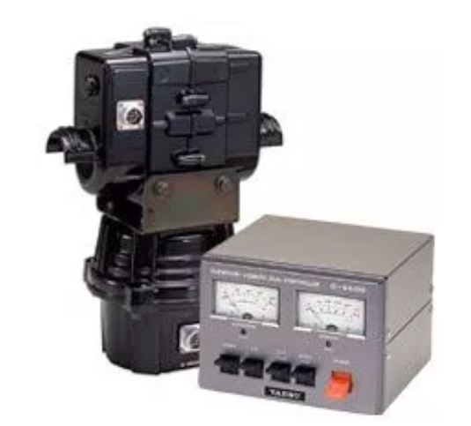

POINTING: c) Hardware: Yaesu Dual Axis Rotator
$$$700+
Basically G450 azimuthal rotator
Combined with elevation rotator

Slide 14
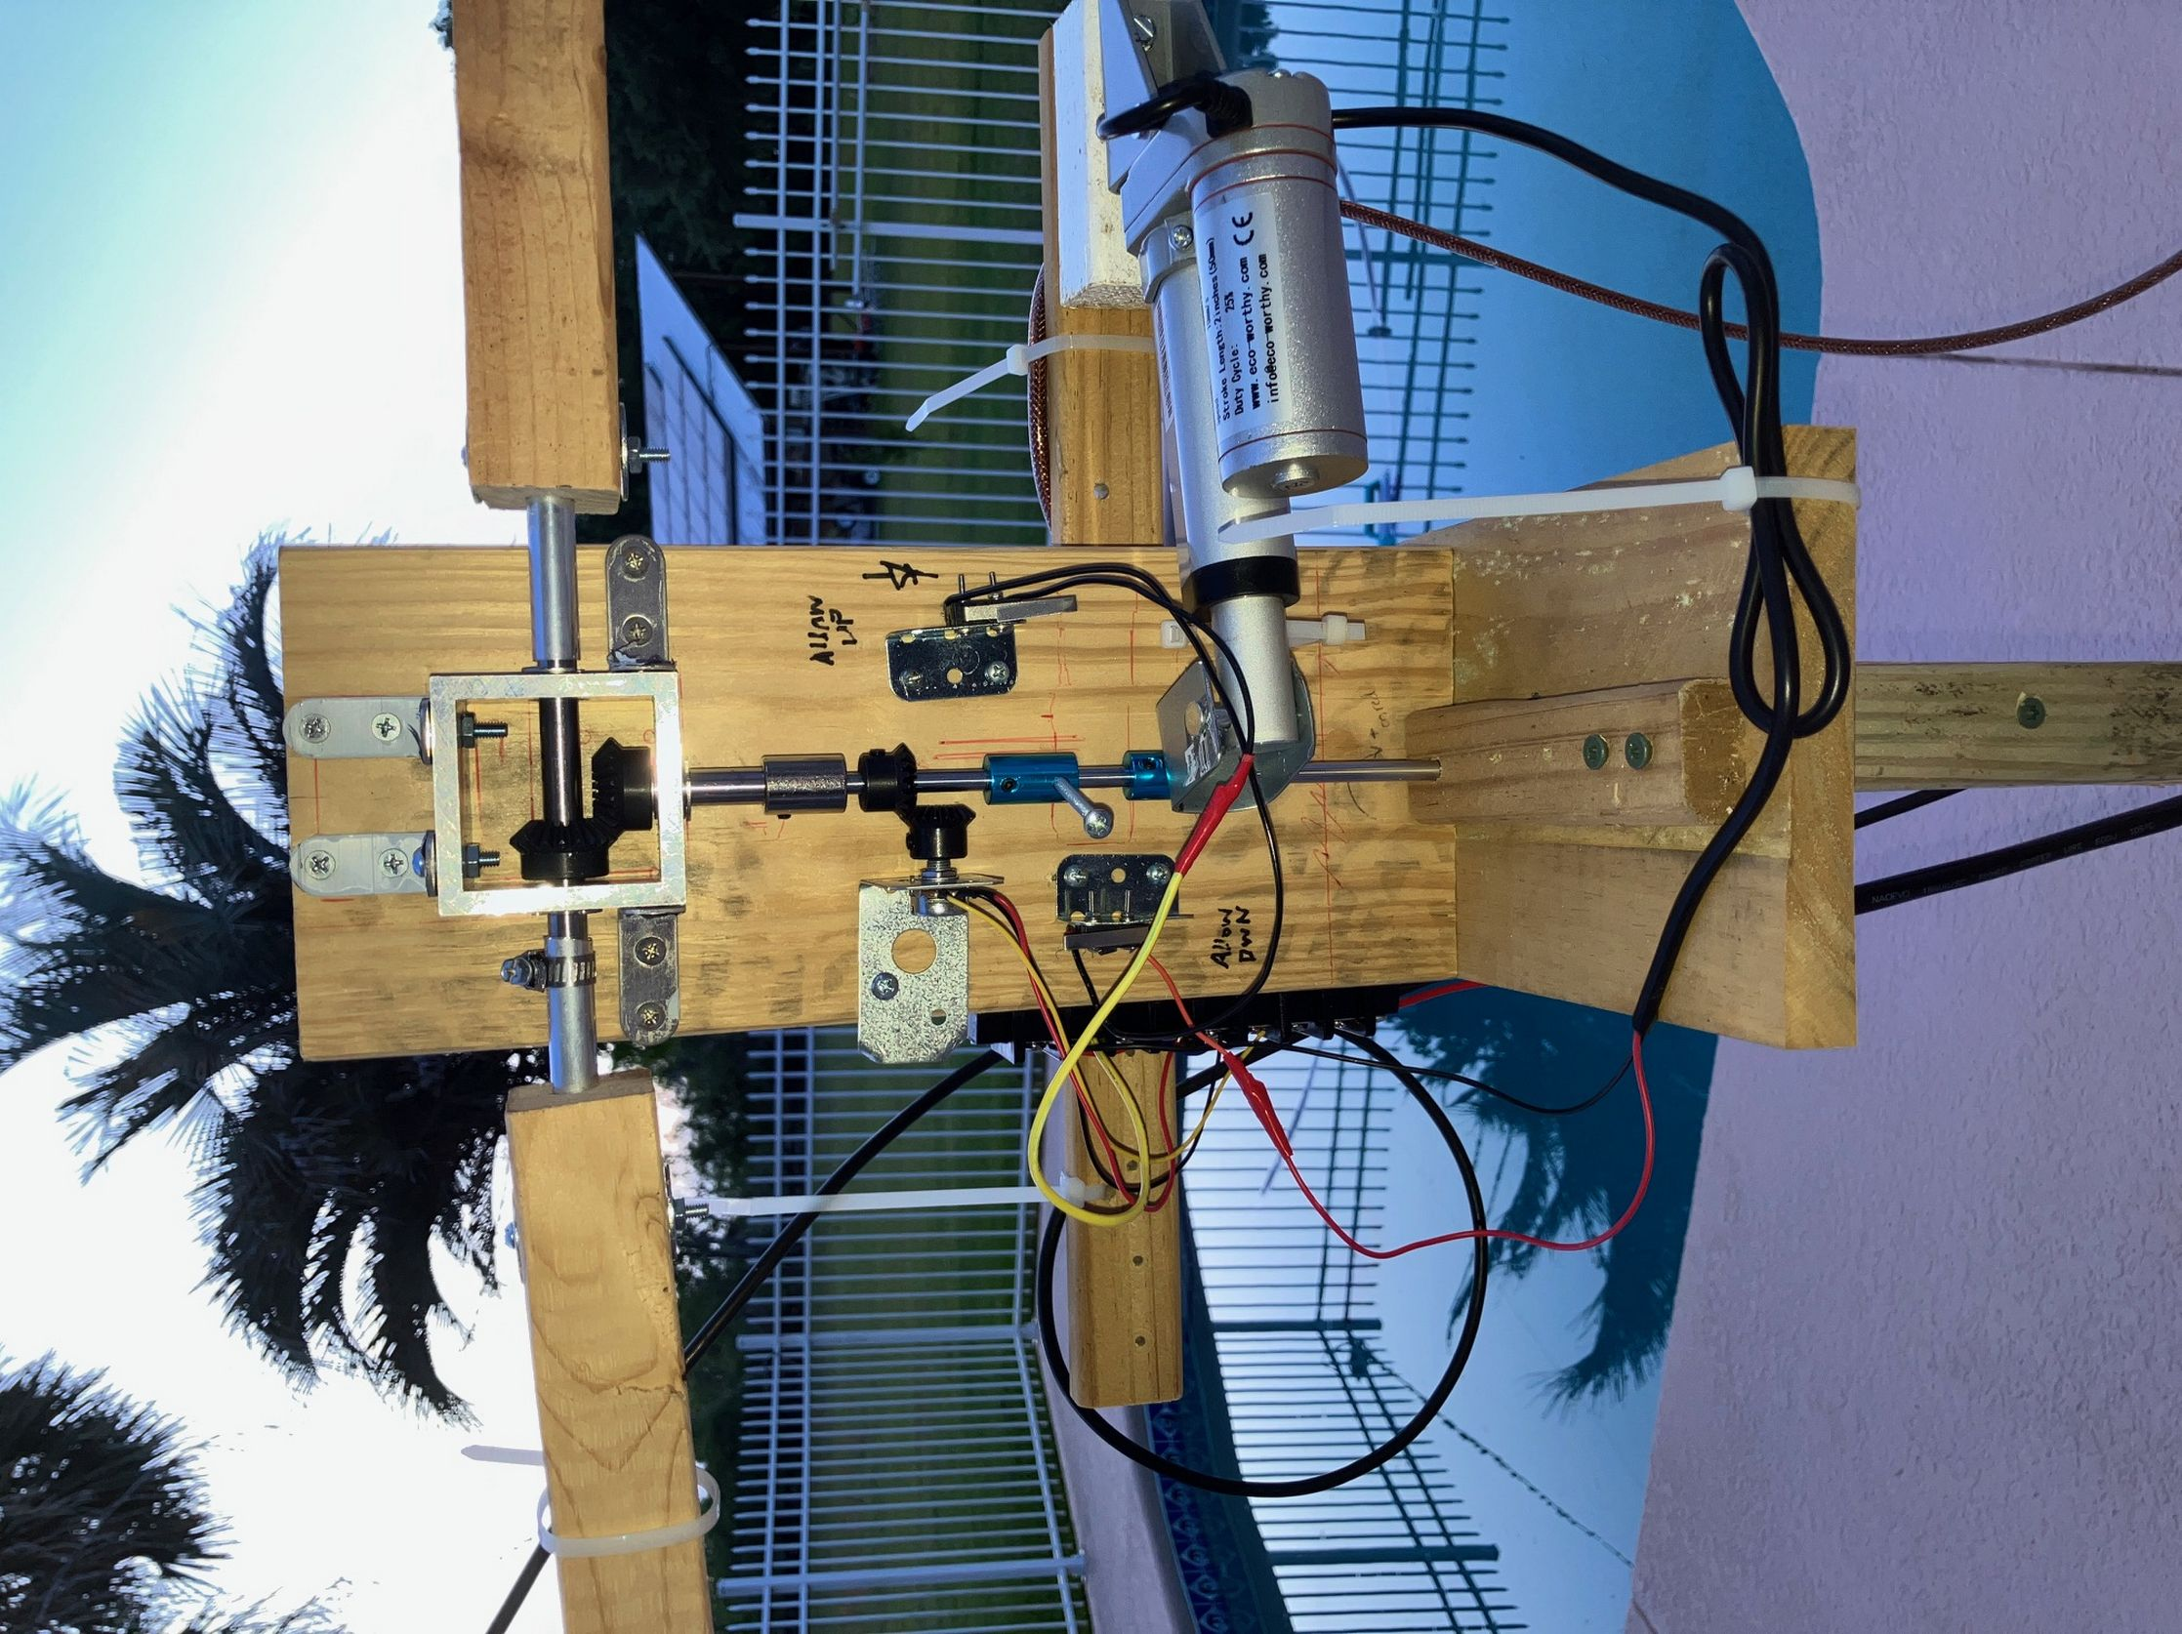
Homebrew Elevation Rotator 1.0 90 degree gear-based rotator
My first effort with linear actuator
Clueless about connecting rods, diameters etc
WORKED...but shaky
https://www.nf4rc.club/how-to-docs/satellite-system-part-iii-antenna-dual-axis-rotator-system/

Slide 15
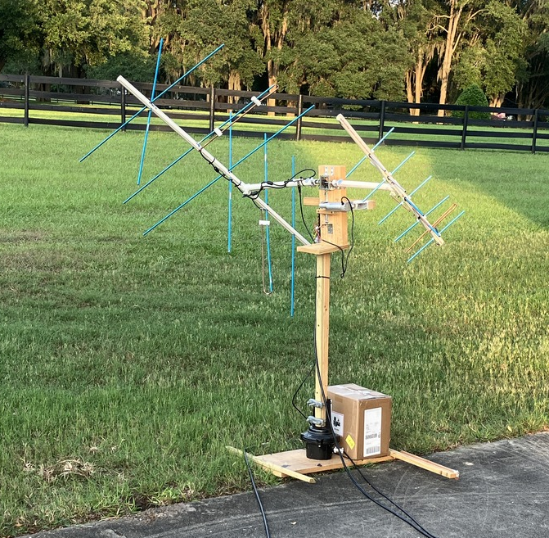
Dual Axis Rotator/Antenna 1.0
Actually worked and made a contact with it!

Slide 16
UPGRADE! Elevation Rotator 2.0
Build around much stronger aluminum masts
Utilize longer linear actuator (12V DC motor)
Simple potentiometer angular monitoring
3D print as many parts as possible, so design is immediately repeatable by other interested hams

Slide 17
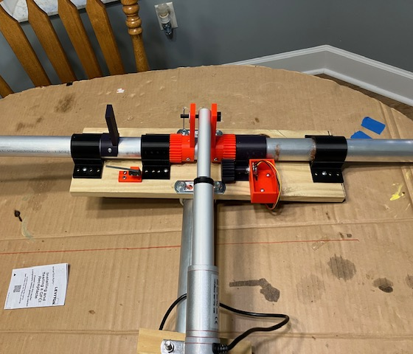
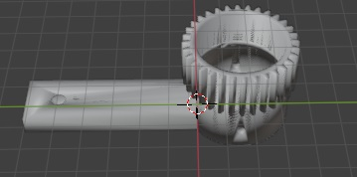
Elevation Rotator 2.0 3D Printed Rotator Components
2’ /Amazon aluminum azimuthal boom
1.5” Amazon alum. Elevation boom
Amazon 6” linear actuator
Bushings to support elevation boom
Geared control arms (two)
Geared potentiometer arm
Potentiometer support
Limit Switch support
Limit Switch actuator
Pin for linear actuator
Easy to replicate by anyone!!

Slide 18
2. Frequency Control
GPREDICT via rigctld can control simpler radios….
SATPC32 – finally able to control both MAIN and SUB of Icom 820H (and subsequent transceivers)
CI-V open collector control via USB laptop output with cable
820H lacks SPECTRUM DISPLAY
Finding self much easier with spectral display – sBitx with Transverter!

Slide 19
Frequency Issues
Beyond separate uplink and downlink Doppler errors…
Satellite offset may DRIFT
My transceiver frequencies also DRIFT
FINDING YOURSELF NOT EASY!!
Spectral display helps a TON
820H doesn’t include….
Sbitx Does

Slide 20



Transverter to the Rescue?
Split the received signal –> TWO receivers
Portion to 820H
Portion to Transverter → 10meter sBitx
Problem: Add transverter and sBitx drift now!!
Must track commands to 820H and command sBitx to equivalent frequency….
Wrote c-code on Rasp. Pi to translate and feed the sBitx with commands – allows corrections for offsets; finding self much easier
Code allows me to make corrections for frequency errors on transverter+sBitx to math the 820H

Slide 21
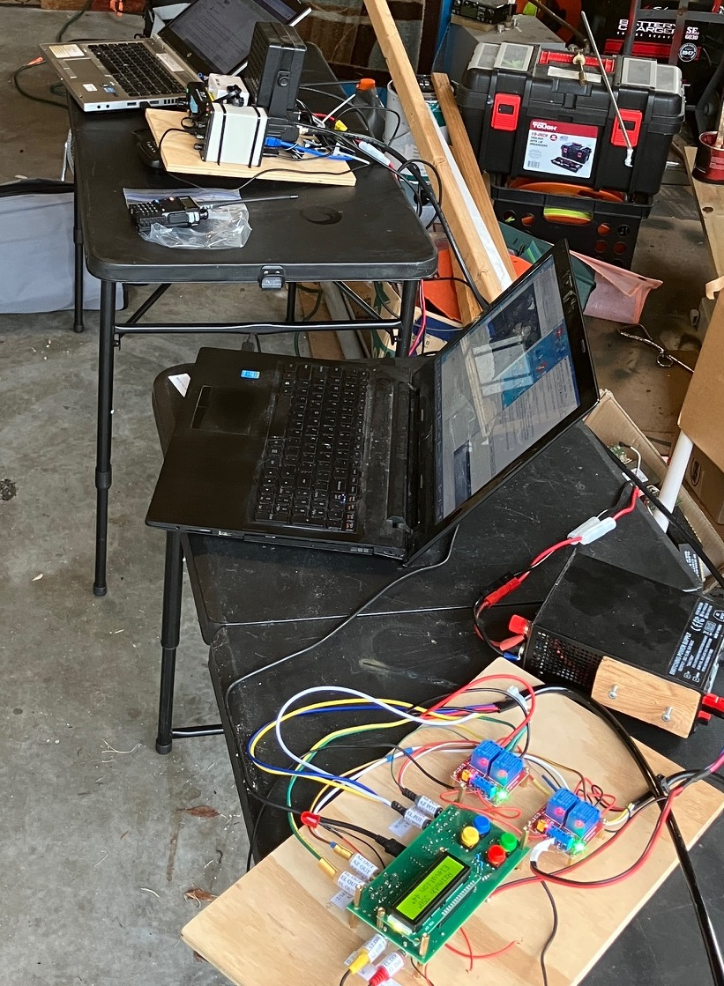

A Fairly Complicated Setup
Trying to keep all of it straight
Blew up 2 (less expensive) preamps in the process
Made a CW QSO on RS44 Russian satellite

Slide 22
3. Transmitter Power

Slide 23
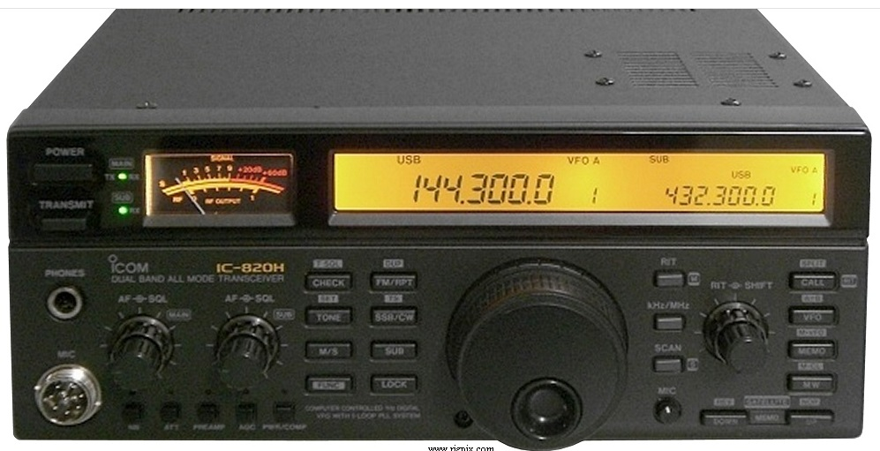
Used ICOM 820H
Low cost duplex VHF/UHF radio
40W typical output
Possibly good sensitivity

Slide 24
Antenna Gain
Problem of Circular Polarization
Pairing two orthogonal Yagi's
3dB loss due to pairing
Difficulties of matching!
Typical solution: 50 ohm → ¼ match to 100 ohm, THEN parallel

Slide 25
Homebrew 2meter / 70 cm antennas
Difficulties with Aluminum Arrow Shafts
Arrow inserts
Threaded Rods
J driven elements vs. folded dipole
Matching problems…..
Lack of experience with better matching systems

Slide 26
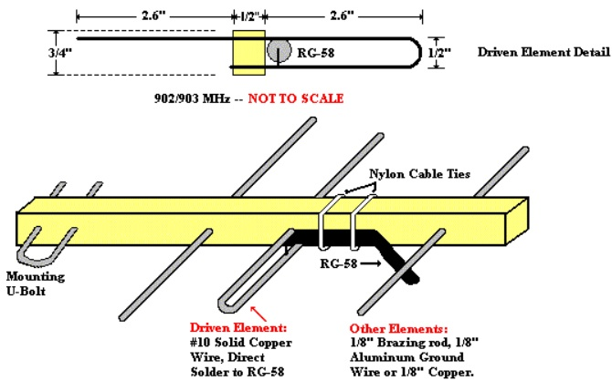
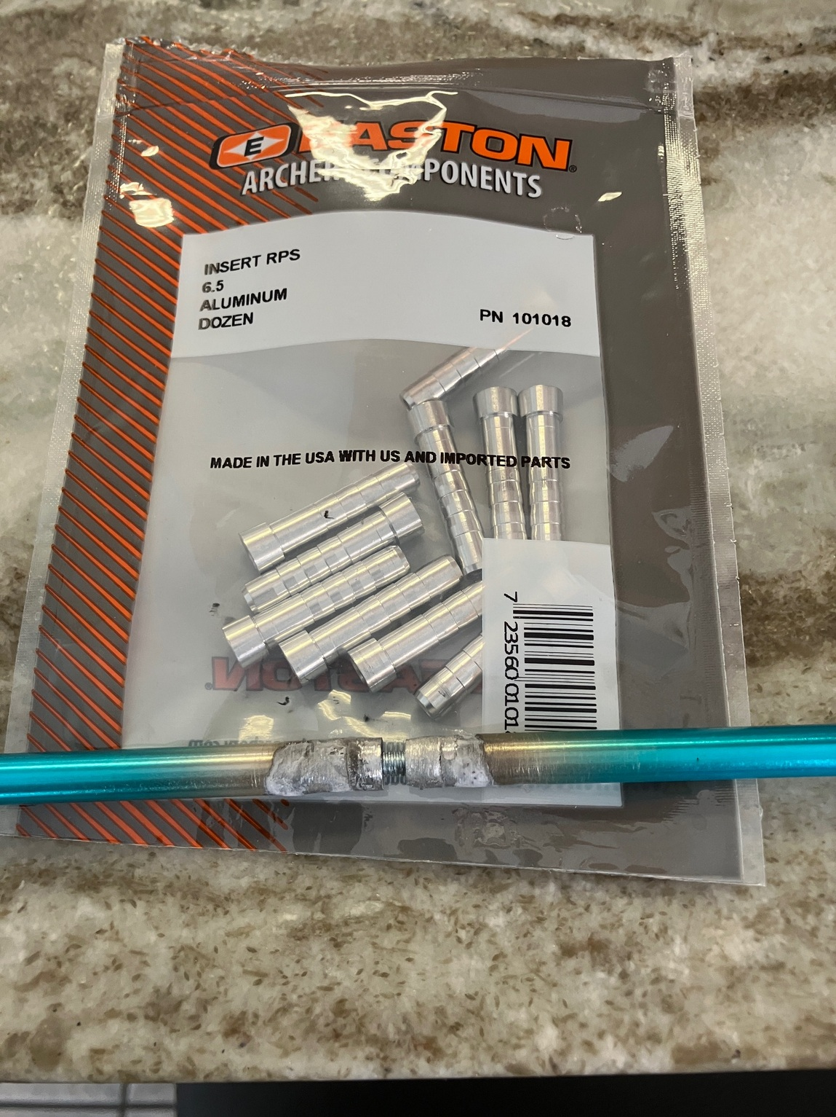
Ken Britian WA5JVB 1994
http://www.fredspinner.com/W0FMS/CheapYagi/vjbcy.html

Slide 27
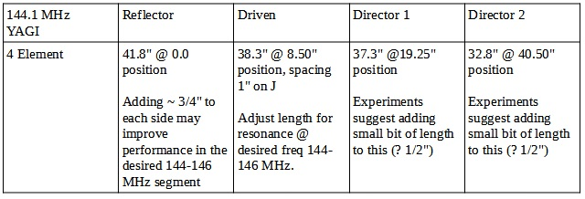
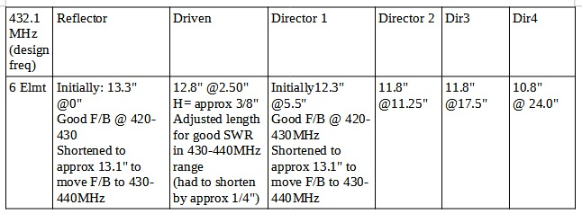
My attempt

Slide 28
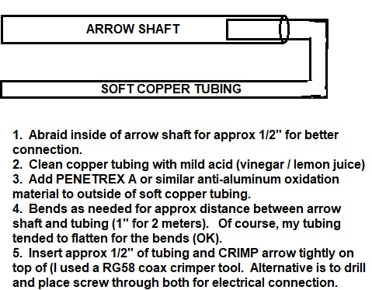
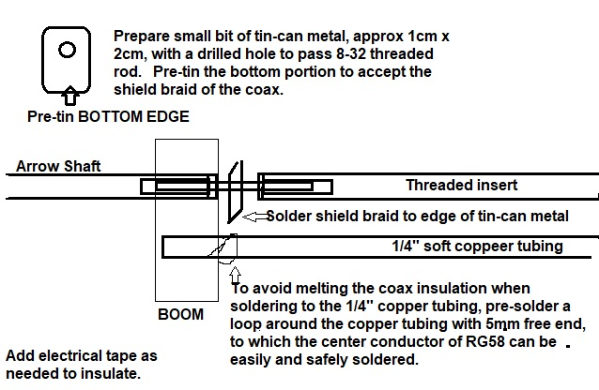
Lots of Trouble with J Driven Element / Matching
https://www.nf4rc.club/how-to-docs/satellite-system-part-iv-cross-polarized-yagis/

Slide 29
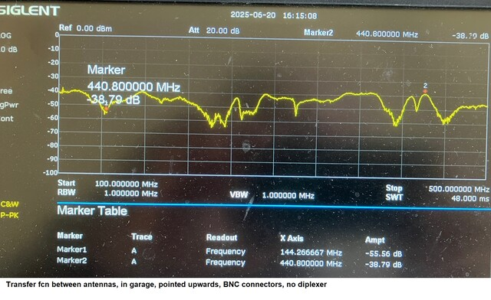
Good isolation between antennas

Slide 30
Less than exciting gain measurements when compared with standard dipoles in my backyard antenna range….

Slide 31
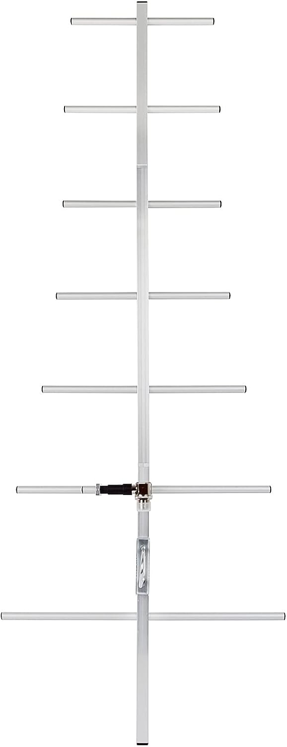
Commercial 70cm Yagi
Far better machining
Gamma Match (Teflon?)
Need non-conductive support boom material to mount on….

Slide 32
3. Receiver Sensitivity (and allowing spectral display)
Coax run adds loss
Attempting to split receiver signal adds loss
Uncertain 820H receiver gain/sensitivity

Slide 33
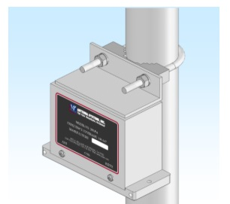
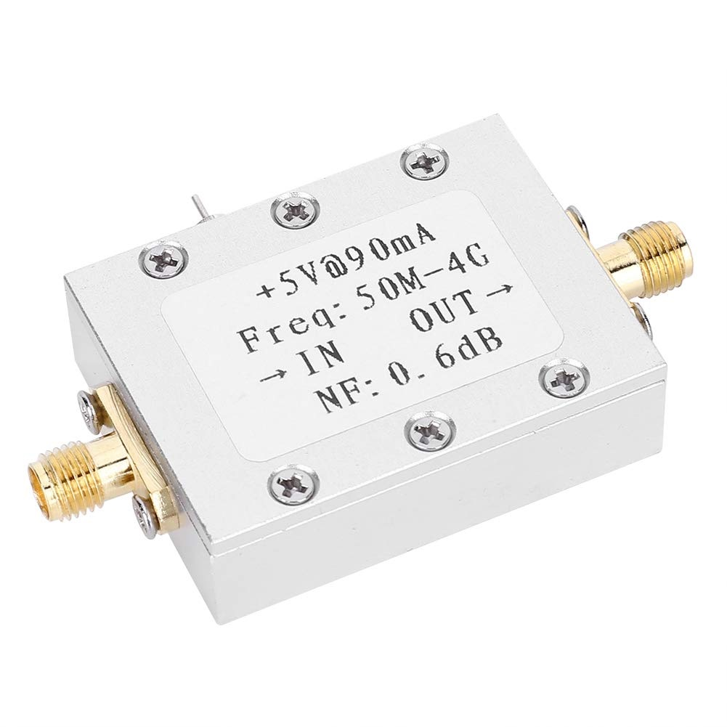
Preamplifiers
$376++ preamp with relay switching included; versus $16 preamp without relay switching...

Slide 34
Preamp Control
Standard: +V on coax center conductor during receive enables preamp
820H allows pre-setting of which BAND will have +V on receive (VHF= SO-239; UHF = N)
Does NOT prevent RF Transmit from switching to unexpected connector!! Making +V critical to protection.

Slide 35
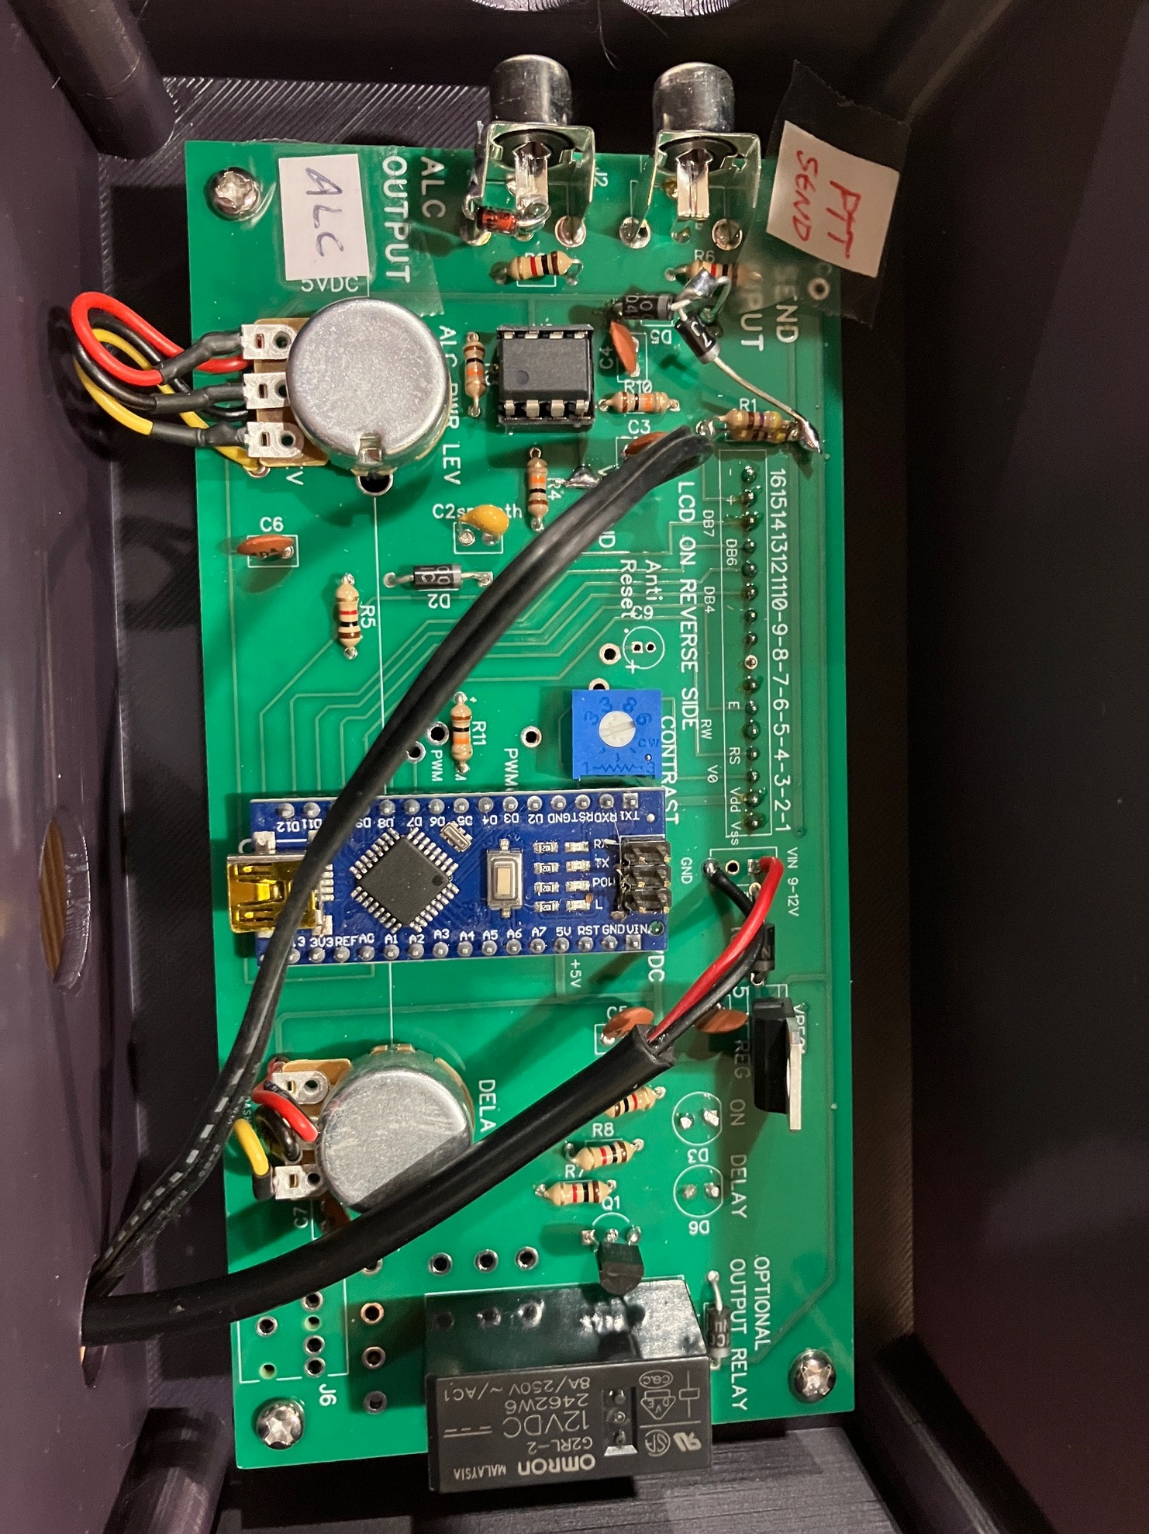
Sequencer / ALC Pwr Level

Slide 36
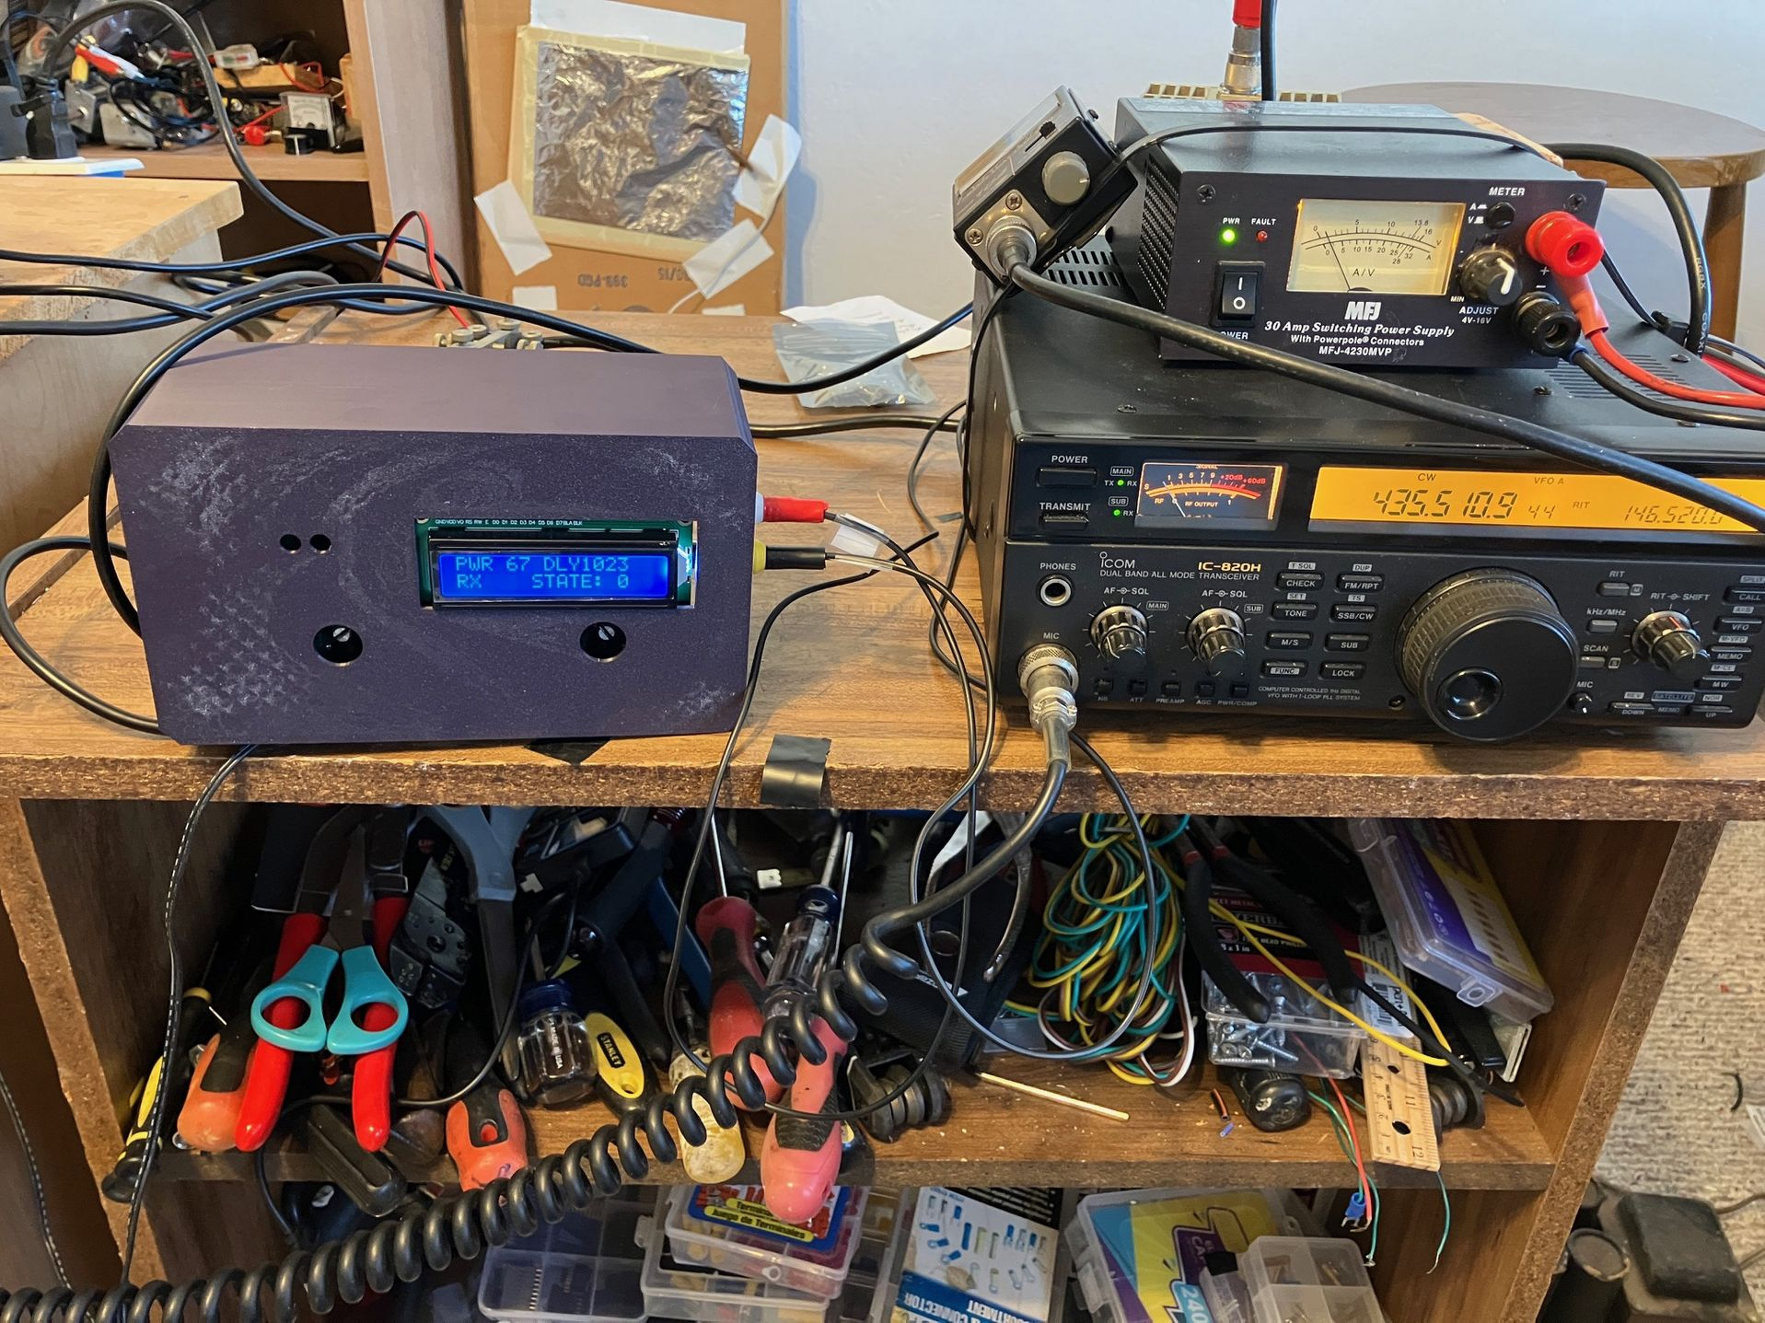
Sequencer Works!

Slide 37
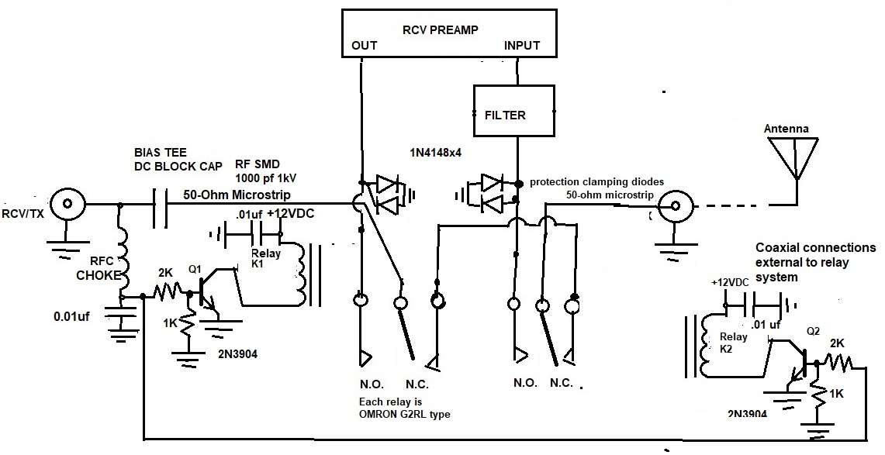
2meter Preamp Relay

Slide 38
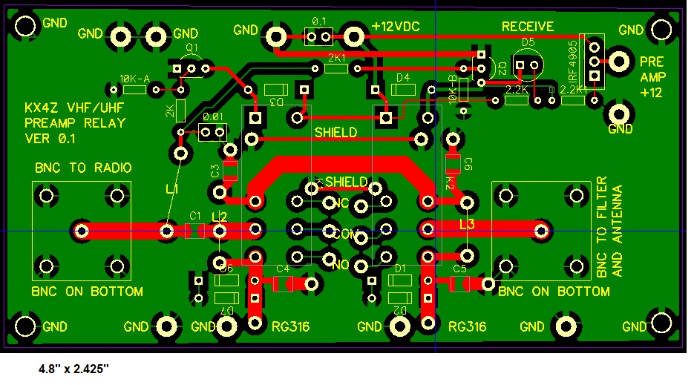
2meter Preamp Relay Board
https://www.nf4rc.club/how-to-docs/satellite-mast-mounted-preamp-protection-board/

Slide 39
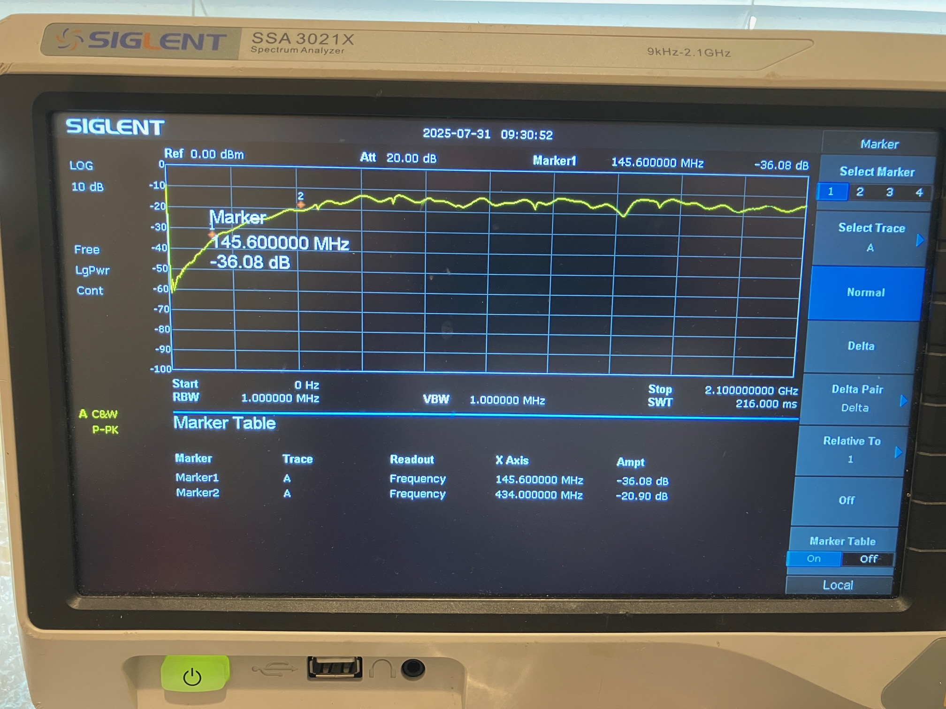

Inadequate UHF Isolation
Good to have 15 dB more isolation than GAIN! (prevent oscillation)
Isolation between preamp coaxial connectors and transmit pathway (1MHz-2.1 GHz) -- both input and output are similar. This shows the isolation of the preamp from the transmit pathway at two meters is approximately 36dB, but the isolation declines markedly at higher frequencies.
LPF required to prevent oscillation.

Slide 40
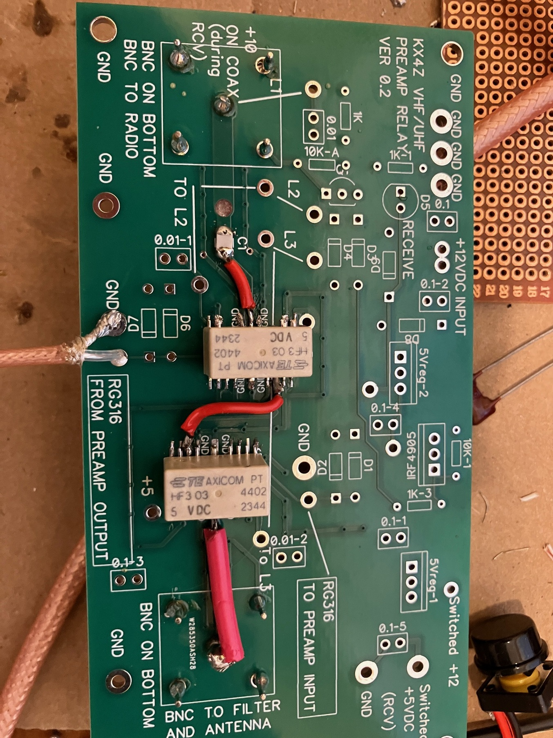
UHF Preamp Switching -1

Slide 41
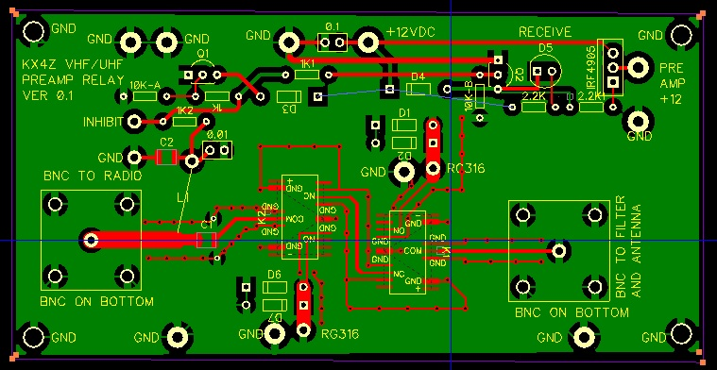
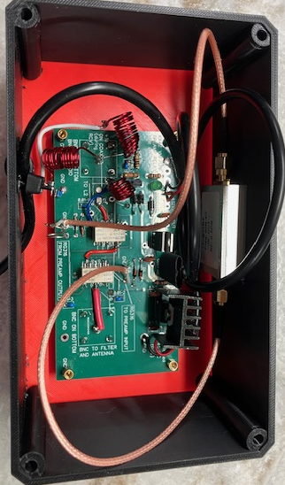
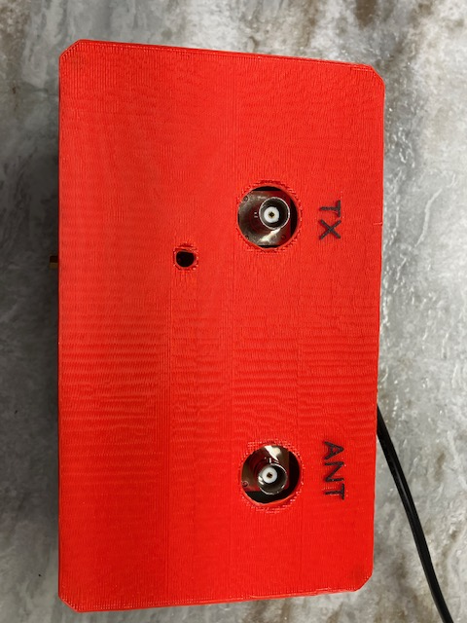
UHF Relay Switching

Slide 42
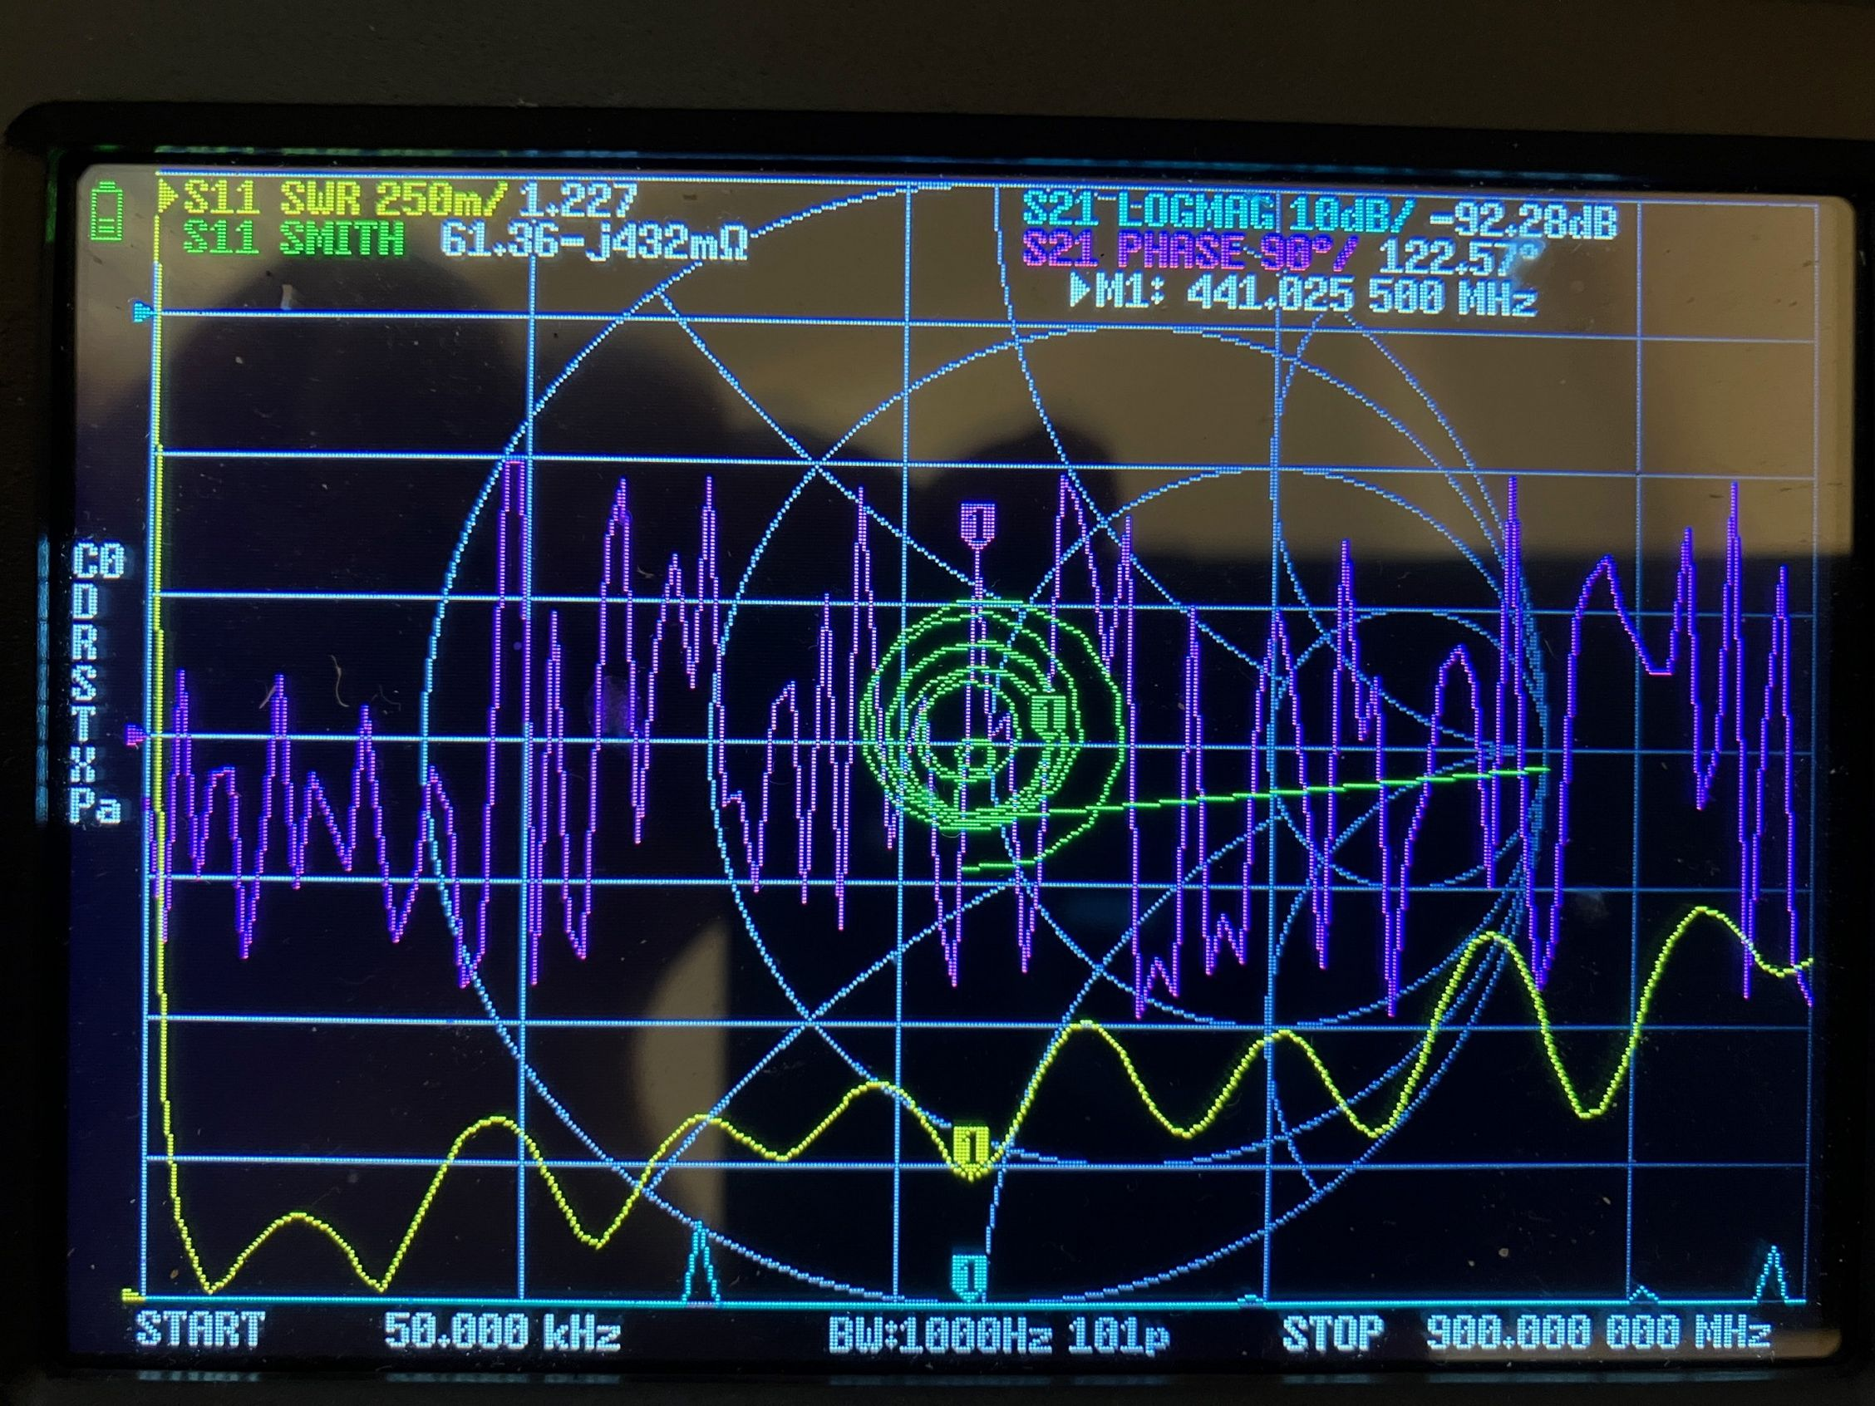
UHF PreampSwitcher

Slide 43
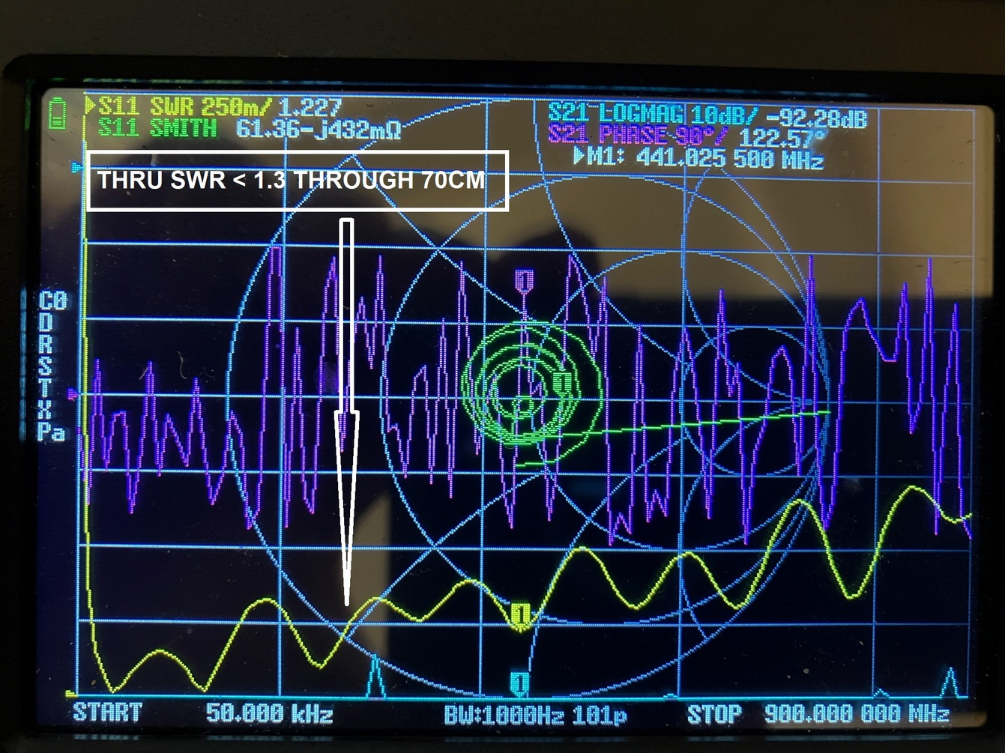

UHF Relay Design
Required special relays
Microstrip design (needed wider traces)
Thru SWR < 1.3:1 thru 70cm
Bias-Tee requires dual-stage LPF to avoid false triggering

Slide 44

Finding Myself: Attempt to Monitor with Sbitx
ICOM has no spectral display
Sbitx on 10meters / transverter
Feed both from receive antenna ( may require preamp or else effective noise figure gets much worse….)

Slide 45
SATPC32 correctly controls 820H
Able to correctly adjust both receiver and transmitter frequencies
Doppler control
Able to adjust separately to correct for satellite offset drift/ground station drift

Slide 46
Control sBitx
Sbitx includes HAMLIB type tcp/ip control of frequency (SATPC32 can’t speak)
Wrote Raspberry Pi software to monitor CI-V commands to ICOM; offset properly for sBitx/transverter; interface to sBitx software.
Includes adjustments for drift

Slide 47

Where Next?
Improve / Stabilize Yagi’s
Finish dual axis hardware / sleeve mount non conductive boom (1” ID PVC) – VALIDATE DESIGN
(Publish .STL files and other updates)
Install Sequencer
Install Preamp(s)
Track Satellites on RECEIVE
Test Transmitting – Validate designs!
Find my signals! (Hopefully stronger!)
WORK STATIONS!!

Slide 48
Questions, Comments?

