Slide 1
Latest from HF Signals
Feb 2026
Gordon Gibby KX4Z

Slide 2
At the end of 2024:
I had put IRF520s in my V2 sBitx
JJ had released 64-bit code for 64-bit operating system sBitx
Zbitx “5+ watts” released
I had learned how to use a transverter to get sBitx onto 2 meters

Slide 3
Review for 2025:
Success of my IRF520’s
Very significant sBitx strengths with updates from JJ W9JES
Using sBitx to help me succeed at “Poor Man’s Satellite Station”
Problems (and solutions) with zBitx
Production stop with zBitx to retool better edition
Low-Low Cost LARCSET released
Havoc with the Tariffs!
LARCSET becomes experimenters’ paradise

Slide 4
Success of my IRF520’s

Slide 5
Finally blew a 50V Z24N
For the first time, I had blown a IRFZ24N MOSFET (50V Vds rating)
Debated on whether to drop to IRF510’s (20W) or IRF520’s (40W)
Both 100V (drain-source) devices; both HEXFET
520 bigger channel, bigger gate capacitance
My V2’s built for larger gate capacitance…..
Elected to go with the IRF520’s and keep higher 80m output

Slide 6
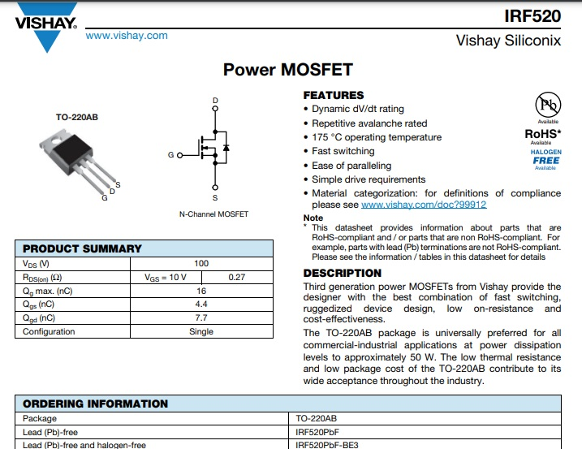
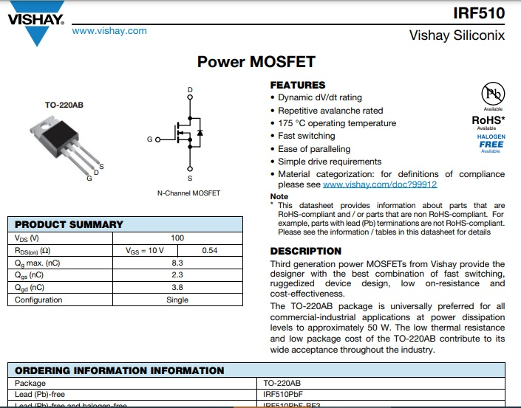
100V IRF520 vs IRF510

Slide 7
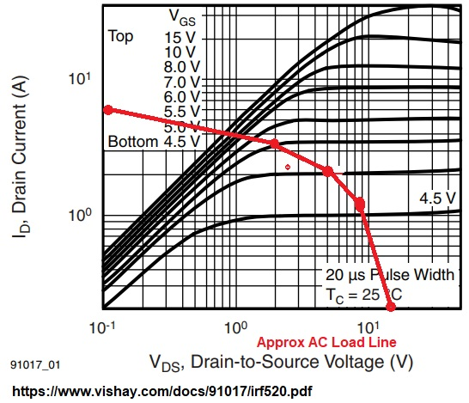
Result:
IRF520: Good power output!
Note MY IRFZ24N system had 5W Zeners – so probably worse higher end performance
FREQ 100% Output hw_settings Comment
3.5 32W 0.0037
7. 33.3 0.0028
10.1 22.6 0.0028 (Z24N ~21W)
14 16 0.0032
18.1 9.33 0.0061 (Z24N 11-12W)
21 16.6 0.0054 (Z24N 15W)
24.9 12.3 0.0063 (Z24N 10W)
28 11.5 0.0063 (Z24N 8 W)

Slide 8
Success!!
Ended up with changing out MOSFETS in both sBitx V2’s
Changed to Al-nitride insulators in both at same time
At least one unit went to TVS diodes
Both units used whenever needed throughout year (not really heavy use because I’m BUSY)
One unit is now the primary radio in our Black Mountain (NC) family vacation home
NO PROBLEMS – despite various “goofs” that happen to all of us, both units are trouble-free and still functioning! (No SWR foldback yet on these units)

Slide 9
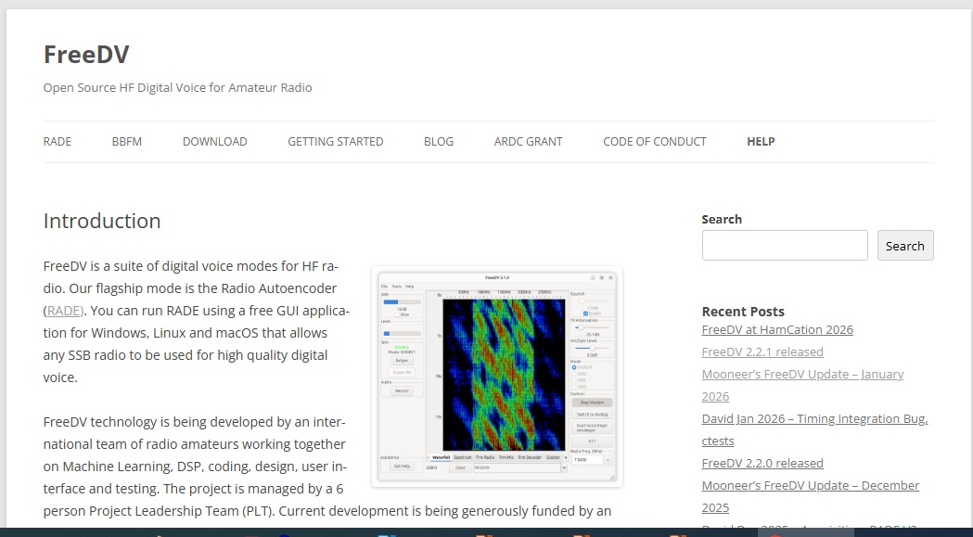
FREE DV
https://freedv.org/
RADEV1 released during the year
FREEDV development due to greatly increased funding
DIGITAL HF VOICE
100% duty cycle digital signals – 1.6 kHz wide
Approx >6dB improvement (my estimations…..)
Truly amazing voice quality and quite workable setup to find other stations
Looks like the wave of the future for voice
Expect years to be widely adopted of course

Slide 10
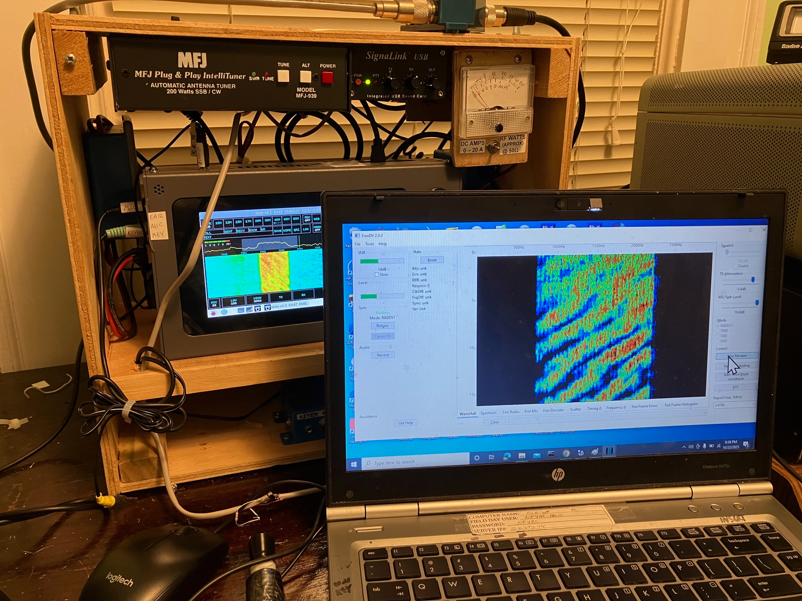
Fully digital signal
100% duty cycle
NARROW
Probably a way to do this on the sBitx without needing an external computer –
Brighter people than me will get it going!

Slide 11
Freedv on the sBitx
Sbitx handled nicely!!
I kept the sBitx at somewhat modest power levels
Grateful for the Al-nitride insulators!! (Heatsinks heat up nicely!)
Amplified with SB-200 572-B amplifier to get 100-200 watts output
GREAT FUN with our Alachua County Crew (from Black Mountain NC)

Slide 12
Sbitx Strengths With JJ Upgrades
W9JES
Discord Server
Entire 3rd Party group dramatically improved stock software originating from single author Ashhar Farhan

Slide 13
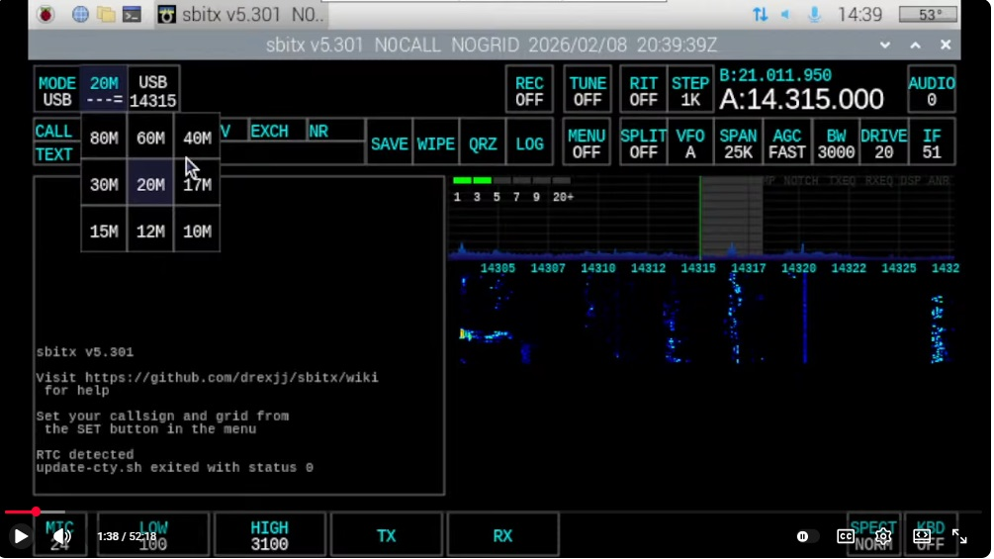
Combo Box Update
BAND

Slide 14
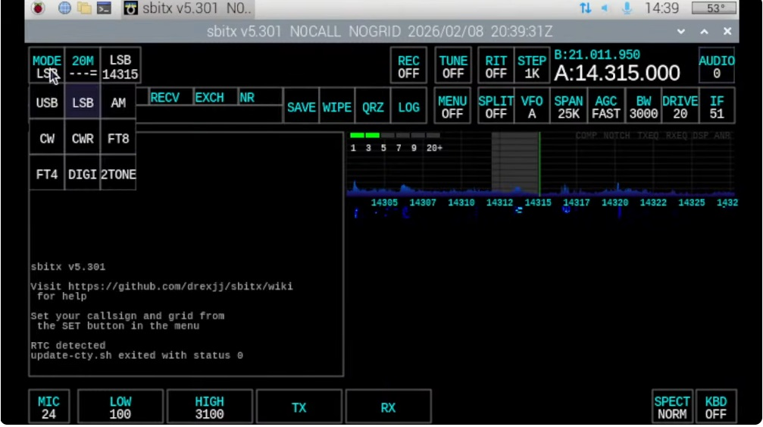
Combo Box Menus
MODE
Screen real-estate savings!
Easier on the eyes
Big Improvement I noted in earlier 5.x update: LSB/CW no need to re-tune to join SSB net!

Slide 15
5.3 Updates
Basic RF hardware now stable; attention turned to maximizing the potential of the raspberry pi software
New UI & usability goodies:
Drop-downs for Band/Mode/Bandstack/Span/Menu → better touchscreen use
Bigger font (10–40 pt) for console/CW decode: \bigfont xx
Persistent console across modes/resizes
CW tune option + decode while TX + toggle (\decode on|off)
Auto Peak Filter in local interface
Quick Options menu (hold both encoders 2s)
Full screen toggle button
Voltage/Current near VFO with INA260 module installed
Power/SWR readout with decimals
High SWR auto power cut (default 3:1, \maxvswr)
\cal hardware calibration, \snap for screenshots

Slide 16
Version 5.301 updates
JJ W9JES (group: thousands of hours of software development)
Same combo box applies to many other items (bandstack, menu, span, AGC, etc)
Increased persistence to material in “console”
\bigfont option to increase font in “console” ( \bigfont off to stop )
“fullscreen” option available (also available as command line startup)
“Quick Options” menu (press both controls 2 sec)
INA260 module: voltage & current display
SWR protection available (auto-foldback on “drive”) (auto set to 3:1)
Adjustable: e.g. \maxvswr 2.3

Slide 17
5.301 cont’d
Full spectrum width now available (moves console to bottom)
\decode off (stop cw decoding)
CW decode now works in “transmit” as well
Key menu buttons highlighted on
CW auto “peak filtering”
FT4 supported
Better handling of non-standard call signs (cq “token”)
TX pitch (position in band) more easily adjustable now
RR73 now works (instead of RRR)
FT now looks up countries for stations

Slide 18
5.301 (cont’d)
FT – allows switching “slot” (odd/even)
Able to send POTA/SOTA/IS FT statements & log park, etc
Different macros available for POTA / SOTA etc.
Color coding of FT stations (orange = new; new grid = amber)
FT auto-responder priority rules
Now able to connect to external (3rd party) logging systems (UDP logging, similar to how WJST-X works)
GridTracker integration
Built-in power setting calibration for bands \cal
\snap (snapshot the screen to folder “screenshots” .png files)

Slide 19
Sbitx and Poor Man’s Satellite Station

Slide 20
With TRANSVERTER, sBitx’ panoramic display is a huge help
Especially to a beginner like me!
With a linear amplifier, a transverter output could work….but easier to use existing VHF/UHF SSB/FM transceivers
Such JOY to SEE YOUR SIGNAL on the panoramic display!!! CW dits or dahs make it very easy to see...

Slide 21
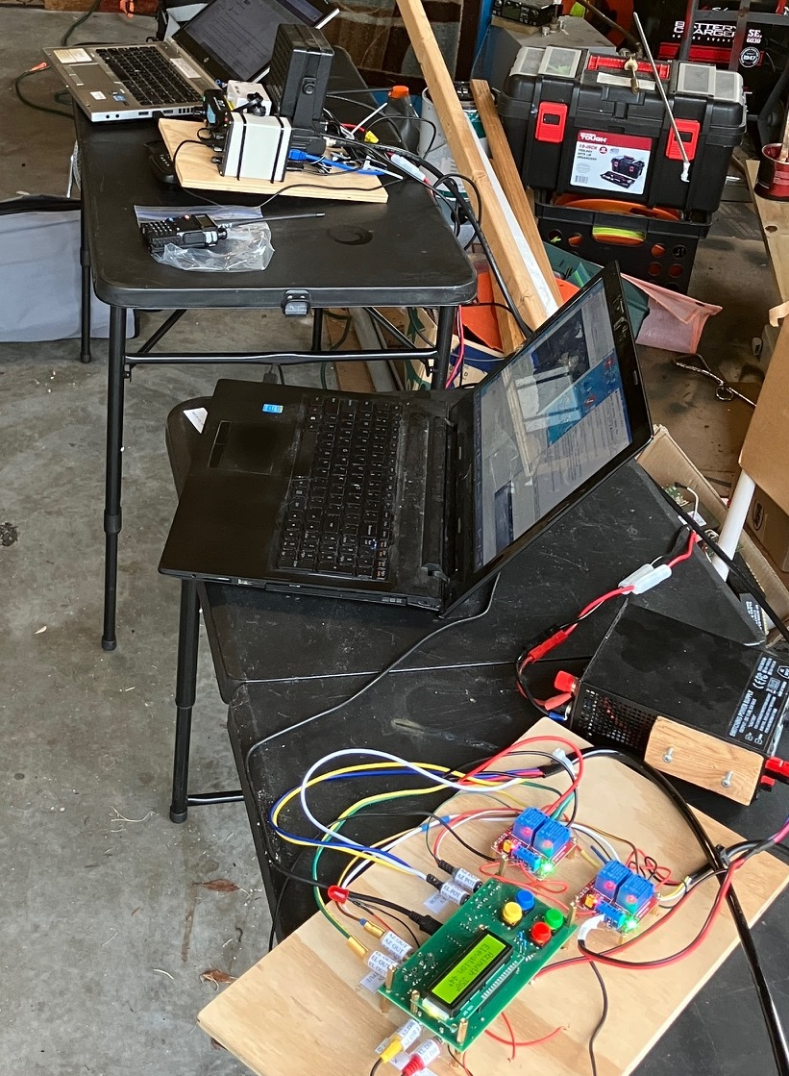
Lots of gear!
Entire series being published in NFL Section newsletter
Article by article as I build this station

Slide 22
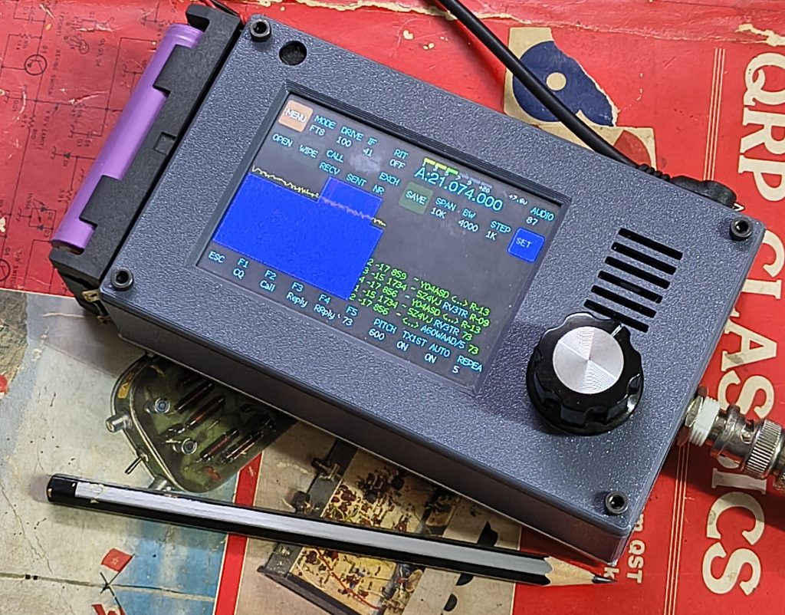
Zbitx Problems / Solutions
5watt, extremely portable self-contained transceiver
Powered by 2 lithium batteries
(design <= 9V)
Announced Dec 24 2024 – shipments began in 2025

Slide 23
Tough Design
Pick and Place Construction
RF printed circuit board design is fraught with traps!
Shielding is difficult and expensive
Digital circuits near high sensitivity RF circuits – hazards!
Ashhar keeps RF signals at low level throughout receiver to MAXIMIZE DYNAMIC RANGE (trade offs are the rule in receiver design)

Slide 24
→Complicated radio!
Separate microprocessor to handle DISPLAY (isolated from external connection)
Makes updating each one very difficult, since only ONE has I/O exposed to the external world
Difficult to properly “shutdown”
Many examples of damaged memory cards….but an unwillingness to recognize the risk.

Slide 25
Non compliant 25 kHz spur
IMHO – BIGGEST ISSUE
First detected around July 2025
Took a LONG TIME (IMHO) to get attention paid to the non-compliant spur
System uses an offset IF centered on 25kHz – so natural concern that oscillator is leaking through to output
Discoverers were doubted, experimental setup critiqued
  But they saw no such spur in other radios, same measurement system
Originally blamed on known “crosstalk” within the Si5351 chip (disproved)

Slide 26
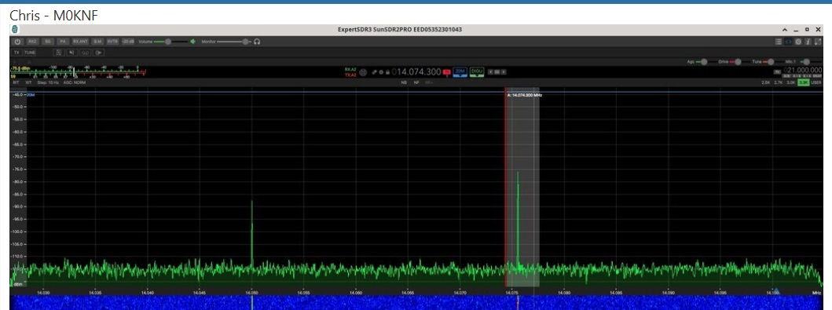
25kHz Spur

Slide 27
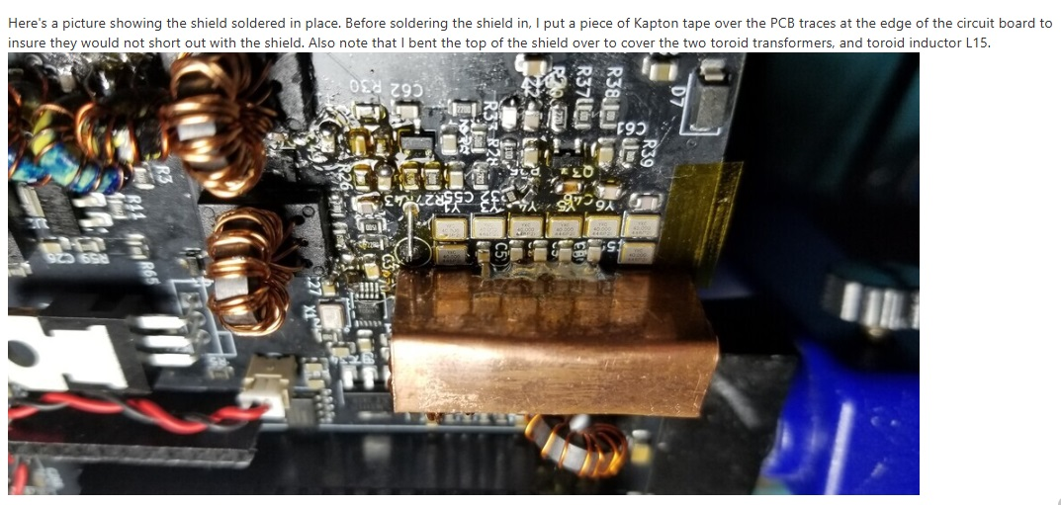
Needed Shielding!!
Steve Beckman N3SB
https://groups.io/g/BITX20/message/121569

Slide 28
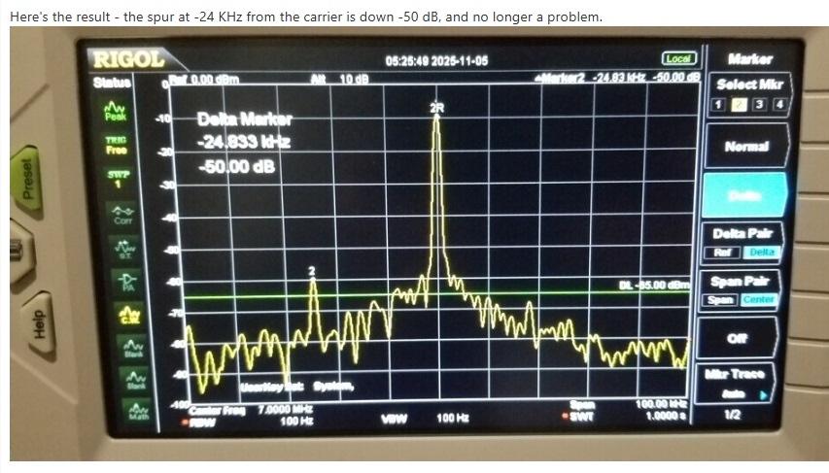
FIXED!
Steve Beckman N3SB
https://groups.io/g/BITX20/message/121569

Slide 29
Hopefully, revision…
Alternate fix: dramatically reduce coupling from oscillator.
  Reduces output, not optimal in my view
Zbitx currently in revision, not available
Suggest improved PCB layout to reduce the problems with crosstalk!
Manufacturing variation is a real issue
Pre-marketing testing is a tough nut but IMPORTANT!!
Expect next version to be better!
Normal improvement over time in products
Recommend shielding or drive reduction in existing units.

Slide 30
LARCSET released

Slide 31
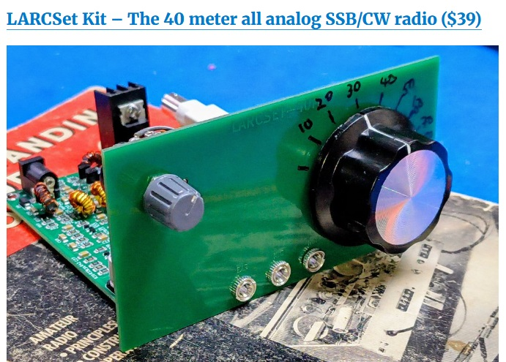

Slide 32
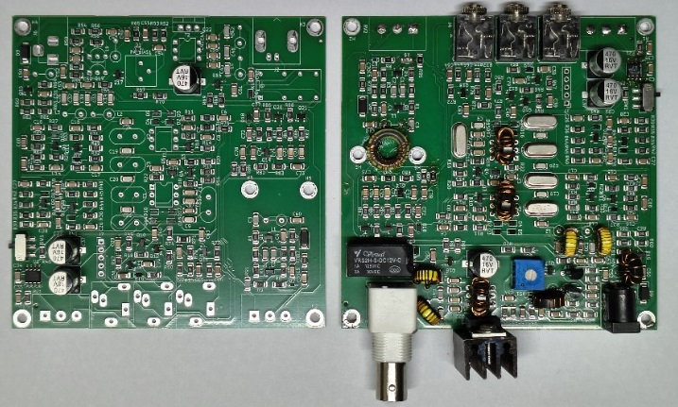
Very modest work for kit completion

Slide 33
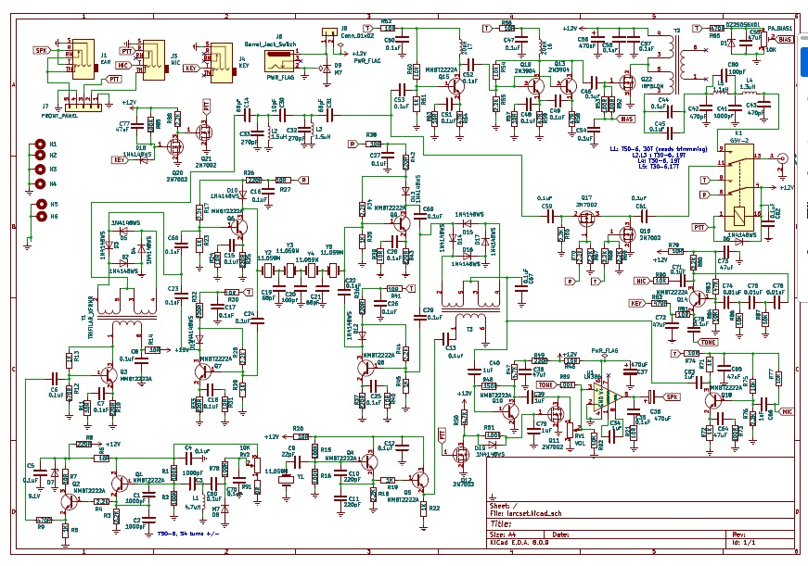
Everything is public!
Even including the printed circuit board design!!

Slide 34
Tariff-lolapalooza!

Slide 35
Confusion!
Trump’s Tariffs and India’s purchases of Russian Oil collided to make a real mess!
Typically $15 administrative fee PLUS tariff costs for US purchases
Dramatic reduction in pricing advantage of HFSignals
Solutions?
  LARCSETs now packed in huge numbers and shipped to Chicago, paying tariffs and much less administrative fees (DHL)
  Then individually shipped to US purchasers
  GREAT SOLUTION from Ashhar & friends!

Slide 36
LARCSET Experimenters’ Paradise

Slide 37
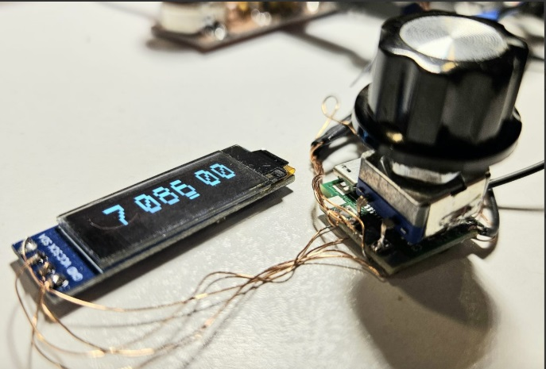
QRPLabs VFO
Made to work with the LARCSET
Multiple oscillators (allows multi bands)
Easily reprogrammed
Includes Hamlib-based CAT control
Even 3Dprinted Bezel available
$23
Full Manual:
https://qrp-labs.com/images/digivfo/DigiVFO_1_00.pdf

Slide 38
CONCLUSION
Mixed year for HF Signals
Sbitx series now solid & great 64-bit software, Ashhar has engendered a strong external group of software designers (as he had hoped)
Zbitx had problems, should get better!
LARCSET is a great radio for learning!

Slide 39
Latest from HF Signals
Feb 2026
Gordon Gibby KX4Z

