Slide 1
The Laser Tool for Hams
This presentation is to illustrate some uses for Hobby Class lasers by Radio Amateurs and electronics enthusiasts.
It is not a comprehensive tutorial for using lasers. That information is best served by on-hand experience.

Slide 2
KV0OOM Mike Hembrey Bio
Tech and General – Nov. 2014
Amateur Extra – Jan 2015
First Laser – Mar. 2019
Lightburn – Apr. 2023
First dedicated Laser – Aug. 2023
Radar Tech – USAF
Electronics Instructor
Hobby Poor

Slide 3
Front Panel
Paint – No paint
Materials
Wood
Acrylic
Clear – NO, but can etch if painted
Black – YES
Colored – Maybe
Edge Light colored transparent - Yes
Other Plastics – AVOID
Metal – Cannot cut, but can mark anodized aluminum or painted metal sheets
Sizes
Area - depends on laser frame
Thickness – depends on material thickness

Slide 4
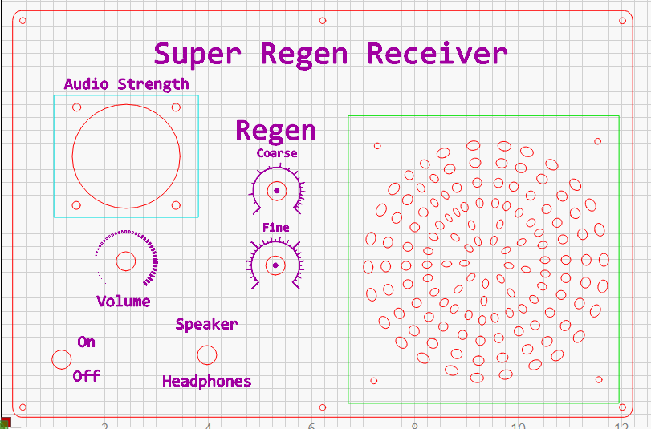
Super Regenerative Receiver
Fiktishious™ Front Panel

Slide 5
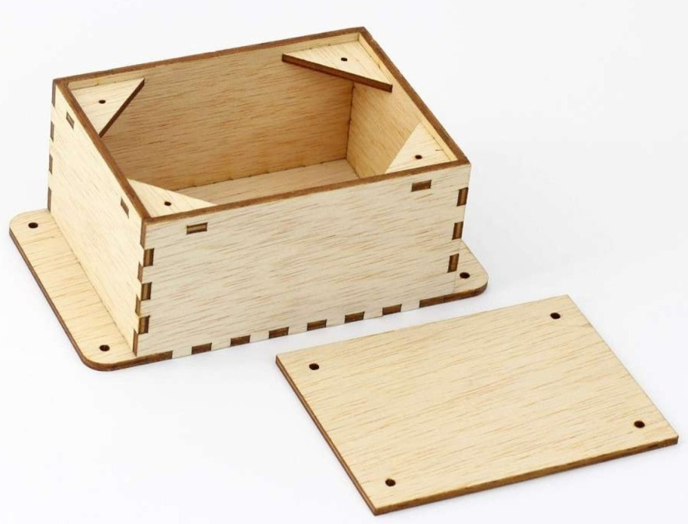
Project Cases
Wood – Can line with foil tape for shielding
https://boxes.hackerspace-bamberg.de/?language=en

Slide 6
Project Case - Details
Cost = $4.00 (not a typo)
Time =
½ hour to cut out
20 minutes to assemble and glue
Size = Up to a 11.5”x11.5”x11.5” cube using stock 12” sizes plywood. Even larger. Depending on the laser frame size, if 12”x24” sheets are used.
Variety = Hinged (no metal) lids, flex wood tops, and more.

Slide 7
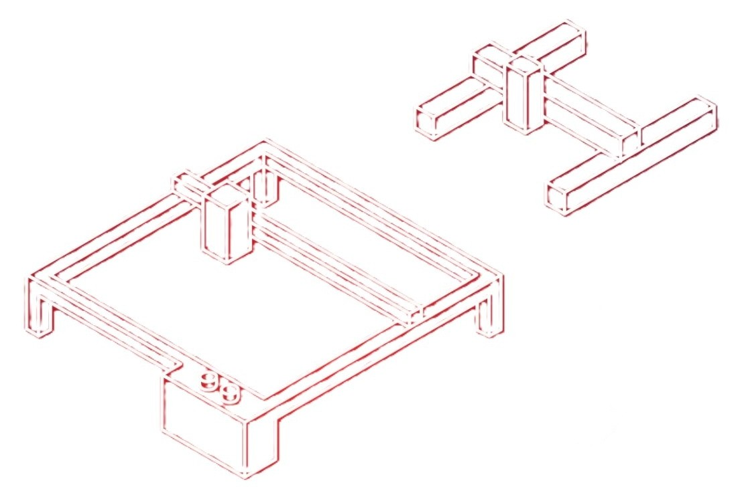
Laser Machines
Diode (visible light)

Slide 8
Laser Machines - Diode
Gantry style open frame.
70 watt to 3 watt, some dual wattage.
170 to 500 LPI (lines per inch).
If cutting, 10 watt (318 LPI) minimum recommended.
Box, H, or T frame styles.
High to low cost.
$1800 to $100, or even less.
Prices do not include enclosures or ducting/venting.
Only 2 colors, burned and not burned.
Think SAFETY, a laser is a fire starter.

Slide 9
Laser Machines - other
CO2 – non-visible light, cuts clear acrylic, large work area, large beam, high maintenance.
$1000 to $7000 price range
Fiber – Can mark metals, Small beam, very fast, low maintenance, focus critical.
$2000 to $10,000 price range
IR – Optional module, 2w max, $350-$500.
Galvo – can be CO2, Fiber, or even Diode (Galvo uses mirrors). Extremely fast, uses many passes to impart enough energy into the material. Can actually etch metal.

Slide 10
Software
Free
LaserGRBL – No design capability, imports Gcode, controls the laser.
XCS – xTool machines only. Needed to get full features of machine.
Toocaa Studio – Basic design capability for path (vector) creation. Controls the machine.
Paid
Lightburn – The industry leader by far. Lifetime license, annual fee for upgrades. Core and Pro licenses, GRBL and all the rest respectively. Complex designs, image processing, large list of file import types. License permits up to 3 PC’s (seats) for flexibility.

Slide 11
PC/IOS to Laser Connections
USB
Most common and fairly reliable.
Distance limited.
Lasers are USB 2.0 protocol.
WiFi
HIGHLY discouraged due to the up and down amplitude characteristic of WiFi signals. Very unreliable, but some users have managed to make it work.
Ethernet
Most reliable, only higher priced lasers have Ethernet capability.

Slide 12
Web Links
Lightburn
https://lightburnsoftware.com/
Lightburn Forum
https://forum.lightburnsoftware.com/
Diode Laser Wiki
https://diode-laser-wiki.com/
LaserGRBL
https://lasergrbl.com/
Toocaa
https://www.toocaa.com/pages/toocaa-studio
Boxes.PY
https://boxes.hackerspace-bamberg.de/?language=en

Slide 13
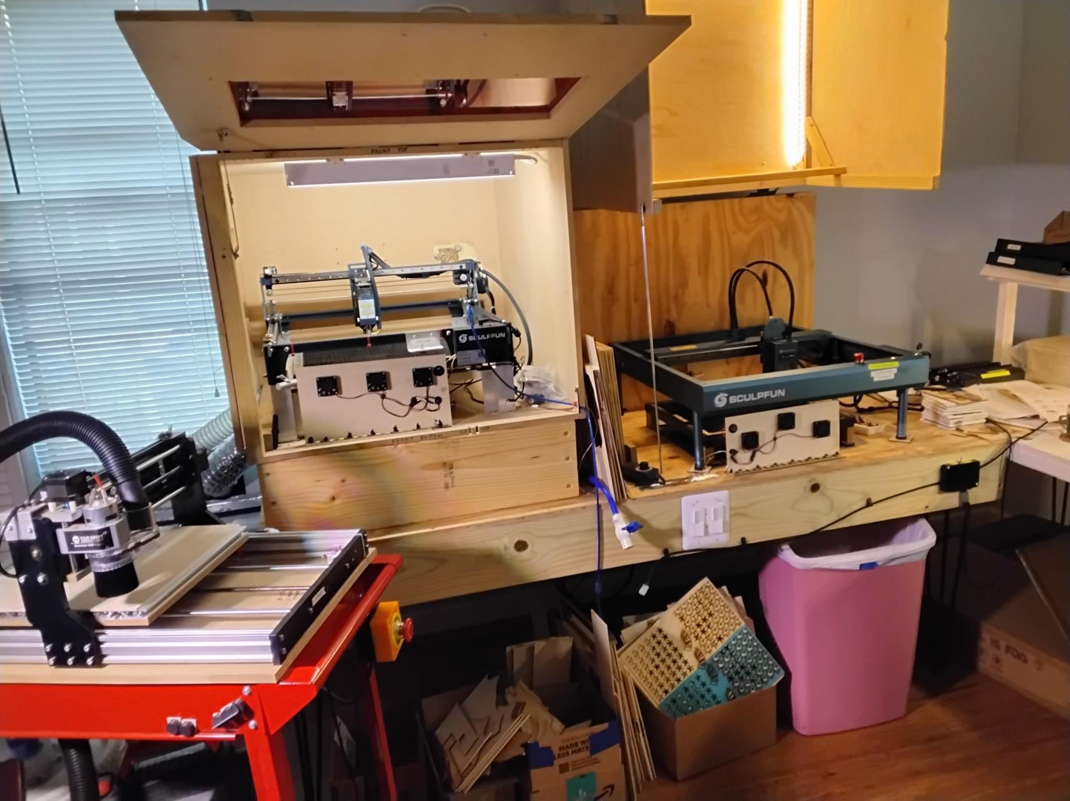
Kv0oom “Laser Shop”

Slide 14
Open Chat
File formats
File “senders”
Other laser uses
Laser Maintenance
Materials costs
Two lasers at same time
Scrap wood
Dealing with smoke
Hazards

Slide 15
Last Words…
A laser,
at any price level,
is not a toy.
A 0.1mm blue light can burn a house down.

Slide 16
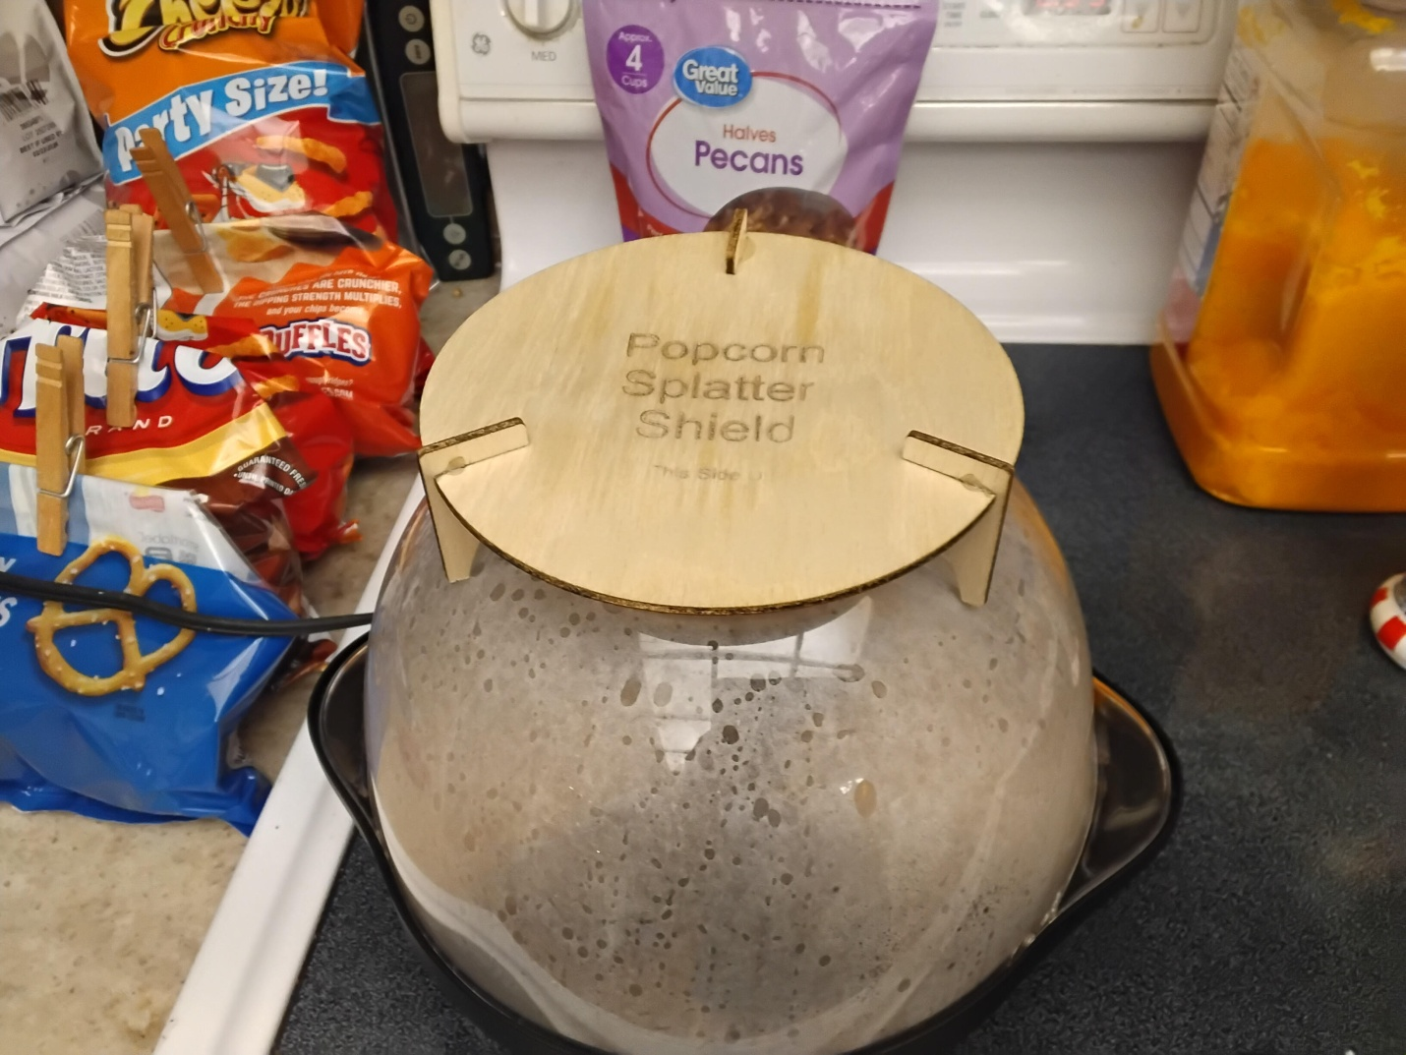
Bonus
You can find other uses for the laser as well…

