Slide 1
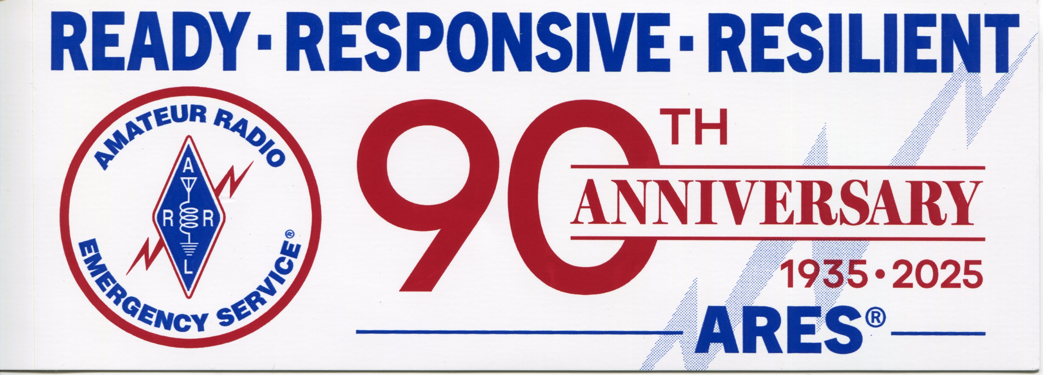
ARRL West Central Florida
ARES Meeting
Dave Rockwell, W4PXE
Section Emergency Coordinator
9/13/2025

Slide 2
Meeting Agenda
Call to Order
Introductions
  Section Emergency Coordinator & Section Officials
  County Emergency Coordinators
  Other presenters and guests
Presentation: Latest Version of the ARRL West Central Florida ARES Emergency Communications Plan
  Brief overview of updates and key changes
  Needed information
WCF ARES Communicator
ARRL ARES Website Updates

Slide 3
Meeting Agenda
Discussion and Q&ACounty Initiatives Updates
  Each County Emergency Coordinator provides a brief update on recent activities, initiatives, and accomplishments
  Opportunity for questions and shared best practices
Open Discussion
  Challenges, needs, and opportunities identified by members
Planning for Next Meeting
  Proposals for agenda topics
  Scheduling and location discussion
Adjournment

Slide 4
EC Introductions
Section
Dave Rockwell SEC
Chuck Johnston, ASEC Exercises
Randy Paine, ASEC Emeritus
Emergency Coordinators & Radio Officers
Charlotte | Manatee
DeSoto | Pasco
Hardee | Pinellas
Highlands | Polk
Hillsborough | Sarasota

Slide 5
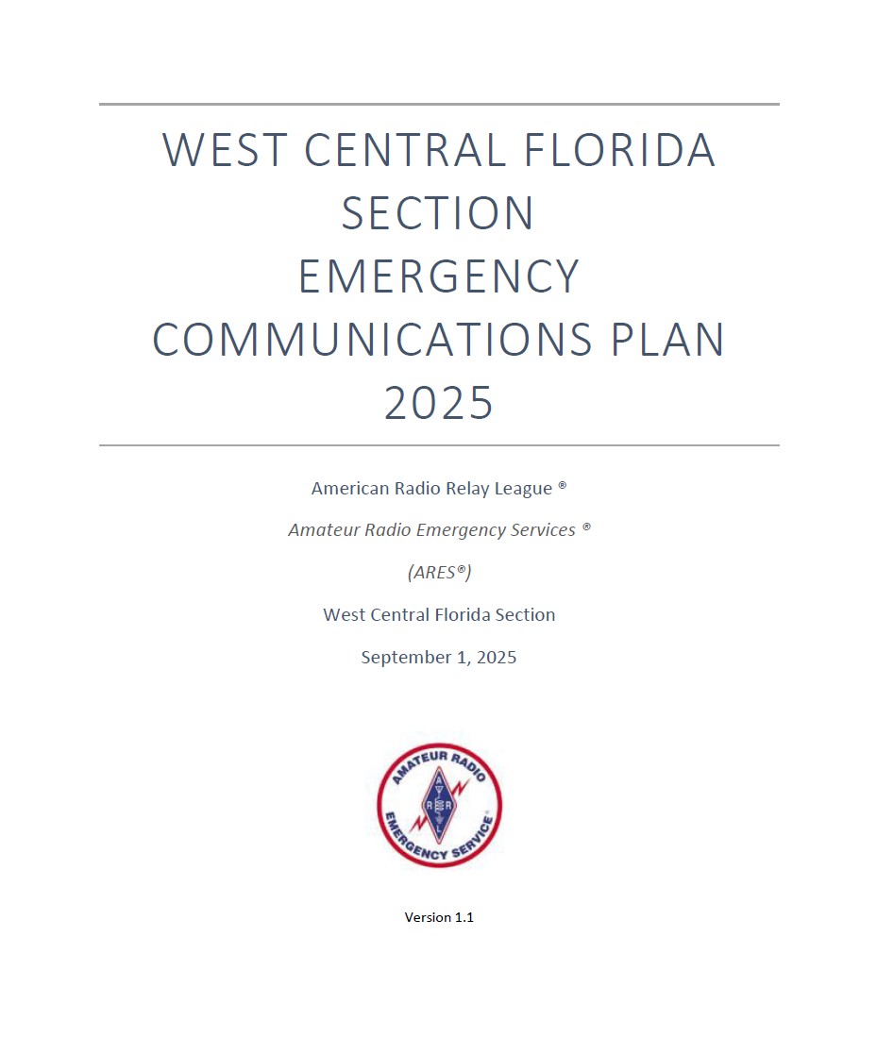
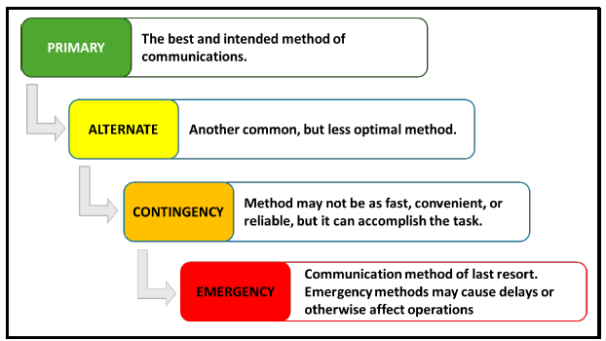
WCF ARES EMCOMM Plan
PACE Model for Communications
Concept of Operations
ARES support is consistent with NIMS and ICS
ARES Groups should be supporting a responding agency
ARES members should undergo qualification and recurring training
AUXCOMM is encouraged and required by some agencies
ARES members should take every opportunity to participate in events, drills, and exercises

Slide 6
WCF ARES EMCOMM Plan
Emergency Activation
ARES members are activated by their sponsoring agencies
ARES members should never self-activate
Safety of member and his/her family comes first
Keep the SEC advised of any activations

Slide 7
WCF ARES EMCOMM Plan
WCF ARES Activation Levels
Four levels
Level 4 – Routine Operations
Level 3 – Alert Status
Level 2 – Partial Activation
Level 1 – Full Section Activation
ECs can request Activation Level change – Contact SEC, SM, or webmaster
Activation Levels are offered as a service to let ARES members know that some or all groups are activated

Slide 8
WCF ARES EMCOMM Plan
The plan contains tables regarding organization, Emergency Coordinators, and EOC contacts.
We need to update the county-to-county table of contacts
Need contact name
EOC radio room phone number or cellphone
Local repeater information
WINLINK addresses
SHARES call sign
Mike Drake, Pinellas ACS, is compiling information, wa1ryq@arrl.net

Slide 9
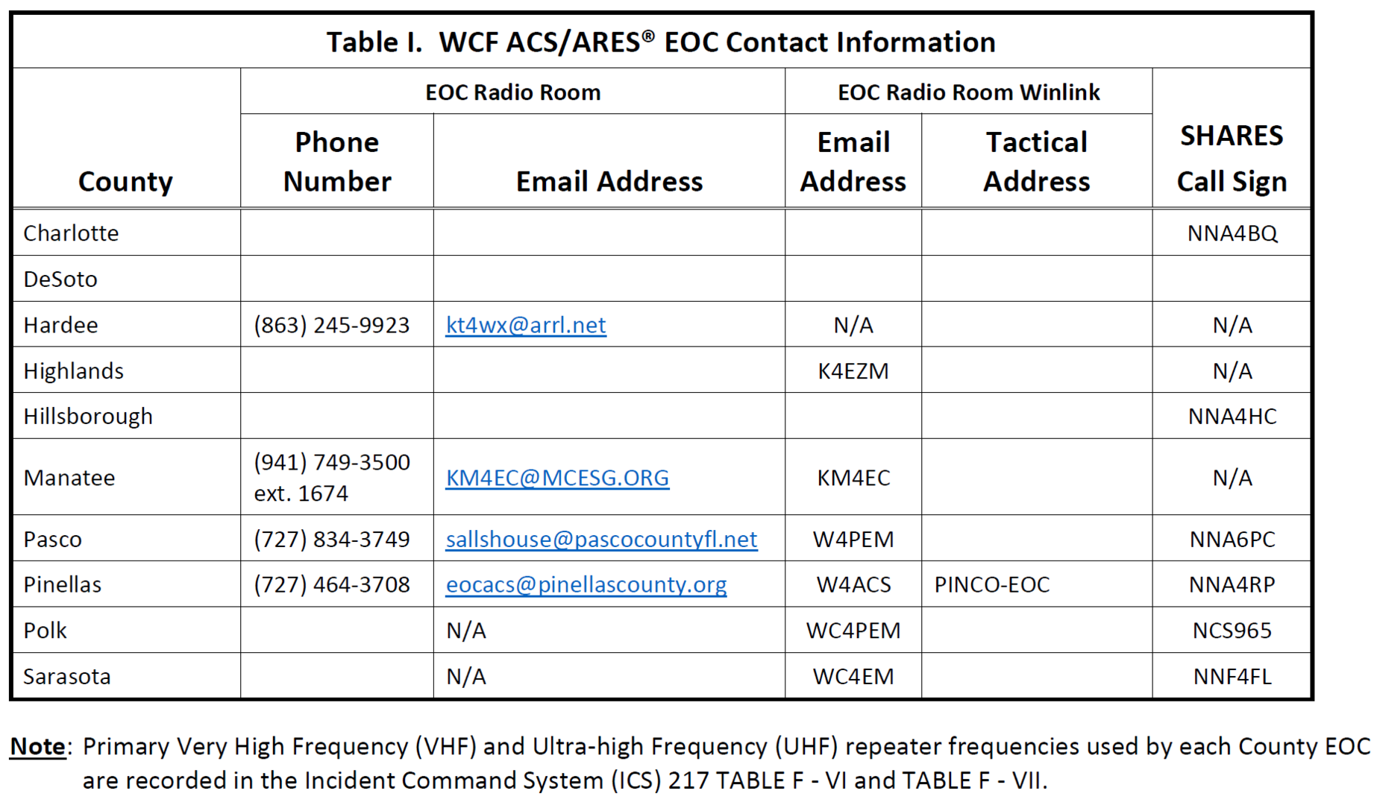
WCF ARES EMCOMM Plan

Slide 10
WCF ARES EMCOMM Plan
EMCOMM Plan exists to support the ECs.
Information you need during emergencies
We welcome suggestions
Battle Rhythm – Publish update every 6 months.

Slide 11
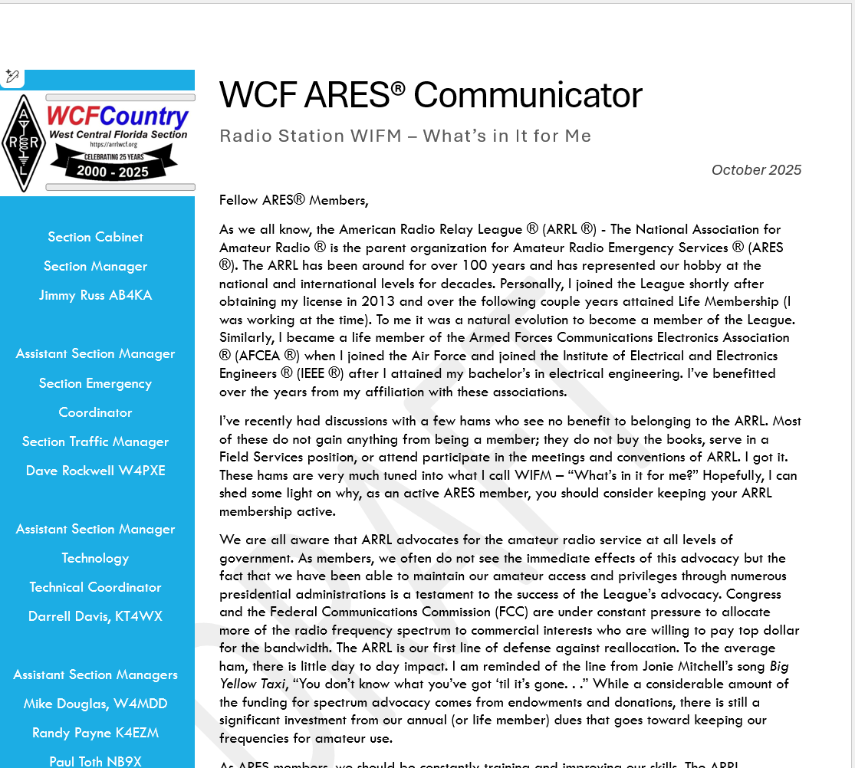
WCF ARES Communicator
Monthly newsletter covering a topic of general interest – Suggestions welcome, looking for guest authors/editors
Monthly report to ARRL from the previous month is attached – Need more input from the counties
Hoping to add a section on upcoming events and one showcasing member activities

Slide 12
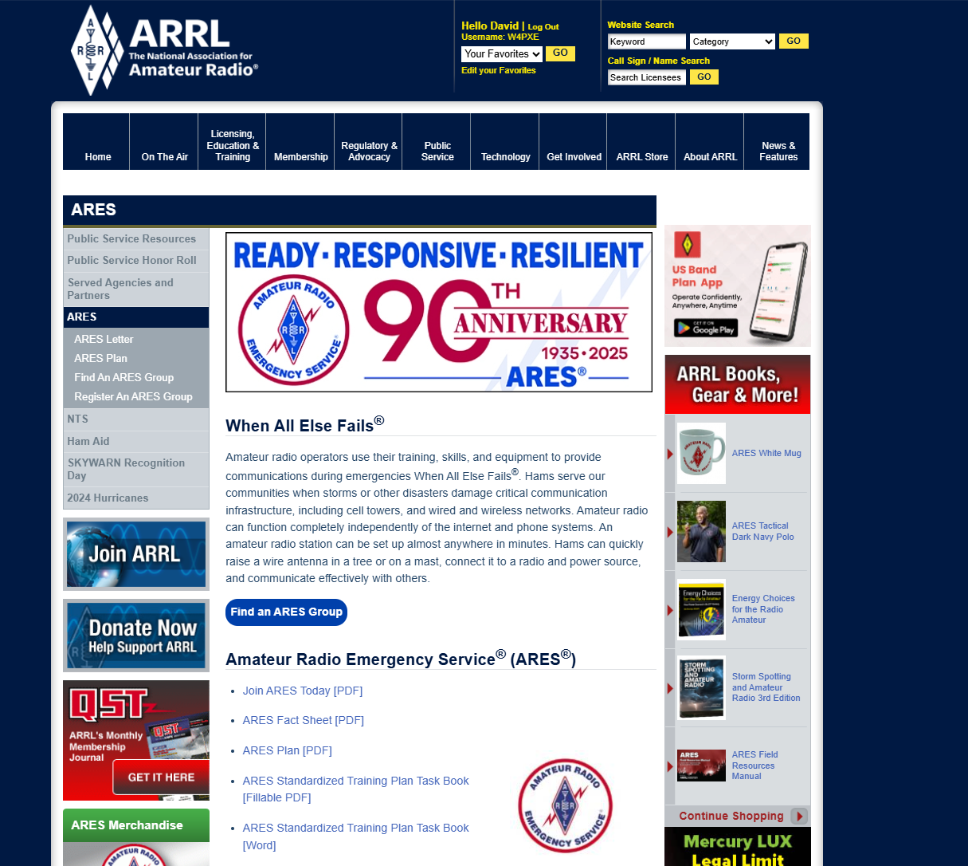
ARRL ARES Website
Check out the new
Find an ARES Group
Make sure you register
your group on the page
Hams looking for ARES
groups will get a map
showing all the groups
centered around the
ZIP code.

Slide 13
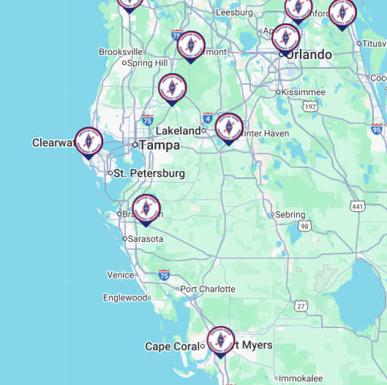
Find an ARES Group Map

Slide 14
County Initiatives
Any interesting best practices?
Guests?
Charlotte | Manatee
DeSoto | Pasco
Hardee | Pinellas
Highland | Polk
Hillsborough | Sarasota

Slide 15
Open Discussion

Slide 16
Next Meeting
Tampa Bay Hamfest – Dec 13, 2:00 PM
Hope to have as many as possible.

Slide 17
Adjourn

