Slide 1
LINUX FOR AMATEUR RADIO
A BRIEF INTRODUCTION
Lee Boulineau
KX4TT

Slide 2
What is an Operating System?
Manages Hardware access and coordination
Manages both physical and virtual memory
Manages Graphics Service
Manages data flow between hardware – data bus management
Manages User Environments
Desktop Environments
Shells
Can be Graphical or Text-Only)
A Graphical User Interface is a Shell
Linux has GNOME, KDE, UNITY, MATE and others

Slide 3
Common Operating Systems
Windows
Shared memory spaces
Error in a shared memory space can lock up multiple apps
Can be very insecure – hackable!!
UNIX-Like
Monolithic – Directly controlled by the kernel
Separate memory spaces for each process
This includes Linux
AIX/BSD are other OSes you may have heard of (UNIX)

Slide 4
What is Linux?
It depends on what you are talking about and who you are talking to!!
Kernel
Distro
GNU/Linux

Slide 5
What is a Linux kernel?
Linux kernel = the core part of the Linux OS that provides interfacing between software and hardware, managing the CPU, management and sorting of memory, and provision of basic services.
Windows has a kernel (the Windows NT kernel).
Yes, there is a Windows Subsystem for Linux, but it is not a kernel. It is a compatibility layer that acts as an interface between Linux executables and the Windows NT kernel (and therefore, the hardware and peripherals).
Android uses a modified Linux kernel.

Slide 6
What is a Linux Distro?
A Linux distro is a complete operating system, just like Windows, UNIX, MacOS, iOS and Android.
Has a kernel, user environments, shells, GUIs
Android is a Linux-based system, but the kernel is modified……….so is it a Linux distro? You can't generally run Linux apps on Android and vice versa…..
MacOS & iOS use some similar functions as Linux as they have a lot of code derived by BSD and Linux, but are not Linux.
Linux and Unix are not the same Operating System, but tend to follow similar command structures.

Slide 7
What is GNU/Linux?
It's an operating system plus applications – like the Ubuntu Distro shown on the next slide………….
So – it is a Linux OS distro plus additional productivity, graphics, game, and entertainment packages
When you hear that someone has Ubuntu, Red Hat, or Mint on their computer, this is usually what they are referencing.
Most Linux distros are really GNU/Linux distros.

Slide 8
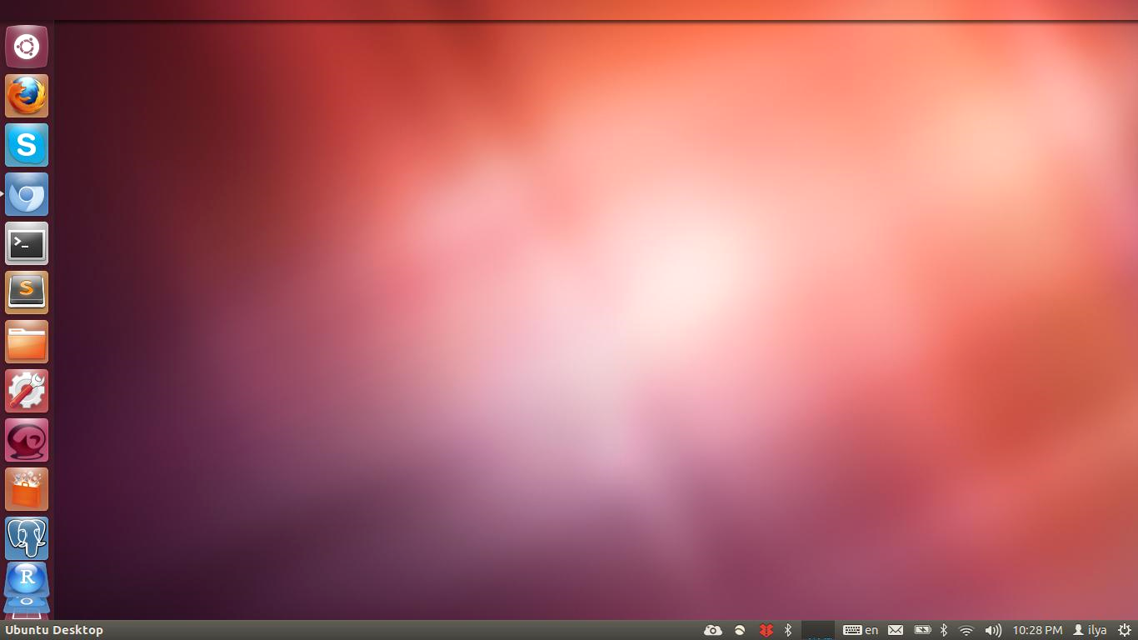
What is GNU/Linux?
It's an operating system plus applications – like this Ubuntu Distro shown here!!!
So – it is a Linux OS distro plus additional productivity, graphics, game, and entertainment packages – like the Firefox and Skype apps seen on this GNOME desktop.
When you hear that someone has Ubuntu, Red Hat, or Mint on their computer, this is usually what they are referencing.
Most Linux distros are really GNU/Linux distros.

Slide 9
Brief History of Linux
By 1990 – you had UNIX (AT&T) and BSD (Unix-like)
AT&T wanted to commercialize Unix in the 80s– big $$$$
Lawsuit by USL (who bought AT&T UNIX) against BSD
Linux went through lawsuits in early 2000s
Linus Torvalds – started writing the kernel in the early 90s.
Started with MINIX – a Mini-UNIX
Richard Stallman - Free Software Foundation.
C Compiler – still the Gold Standard
Started writing a UNIX-like OS (GNU Project)
Open Source Development Labs - became Linux Foundation
Free Standards Group – Developed open source standard
Linux Foundation – Merger of the two groups in 2007

Slide 10
Why not UNIX?? Or BSD?
UNIX was Proprietary – AT&T Bell Labs,then USL, then Novell
Xenix (a Microsoft, and later SCO port of UNIX to the Intel 8086/80286 series of processors) was expensive – and end users often had to buy Windows for Xenix to get a GUI for the non-techies
Lawsuits abounded over the use of UNIX code
USL vs. BSD, Novell vs. Linux
BSD lawsuit left cloud of possible legal trouble
BSD didn't require open-source posting of kernel code (no GPL license)
Since BSD was written by small set of developers, it discouraged crowd-sourced innovations – unlike Linux

Slide 11
So – Why use Linux over Windows??
Again, It depends!!
Many Flavors (Distros) means Many Choices
Portable – can be ported onto other hardware
Powerful – less load on CPU when configured properly
Flexible – doesn't need the fastest or latest hardware
Allows you more control over most aspects of the OS
Secure – IF YOU STAY OUT OF ROOT!!
Most Distros are Free

Slide 12
Why use Linux as a Ham Radio OS?
Many of the same reasons as using it for everyday computing
Ready-Made Programs for Amateur Radio
Fldigi – PSK/RTTY/Digital modes
WSJT-X – FT4/FT8/MSK144
Xlog – Logging
Gpredict – Satellites
RTLSDR – SDR controller
Many general use programs – Browsers, e-mail, Office, A/V
Compatibility Layers that will run some Windows programs (WINE)
KB1OIQ has a Ham Radio Linux GNU/Distro!
AB0VI, ON4AA, and our own K2LYV use Linux in amateur radio
HamOS – Debian-based Linux distro for amateur radio

Slide 13
Flavors of Linux – Hardware is important
There are lots of different Distros of Linux
You must evaluate your hardware before choosing one!!
Ubuntu 19.10 needs 2 Ghz dual-core CPU / 4 Gb RAM
The standard GNOME Desktop can be a power hog
You can change over to Unity or LXDE (see below) to save power.
With an older system, Lubuntu will work with 256 Mb (likes 512 Mb)
The LXDE Desktop is also lighter on the CPU.
Other lightweight distros are Xubuntu, Linux Lite, Puppy Linux
These releases can breathe new life into an old computer
This is even more critical with single-board computers!

Slide 14
Flavors of Linux – .rpm and .deb
Different Package Management Systems (Installers)
Most Flavors of Linux use one of these two systems
.rpm - originally used in Red Hat Linux
Now used in Fedora/CentOS/SUSE
yum, apt-rpm, Smart Package Manager make software installs easier
.deb - Many Linux Distros are based on Debian
Ubuntu, PureOS, Lubuntu, Xubuntu, Kubuntu, Mint
apt - Advanced Packaging Tool is the .deb equivalent to yum
apt-get will be used a lot (or sudo apt-get; hang around for K2LYV!!)
There are other managers used, like pacman and portage
Slightly different commands, but similar properties

Slide 15
Flavors of Linux – .rpm and .deb Part 2
Command examples for .rpm and .deb
Installing Xlog in an .rpm system
yum install Xlog (if in a repository)
yum localinstall Xlog (if on the local machine)
Installing Xlog in an .deb system
apt-get install Xlog (if in a repository or on the local machine)
sudo may be required depending on your login
Since the commands differ between them, it may be wise to stiff to Distros using the same manager for all systems.
For instance, you may wish to use Ubuntu on your desktop if you plan on using Raspbian on a Raspberry Pi………………

Slide 16
Flavors of Linux – Desktops
You can change out Desktop Environments through your Package Manager
GNOME
Part of Ubuntu Distro
A bit of a resource Hog
KDE
Part of Kubuntu
Also a bit of a resource hog
Trinity
Very Windows-like in appearance
MATE and XFCE – use less resources than GNOME/KDE

Slide 17
GNOME – PART OF THE UBUNTU GNU/LINUX DISTRO

Slide 18
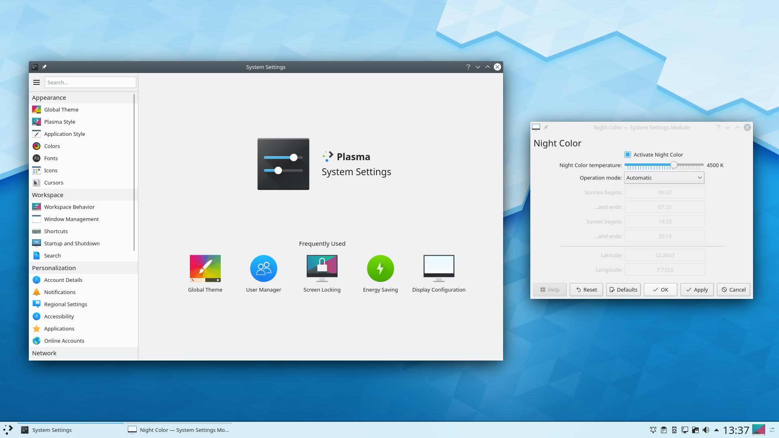
KDE – PART OF THE KUBUNTU GNU/LINUX DISTRO

Slide 19
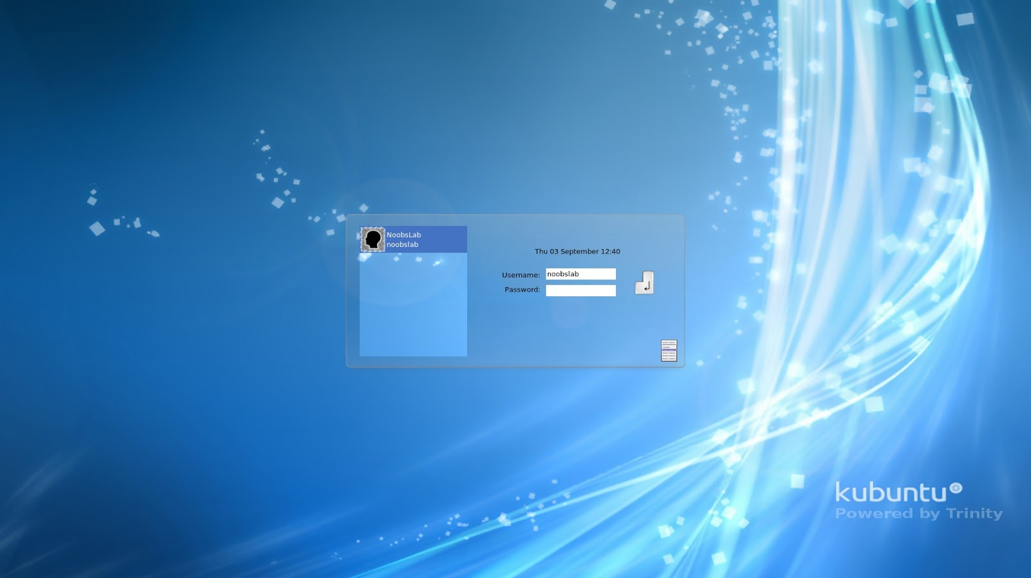
TRINITY DESKTOP – VERY TRADITIONAL APPEARANCE

Slide 20
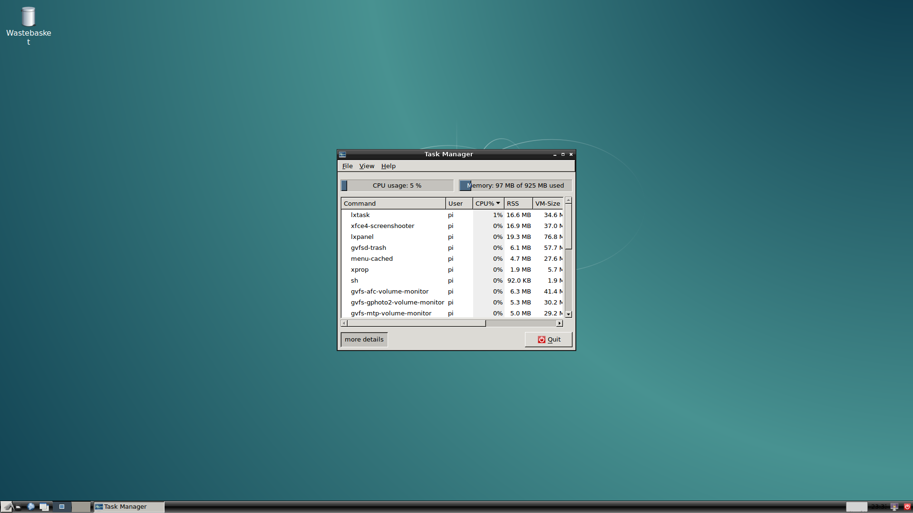
MATE – USES LESS RESOURCES THAN GNOME

Slide 21
Portability – Single Board Computers
Raspberry Pi – has Raspbian as the basic Linux OS
Other Linux Operating Systems available
Ubuntu Mate, Snappy Ubuntu Core, OpenELEC
RaspBSD – not Linux, but very similar (BSD-based)
ARM-based platforms (Android Phones often use these)
Pine A64 series ,Odroid Arduino Portenta – ARM Cortex
BeagleBoard – uses TI ARM-based CPU
Other CPU platforms – Atmel Atmega (32-bit)
Ported onto Chromebooks / Kindle readers / Android Phones

Slide 22
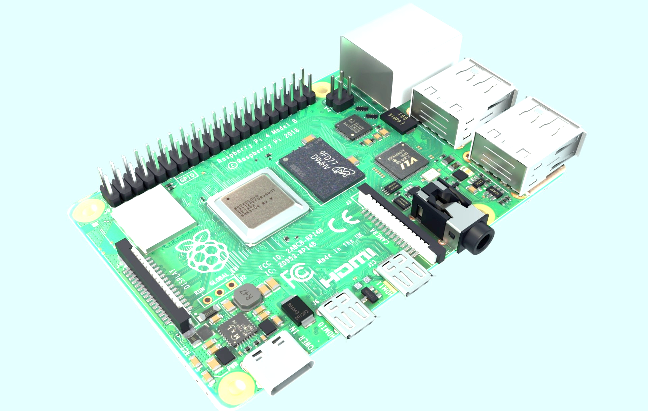
Raspberry Pi 4

Slide 23
SO – YOU WANT TO TRY LINUX OUT !! TRY BEFORE YOU BUY!!!!
OLDER SYSTEMS – REPLACING XP, FOR INSTANCE
Example - Pentium or Celeron G Series and 1-2 Gb RAM
Lubuntu will run nicely on this kind of hardware
Uses LXDE Desktop – less power required than GNOME or KDE
Gotchas
Using high-requirement apps
Ex – Google Chrome may strain things a bit
Midori is a example of a nice lightweight web browser
When installing apps, especially on older hardware, pay attention to the dependencies – they can add up to a large chunk of CPU power and/or memory
Other Linux Distros for old hardware
Linux Lite, Peppermint, Bodhi, Puppy Linux

Slide 24
TRYING LINUX OUT PART 2
MORE MODERN SYSTEM – UBUNTU IS A GOOD CHOICE
Trying it out without installing on your hard drive
https://tutorials.ubuntu.com/tutorial/try-ubuntu-before-you-install#0
Has options for burning a DVD or a bootable USB stick
DOES NOT AFFECT EXISTING OPERATING SYSTEMS IF YOU PAY ATTENTION
DVD option – Gotchas
Not burning the drive correctly- must use a .iso burner
ISO Recorder is good for this and is freeware
Bootable USB - Gotchas
Not configuring as Bootable!

Slide 25
QUESTIONS???
ASK K2LYV ;-)

