Slide 1
Remote Operation with RemoteHams.com
Luis V. Romero – W4LT
WCF Technical Conference 2016

Slide 2
Overview
What is RemoteHams
What Software is needed
The Client
The Server
What hardware is needed
Setting it up (With a TS590)
Live Demonstration

Slide 3
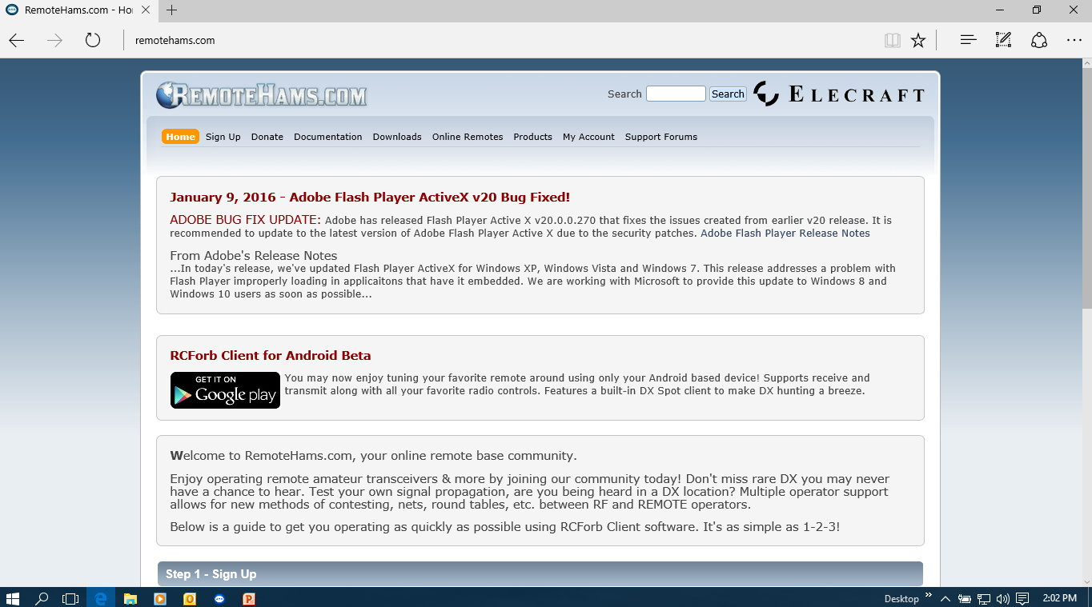
What is RemoteHams.com
“Open Source” project providing software to enable remote station ops.

Slide 4
What is RemoteHams.com
The Client (that runs on the computer you want to use as the remote)
The Server (that runs on the computer that is connected to the radio)
RCForb_Client_nnn.nnnn.exe
RCForb_Server_nnn.nnnn.exe

Slide 5
What is RemoteHams.com
Computer requirement for Client:
Windows XP, Vista, 7, 8, 10
.NET Framework 4.0
Adobe Flash Player Active X
1.0 GHz CPU minimum
1GB RAM minimum
Sound Card for audio
Headset/microphone for SSB
256kbps internet connection

Slide 6
What is RemoteHams.com
Computer requirement for Server:
Windows XP, Vista, 7, 8, 10
.NET Framework 4.0
1.0 GHz Dual Core CPU (or better!)
1GB RAM (if only running this application)
256kbps internet connection

Slide 7
What is RemoteHams.com
Computer requirement for Server:
Windows XP, Vista, 7, 8, 10
.NET Framework 4.0
1.0 GHz Dual Core CPU (or better!)
1GB RAM (if only running this application)
256kbps internet connection
I recommend a Dual Core machine as a minimum for
good overhead if running remote access and configuration
software (Like Team Viewer, anti-virus and other handy utilities).
Starving the software of memory and processor will lead to sluggish
tuning and audio stuttering… always a bad thing!

Slide 8
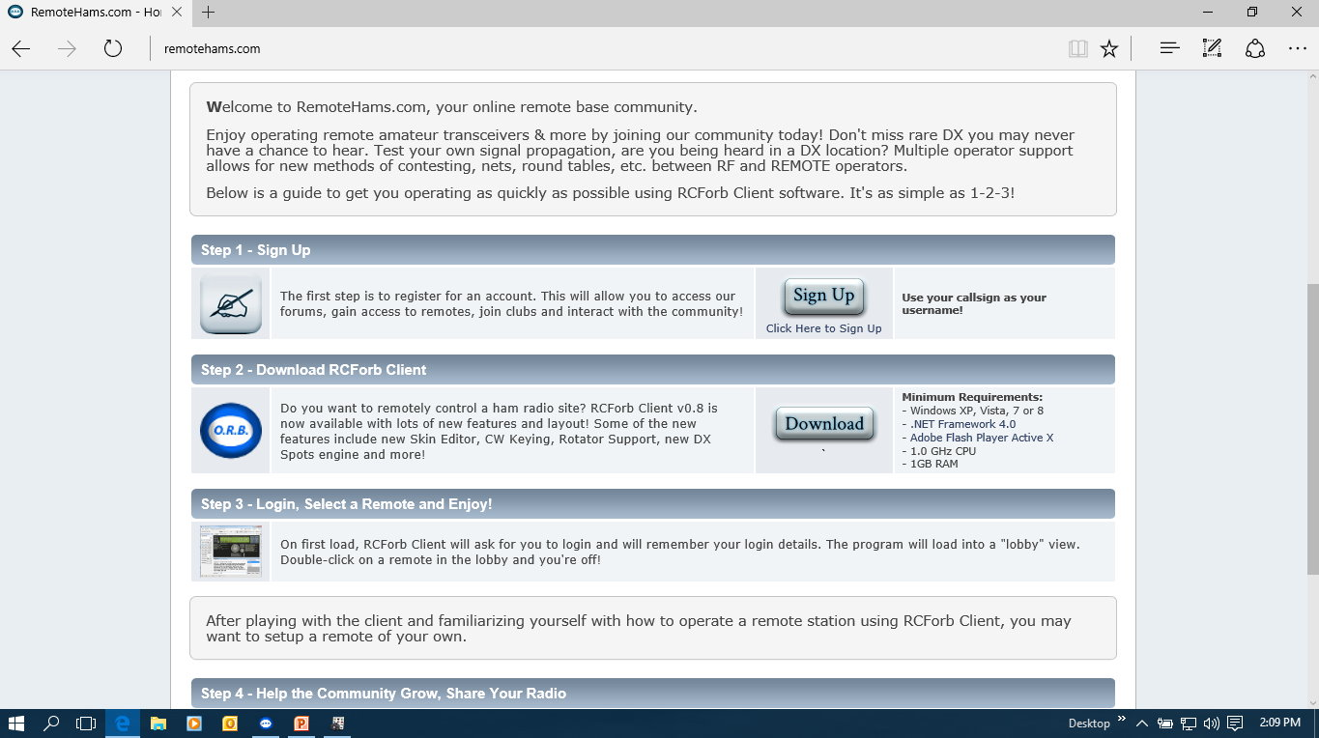
Downloading the Client
To get started: Join the group
Download the client first

Slide 9
RemoteHams.com Client
The client allows:
Connecting to the remote bases on the system
Manage audio from the radio and microphone to the radio in SSB/Digital
Manage sending and receiving CW via the computer keyboard
Display a virtual radio front panel on your computer monitor, tune and adjust the transceiver controls

Slide 10
License issues
The system will require you supply your Amateur license via upload
This will allow owners of the remote bases to ascertain if you are a “real” licensed ham
Either scan your existing license, take a photo of it, or download a copy from the FCC ULS website
“ORIGINAL” ULS versions only!

Slide 11
License issues
An Original license from the ULS Says that it is an OFFICIAL COPY.
REFERENCE COPIES can be downloaded by anyone.
See the ULS instructions or the ARRL website for information on how to download an OFFICIAL COPY of your Amateur radio license

Slide 12
License issues
You don’t need a license to only listen
Want to transmit? Ask for permission
Each owner decides who will or will not be allowed to transmit on his station
Each station owner is responsible for license verification
Some stations require club membership to operate
License legality is your responsibility in the case of foreign stations

Slide 13
Using RemoteHams.com
Sign up for the support forums

Slide 14
Using RemoteHams.com
There really is no operations manual
The forums are the place to ask questions and learn how to use the software
The software is rapidly evolving, so it pays to monitor the forums
The principal developers monitor the forum and are very responsive.

Slide 15
Setting up your Radio
Download the SERVER software
Run the executable on your computer
Configure your Audio parameters
Open ports on your router as follows:
TCP 843
TCP 4524
TCP 4525

Slide 16
Setting up your Radio
Configure your radio and control ports
Add the information you want to present to the internet in the Publishing tab
Rock and Roll! You are online! Its that easy!

Slide 17
And now: The Live Demo!
Lets see how to access stations with a live demo on the internet.
Lets take a look first as to how configure your client
Then, if there is time and interest, I can show how to configure the server remotely

Slide 18
Remote Operation with RemoteHams.com
LIVE DEMO
GOES HERE!

Slide 19
Remote Operation with RemoteHams.com
Luis V. Romero – W4LT
WCF Technical Conference 2016
Thanks for your Attention.
Questions? W4LT@IJ.net

