Slide 1
All About NXDN
In West Central Florida

Slide 2
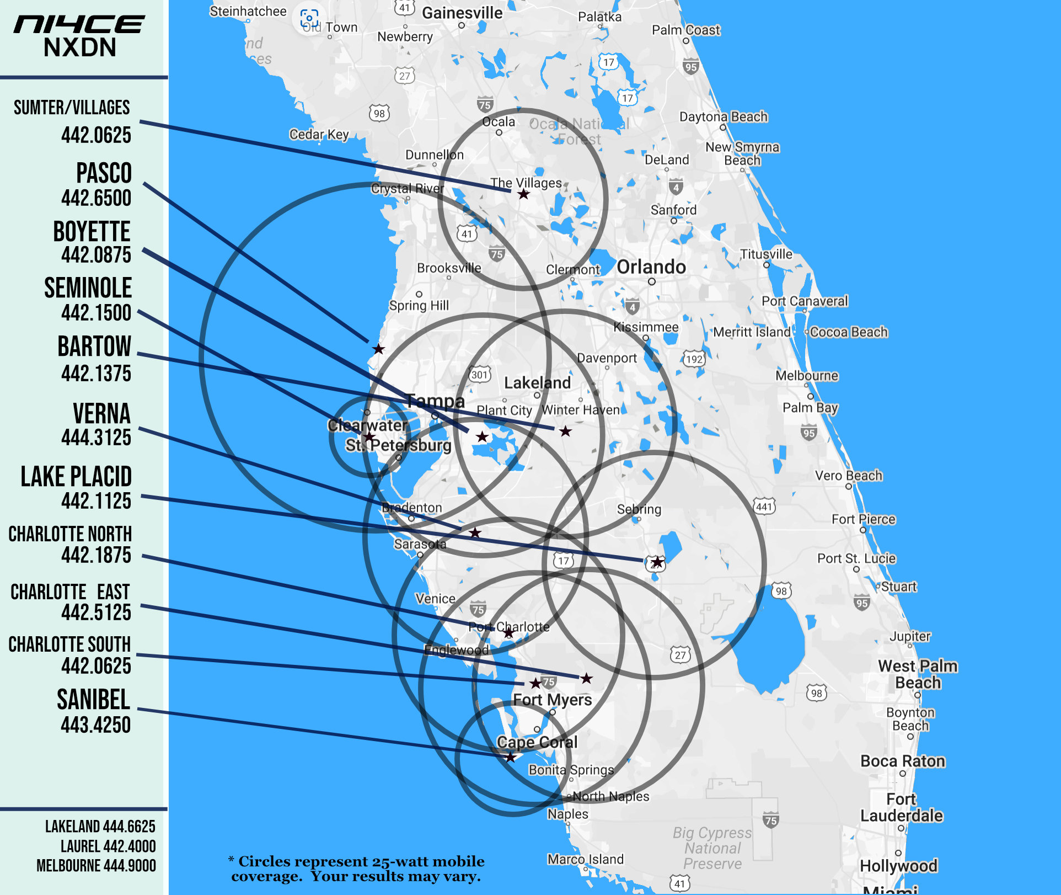

Slide 3
WHAT IS NXDN?
Ultra Narrowband Digital Mode - 6.25 KHz
FDMA Modulation for Clear Audio and Data Streaming
Supports Multiple Talkgroups for Optimal Channel Utilization

Slide 4
Superior Weak Signal Performance
Decodes digital stream down to -116 dBm
Decodes clear, easy to understand audio when Analog is noise
Optimal for use INSIDE well constructed structures
Works equally well in repeated and simplex modes

Slide 5
NXDN RADIOS
FIRST Generation since 2005
No Over-The-Air Alias
No Talkgroup Scanning with SELective Squelch
Limited Text Messaging

Slide 6
NXDN RADIOS
SECOND Generation Radios Since 2015
Supports Over-The-Air-Alias (Transmit your FCC Callsign)
Supports Talkgroup Scanning in SELective Mode (RX Group)
100 character Text Messaging

Slide 7
ICOM vs JVC-KENWOOD
CONVENTIONAL VOICE COMPATIBILITY
PROPRIETARY TEXT MESSAGING - No Bridge to Translate one format to the other
OTHER PROPRIETARY FEATURES

Slide 8
WHERE CAN I PURCHASE A NXDN RADIO?
NXDN is a Part 90 Land Mobile Radio Product
ICOM and JVC-Kenwood LMR Dealers are primary suppliers
The Internet
Traditional Amateur Radio Dealers???

Slide 9
Amateur vs LMR Hardware
AMATEUR
LMR
Amateur Frequencies ONLY
Often 430-450 MHz (not the entire band)
Technical Specs not as refined
Includes ENTIRE Amateur Radio Band
Includes FRS-GMRS Frequencies
Includes Part 90 Band (for EmComm)
Better Technical Specifications means Better Performance
Not prohibitively expensive

Slide 10
NXDN Radios
Low Split Portables and Mobiles (400-470 MHz)
ICOM F6130D is an ALL BAND Mobile (400-512 MHz)
WBFM Analog Option Available on some radios
All NXDN Radios Can Operate In Analog Mode
After market Antennas Offer Little to No Advantage
Look at Wide-Band Antennas (400-500 MHz)
Multi-polarized and Circular Polarized (CP) offer BEST Performance

Slide 11
OPERATING TIPS
Announce Yourself with Callsign AND Talkgroup
Use TG 1200 as a Calling TG
Use TG-1 when you are using a Single Repeater
BUSY LOCKOUT

Slide 12
The ni4ce NXDN Network is Radio Over IP not Voice Over IP

Slide 13
WEST CENTRAL FLORIDA TALKGROUPS
1 – LOCAL to each Repeater
1200 – FLORIDA
1201 – West Central FL
1215 – SW Florida (S. Sarasota, DeSoto, Charlotte & Lee Co)
1230 to 1233 – TACTICAL On Demand Talkgroups
1299 – NWS Ruskin SKYWARN

Slide 14
FUTURE ni4ce IMPROVEMENTS
VOTE SCAN (Channel Steering based on RSSI)
A more ROBUST Infrastructure
GPS Signaling Ported to APRS

Slide 15
NXDN CONTACTS
Paul Toth-NB9X
ptoth1@tampabay.rr.com
Tom Chance-K9XV
k9xv0829@comcast.net

