Slide 1
EMP Proof Communications in the Age of Putin
Gordon L. Gibby MD
KX4Z NCS521 NND4FL

Slide 2
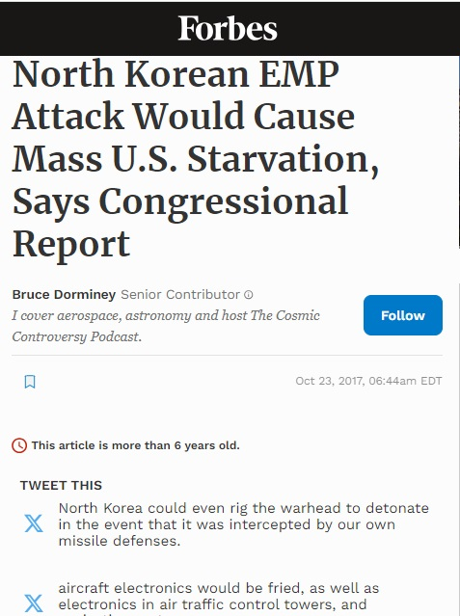
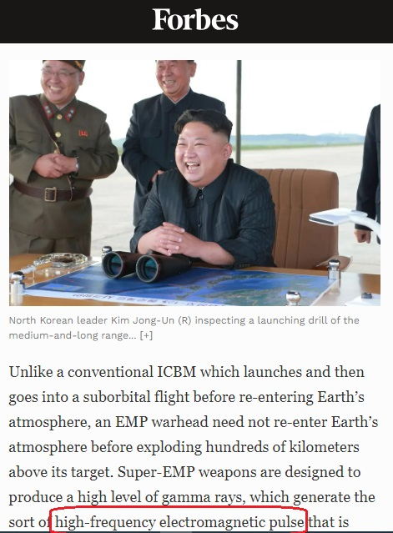
One dictator after another...

Slide 3
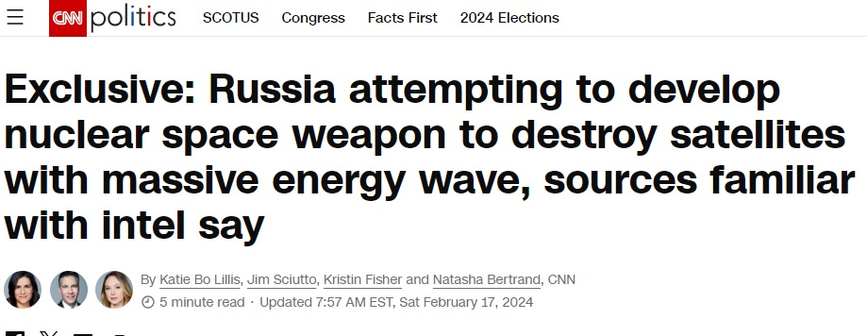
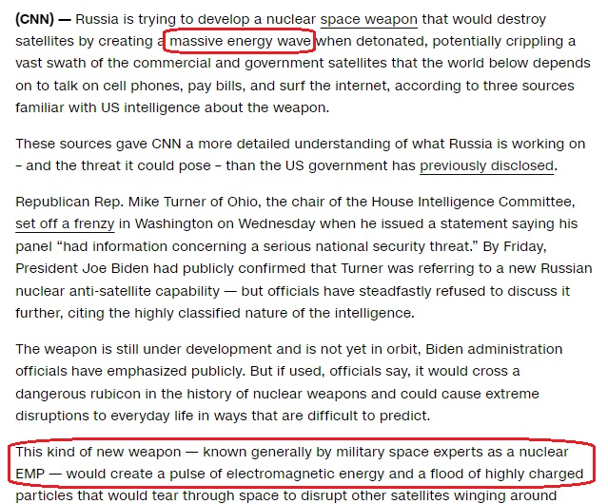

Slide 4
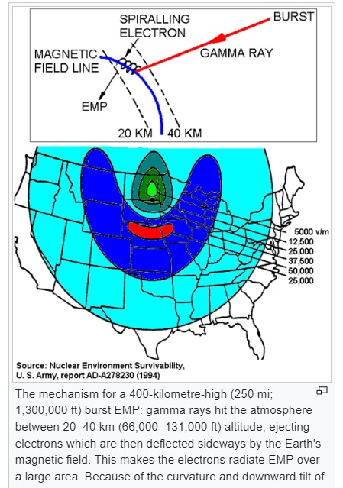
10-25 kV/m E Field (nano sec)
REF: https://en.wikipedia.org/wiki/Nuclear_electromagnetic_pulse

Slide 5
Test Waveforms
“Advanced Fast Electromagnetic Pulse System (AFEMPS): A 3.5 MW pulser combined with a wire-spread antenna system provides system level testing and meets MIL-STD-2169B Early-Time HEMP Waveform”
“Vertical EMP Facility (VEMP): A VEMP using a 2.0 MW pulser is being developed to provide the Early-Time HEMP Waveform and is scheduled to be operational no earlier than January 2013.”
https://www.wsmr.army.mil/tc/test/svc/neee/eme.html

Slide 6
What role do community Hams play?
Often Subject Matter Experts to assist community professionals.
Recommend mitigation techniques commensurate with resources and balancing risks.
(Rare but extremely damaging vs much more common storms)

Slide 7
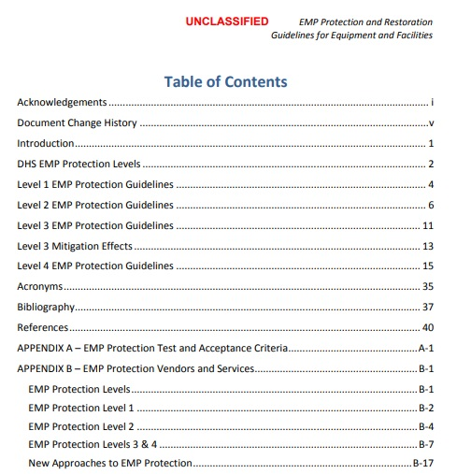
Refer to 2016 DHS Recommendations
Graded series of “protection levels” – assist local authorities to recognize potential to get to higher levels.

Slide 8
Defensive Strategies
Bandwidth limitation: by limiting bandwidth, total energy is limited. (Our antenna systems naturally do this)
Voltage Clamping: by gracefully arcing or active voltage clamping, limit the energy delivered to delicate circuits
Limit aperture exposed to E-field (shorten wires, or SHIELD; extreme example is Faraday Cage)

Slide 9
Voltage Clamping
Coax cables will arc. ? re-usable?
Lightning arresters may add protection, particularly if bandwidth limitations have slowed down the “pulse”
Gas-discharge tubes (low pressure gas) are standard protection, available in multiple voltages. Standard device in ham radio lightning arrestors
ESD diode protection
Capacitive bandwidth limitation

Slide 10
Receiver Protection
Large number of receivers, from homebrew QRP rigs to $$$ commercial radios include diode protection of receiver inputs
Bandpass filters dramatically reduce incident energy (but may be damaged)

Slide 11
Accessory Protection
CMOS device protection – example keyer chip
Utilize additional MOSFETs to absorb energy
LIMITED ability
Consider adding additional protection. Zeners, diodes, etc

Slide 12
TRANSMITTERS
Appear much more difficult to protect.
Must produce significant AC voltages (e.g 50-400 VAC)
SWR can raise voltages significantly
Difficult to set protective level guaranteed to protect
Solid State transistor design may be close to limits of device!
Transistor finals susceptible even to SWR damage (excess voltage/current) – what will 25kV do to them???

Slide 13
Devices with natural protection
VACUUM TUBES
Arcs actually common in transmitting tubes.
Actually remove unwanted gases.
Tubes generally unharmed (worry more about power supplies)

Slide 14
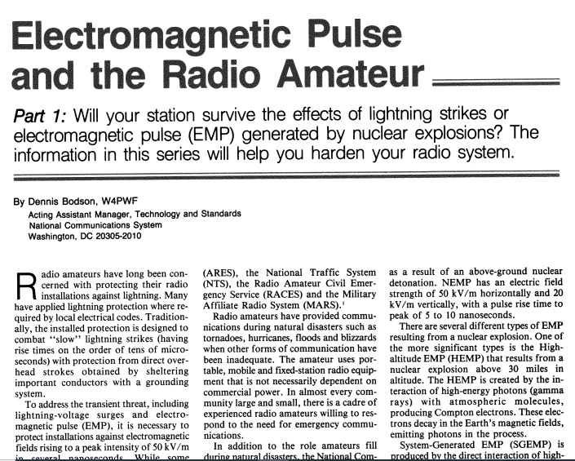
QST published government study
REF: https://qsl.net/kx4z/QST-Electromagnetic_Pulse_and_the_Radio_Amateur.pdf

Slide 15
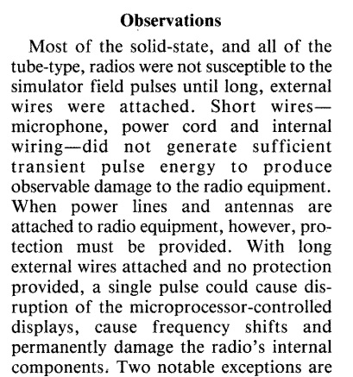
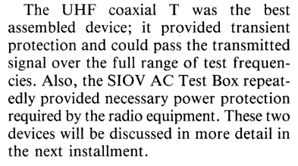
Resilience

Slide 16
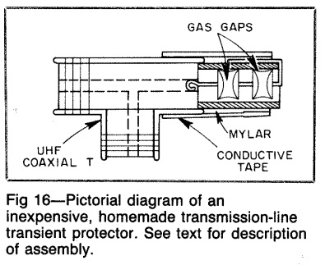
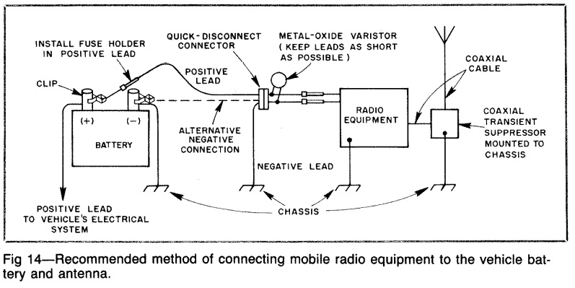
Reasonable Protective Solutions

Slide 17
Goal: Dissipate arriving energy
EOC facilities provide some SHIELDING due to re-bar
Main concern are arriving antenna cables and power cables
Protect antenna lines with 1:1 chokes / gas discharge tubes
Protect power cables with MOV / dual-stage UPS, voltage disconnect limits.

Slide 18
Resilient Gear
Manual antenna tuners with air wound inductors (impervious)
Manual antenna tuners with air-variable caps – voltage limiters!
Vacuum tube amplifiers – resilient
Vacuum tube transceivers – resilient
Hybrid radios – can be made resilient with protection of receiver (Kenwood TS-520 etc)
Not that difficult to protect gear if thought given.

Slide 19
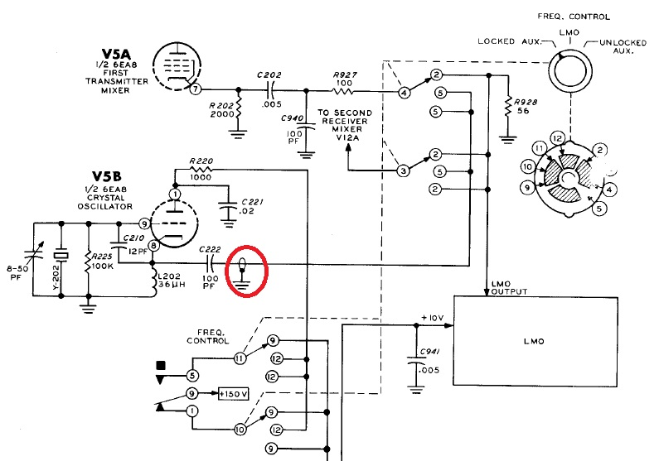
Easy to inject computer controlled signals
External VFO into SB series
(Similar solutions for HW series)

Slide 20
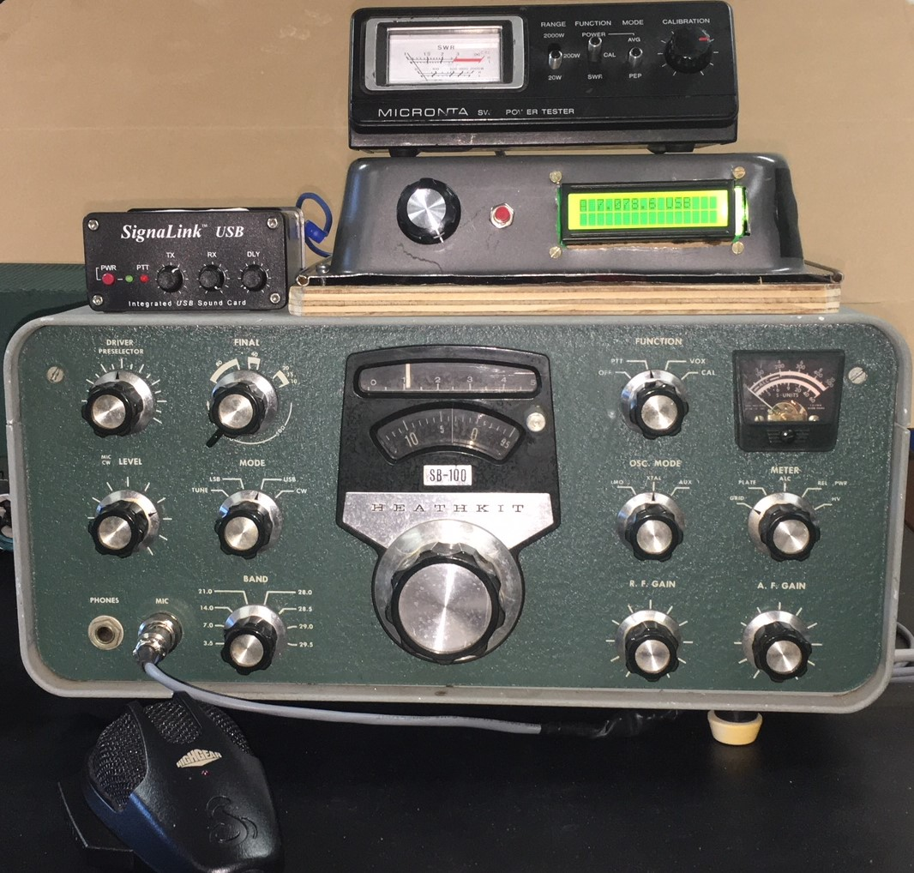
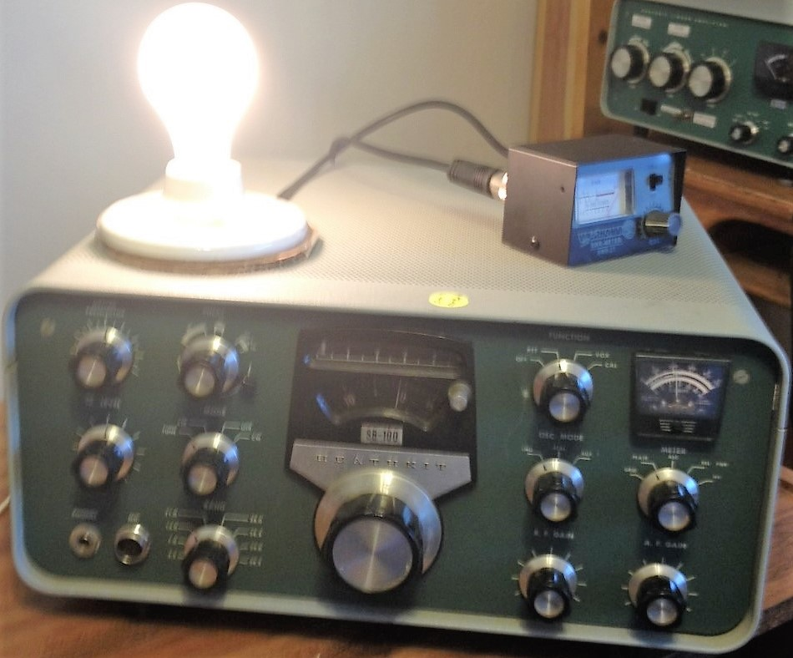
External digital VFO

Slide 21
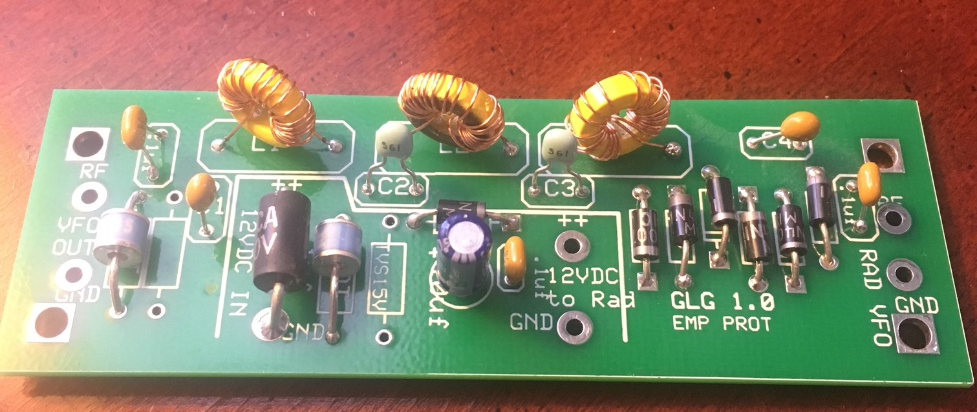
EMP protection to accessory

Slide 22
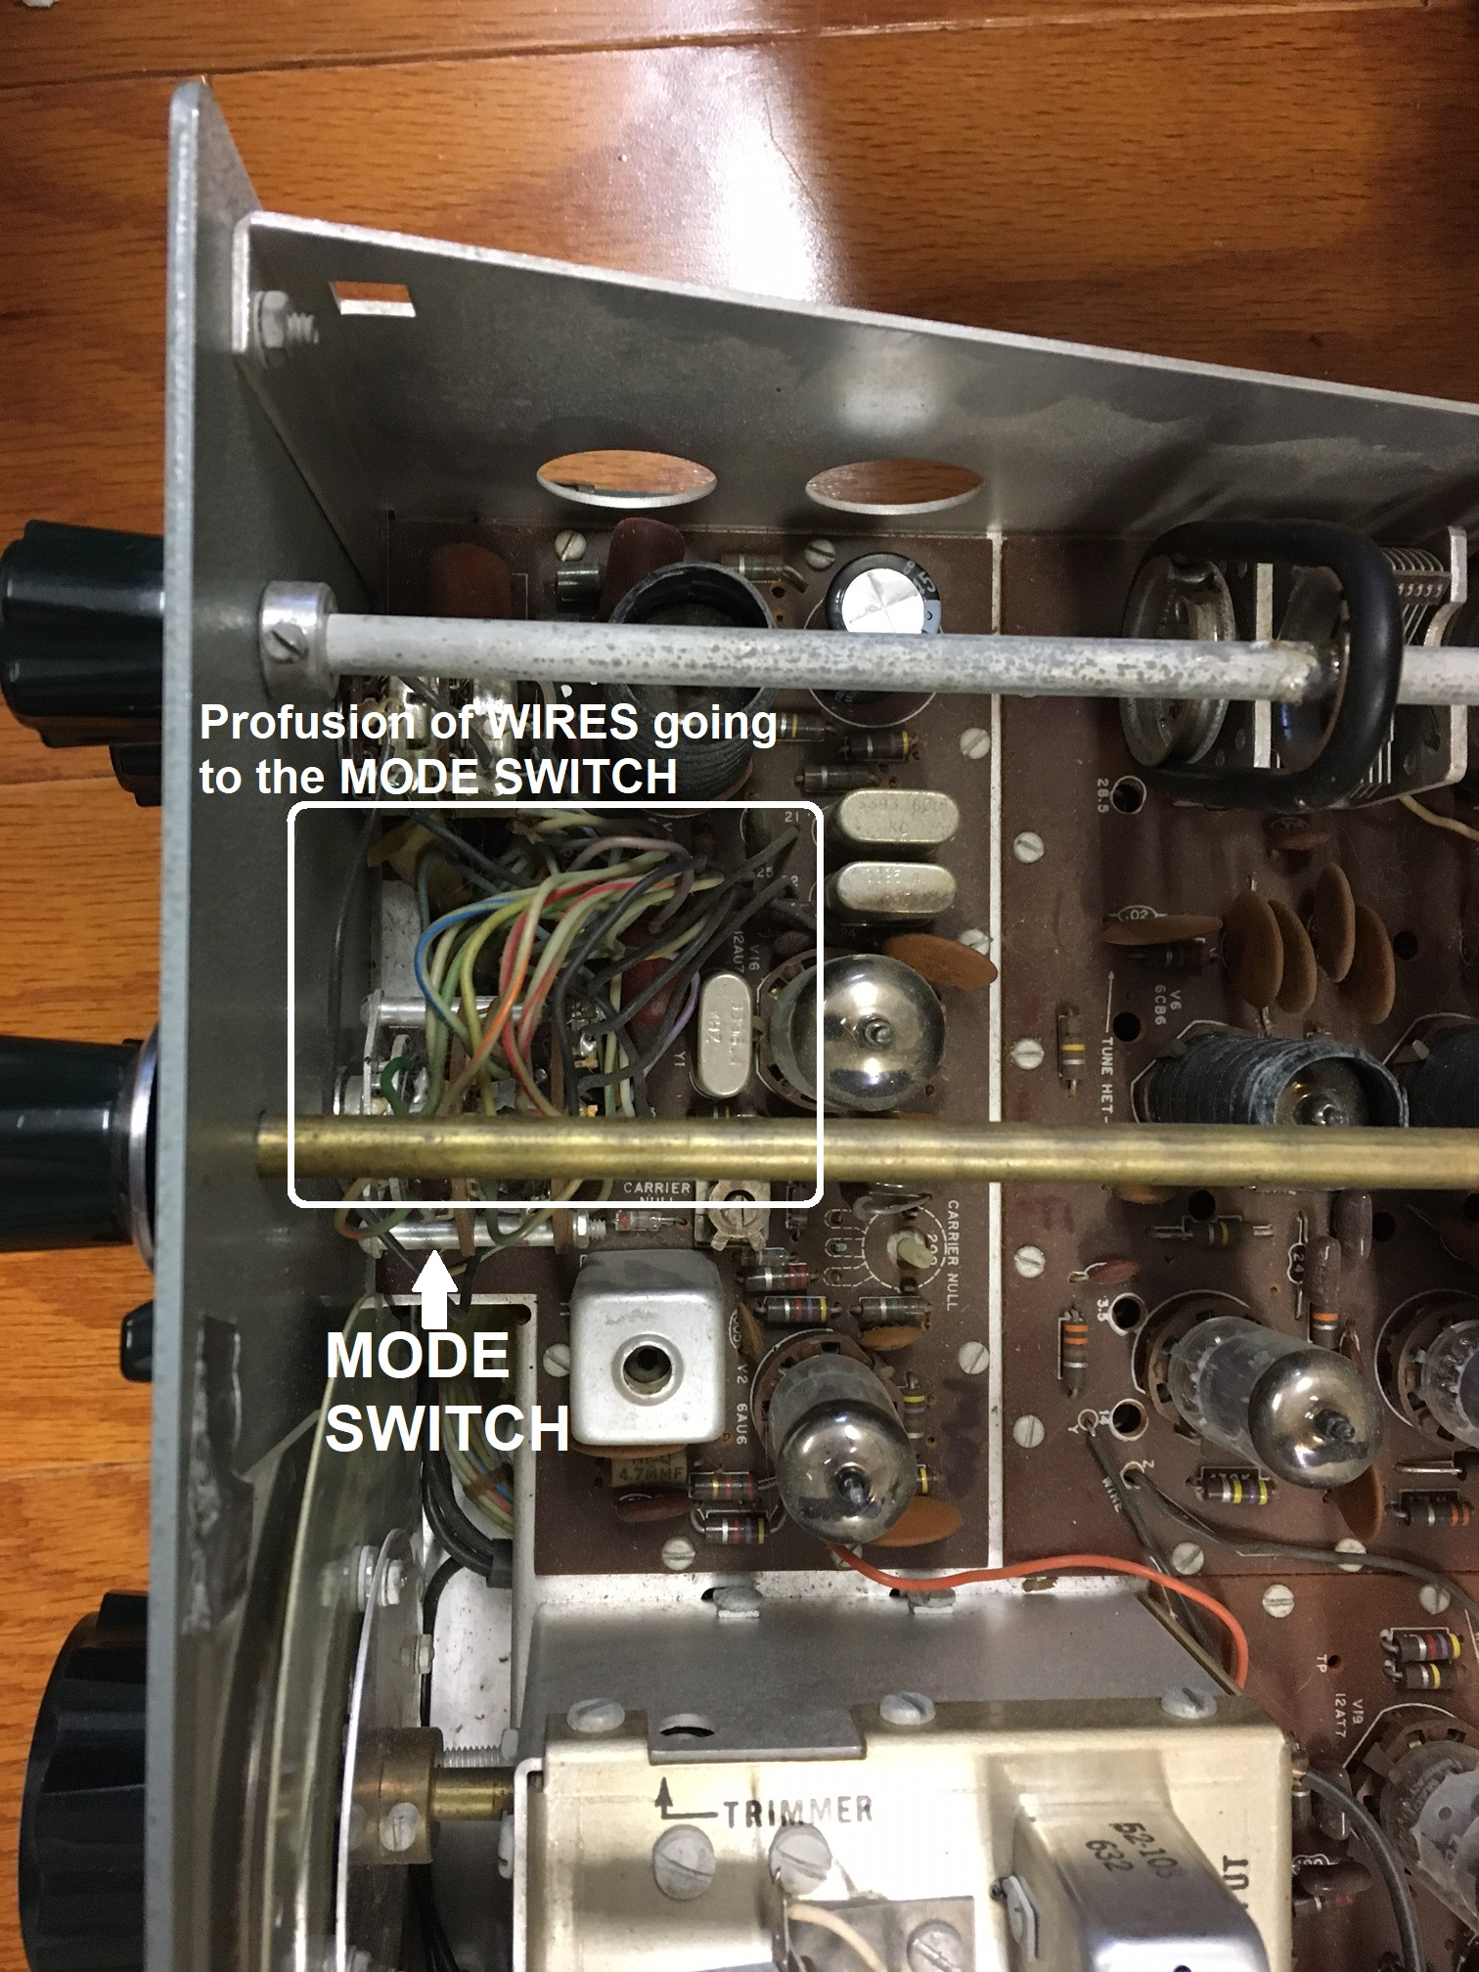
Irreplaceable Rotary Switch: MODE
Modern microprocessor-controlled radios make multiple configuration changes via multiple microprocessor outputs, adjusting filters, connecting signal paths, switching power voltages.
Older non-computer radios accomplished these type controls via complex rotary switches / relays.
The Heathkit MODE switch is irreplaceable, with multiple wafers, each front & rear, and complex custom logic. Corrosion and physical damage eventually make these switches unreliable.

Slide 23
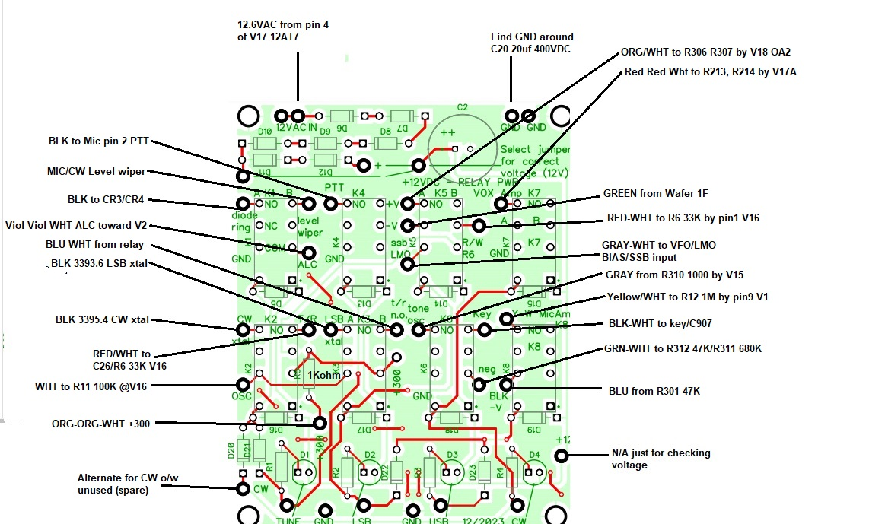
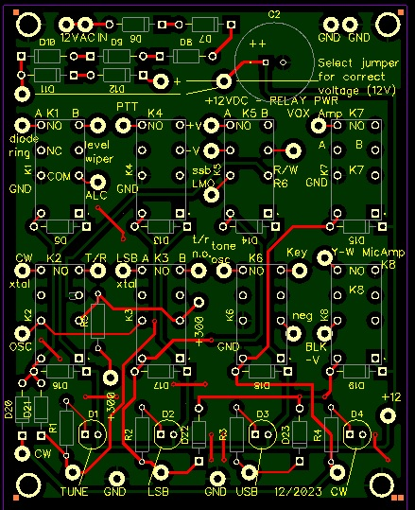
Relay-Based Replacement
Avoided EMP-vulnerable control logic in favor of simple RELAYS. System could be controlled by solid state opto isolators if desired.

Slide 24
Development identified 14+ logic connections made by the “mode” switch.
Heathkit switched very few RF connections (primarily choosing between 3 carrier crystals).
Almost all switched connections were DC or audio signals. Unfortunately, some were 200VDC.

Slide 25
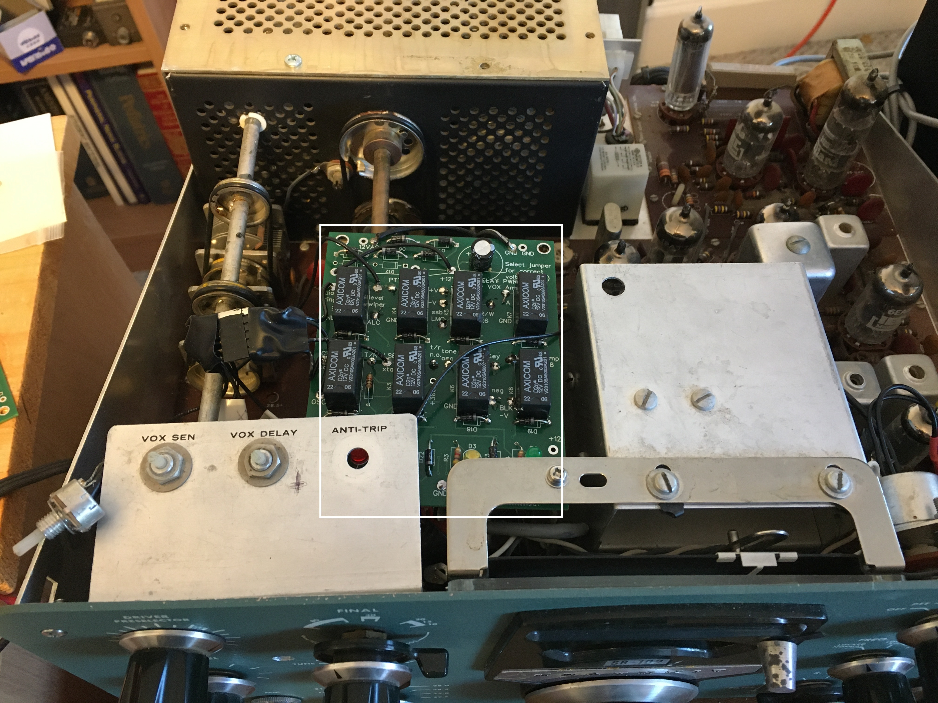
Successful Prototype installation

Slide 26
Alternative EMP-hardened designs
Relay-switched pi-networks and simple 6146 tube amplifiers can provide EMP-hardened end-amplifier exposed to antenna systems. With little need for heat sinks the volume difference isn’t that great and efficiency higher.
A simple front-end vacuum tube preamp can shield the remainder of the receiver from EMP energy with modest design complexity.
Fragile computer systems can use opto-isolators to isolate from much of the RF circuitry. Hybrid designs (such as the sBitx) that perform SDR in a 0-50kHz window can be operated via optically isolated devices.

Slide 27
Conclusion
There ARE protective strategies that can be relatively easily employed and many are “dual use” – additionally protect against lightning or power line issues.
Hams can assist in raising protective levels for critical systems, such as infrastructure-free HF communications
Becoming subject matter expert adds value to experienced hams who can balance priorities.

Slide 28
Comments / Discussion?

