Slide 1
How much protection do FCC Part 15 Conducted Noise Limits Provide? Will your radio work at your EOC?
Gordon Gibby MD
KX4Z NCS521
February 2024 / TECHCON 10

Slide 2
Goal
Provide guidance to facility designers so that incidental or unintentional radiators will not disrupt or hamper backup High Frequency (HF) radio communications by radiating noise.
Answer the question of whether advertised compliance with FCC Part 15 conducted noise limits is sufficient protection.

Slide 3
HF Backup Communications
Dangerous world.
Public switched telecommunications have multiple vulnerabilities not only to weather, but also to malicious intent of hackers or state actors
HF communications are infrastructure-independent.
Government, military and private entities therefore often use HF as a backup.

Slide 4
Examples include Florida Division of Emergency Management using federally provided SHARES frequencies / log-periodic and loop antenna for backup communications to Florida Counties
Military using NVIS and other communications for battlefield communications
Traditional backup Embassy long-range communications.
Recent interest by stockbrokers for decreased latency communications.

Slide 5
Damage to HF backup communications can severely hamper coordination and control in the event that normal communications are overloaded or damaged.
Examples include Katrina, Iowa derecchos and many more instances where weather degraded normal comms, misaligned microwave antennas, downed towers, or fire engulfed facilities.

Slide 6
Path Budget
HF communications may be operating at the tail end of the allowable path budget.
Adding 10dB of noise beyond background can be extremely disruptive to HF communications.

Slide 7
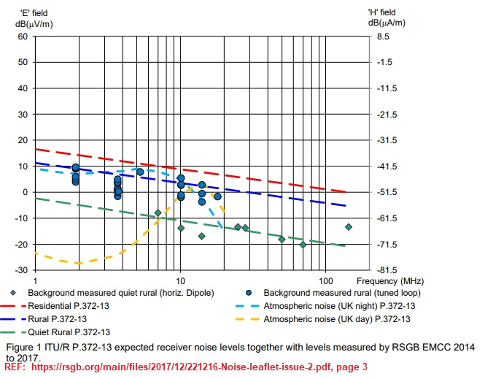
Unavoidable Noise

Slide 8
FCC Limits
Above 30MHz Part 15 (and European CISPR regulations) require measurement of RADIATED noise.
Below 30 MHz, only conducted noise is regulated.
Why?

Slide 9
Inefficient Radiators
Conventional engineering wisdom: antenna < 1/6 wavelength is inefficient
Primary radiator of many devices is their power cord, which is short.
Building wiring is highly variable and cannot be specified.
Therefore, the only known radiator (power cord) is inefficient.
More effective to limit the CONDUCTION of noise into that wiring, which will limit the power available to the (unknown) eventual building wiring.

Slide 10
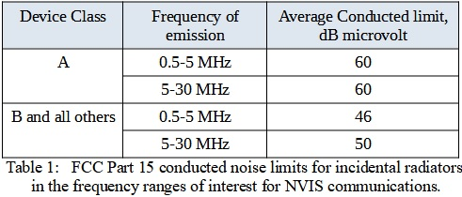
FCC Conducted Noise Limits
Class B = residential; Class A = commercial, etc.

Slide 11
Alachua County
Existing EOC has tremendous RF noise detected inside, on the roof, on the ground wiring, and everywhere throughout, presumably from computers and switching backup supplies.
This necessitated very long coaxial cable runs to place antennas at good distances from the building.
County is renovating a structure for a new EOC and proposes to put in uninterruptible power supplies potentially re-creating the problem.

Slide 12
Need to be able to advise designers now to specify equipment and installations that will NOT recreate the problem.

Slide 13
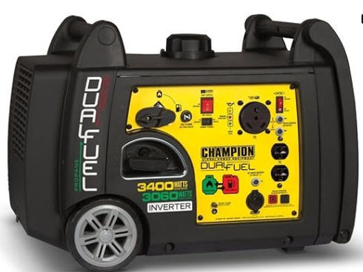
Device Under Test
3400 Watt Dual Fuel (Propane/Gasoline) inverter-based generator advertising Class B compliance.

Slide 14
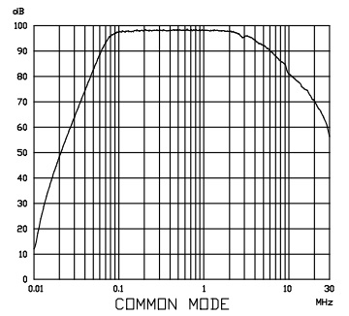
Known Noise Maker
Our team has considerable experience with this inverter generator (and others) and knows that extensive filtering (>50dB) is required to allow it to operate in the neighborhood of HF antennas. (Despite Class B rating)
REFERENCE: https://cdn.automationdirect.com/static/manuals/emifilters/MIF23.pdf
“Filter Insertion Loss Characteristics, CISPR 17 – 50 Ohm method”

Slide 15
METHOD
Conducted Noise Measurement

Slide 16
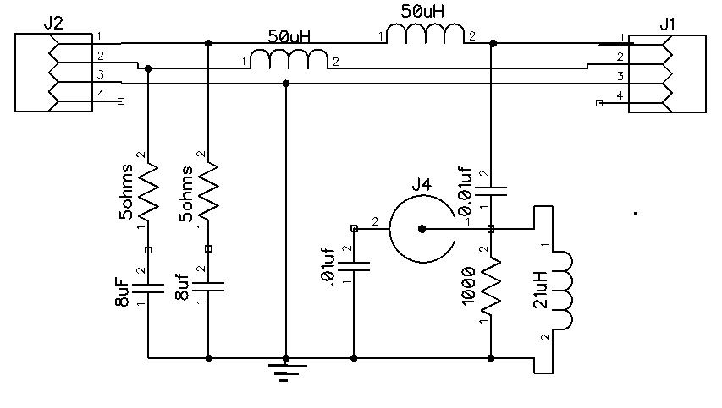
V-type LISN constructed

Slide 17
Purpose of FCC-required LISN
In case of device requiring AC power, prevents noise from AC lines reaching device and contaminating test.
Provides 50 ohm load for frequencies of interest to device
Provides separating impedance (50 uH) thought to simulate 30meters of house wiring.
These devices are extremely $$$$

Slide 18
Monitor Tap: 0.01uF cap instead of 0.1 (easily handles lowest frequency of interest)
High Pass Filter (500kHz) added to reduce overloading of spectrum analyser by lower order harmonics (distortion) of the inverter output as not concerned by those.
Sufficient external 50 ohm pad attenuators used to allow analyzer to operate.
Measurements at 3.5, 7, 10.1 MHz. 10 kHz BW (nearest available to 9kHz standard)

Slide 19
Adequacy of LISN assessed by measuring SWR from the “hot” side.
NOISE MEASUREMENT – combined differential + common mode measured from both hot and neutral wiring from generator versus ground.
Generator GROUNDED by approx 5 foot #14 wire directly to solid ground rod.
Note this is DIFFERENT from FCC prescribed measurement (DUT on 80cm high table, grounded only through cable, ground plane underneath)

Slide 20
Radiated Noise Measurement

Slide 21
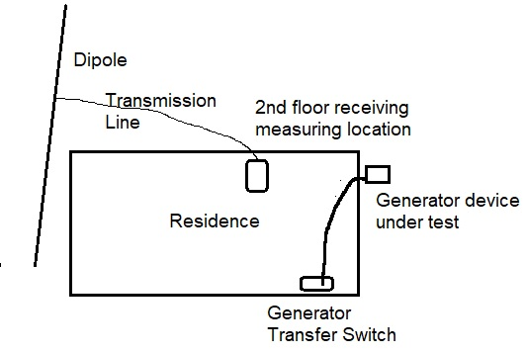
Not-to-Scale approximate physical setup.
When appropriate, generator powers 2nd floor and portions of 1st floor

Slide 22
Antenna
Non-resonant antenna approx 100 feet long
300 ohm window line to T tuner
Assumption made that antenna is “full sized” for each band.

Slide 23
At each frequency, manual T-type antenna tuner set for SWR<= 1.5:1
Measurement of received energy taken at 3.5, 7, 10.1 MHz @ 10kHz Bandwidth
Noise floor of spectrum analyser measured
Baseline received without generator.
Measurement with generator powering house.

Slide 24
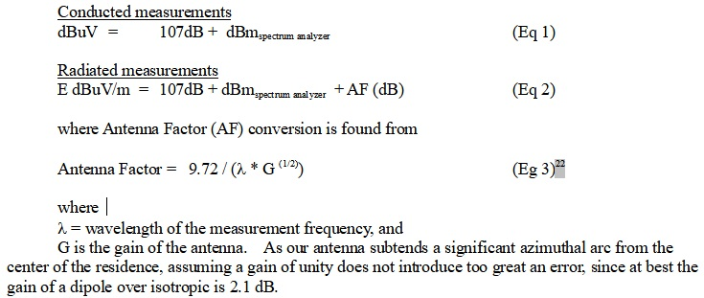
Relevant RF Equations

Slide 25
AF for full size dipole

Slide 26
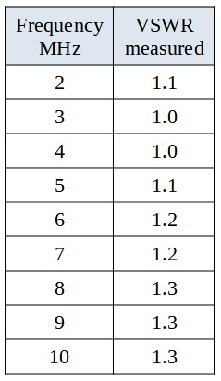
RESULTS
Assessment of adequate of home constructed LISN

Slide 27
Conducted Noise Measurements

Slide 28
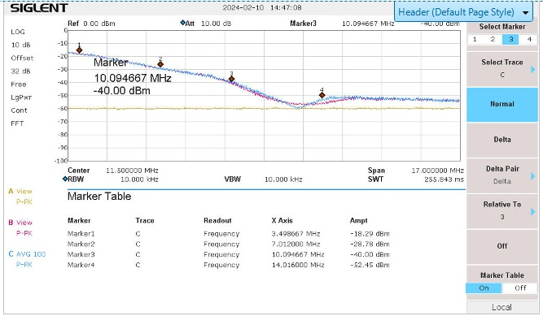

Slide 29
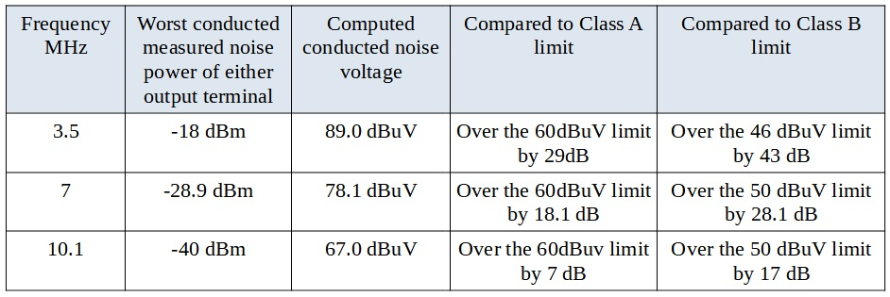
Conducted Noise in FCC Units

Slide 30
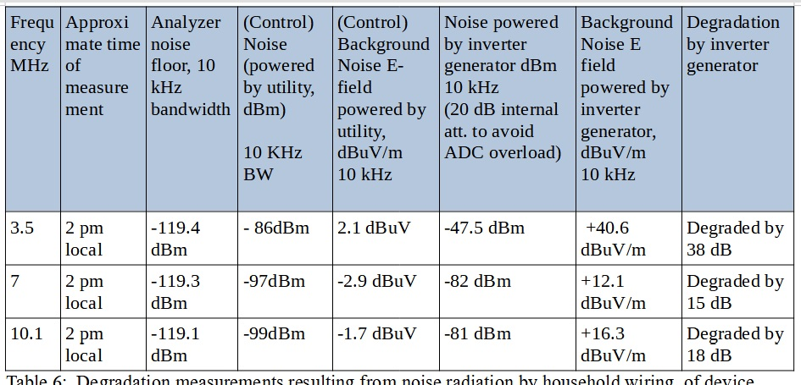
Received Noise

Slide 31
DISCUSSION

Slide 32
Grounding and generator placement enhanced radiation – but are prudent and normal expected safety procedures
Generator is 6 years old.
LISN data suggest adequate performance of LISN
Background RF measurements fall nicely of RSGB data between “Rural” and “Quiet Rural” suggesting appropriateness of AF

Slide 33
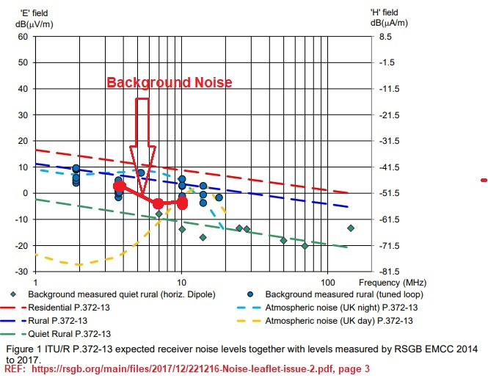
Background noise measured

Slide 34
Passive Environment
Key understanding that the environment is LINEAR. ie. Doubling noise radiated will double noise received.
Therefore all results can be linearly scaled down to “control background” to find the necessary limit on ACTUAL conducted noise to avoid hampering RF reception.

Slide 35
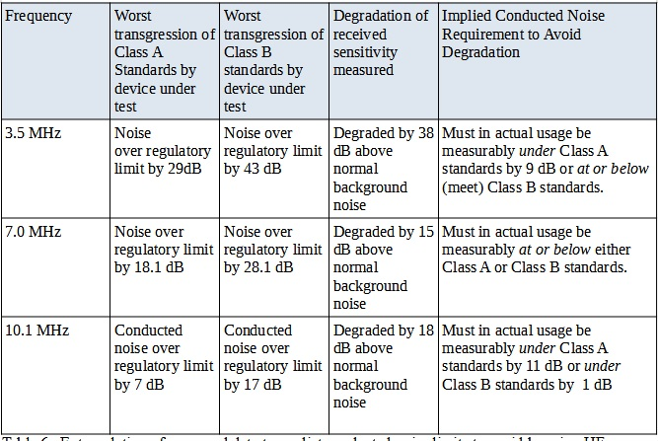
Computation of Required Performance

Slide 36
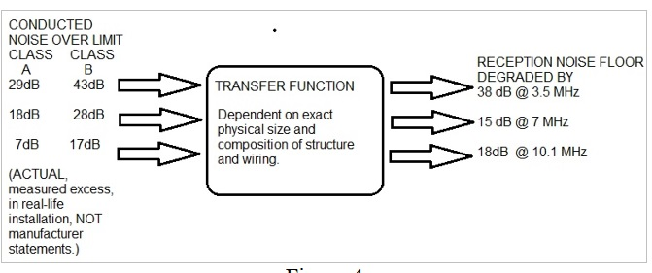
Illustrative Results

Slide 37
This one anecdotal situation:
Stated compliance with FCC limits – even Class B limits – is NOT ENOUGH
ACTUAL performance in realistic situation is far more important.
80 meters: Req. 9DB below Class A or meet Class B
40 meters: Req actually meeting either A or B
30 meters: Req actually under Class A by 11 dB or under Class B by 1 dB

Slide 38
Only one situation studied.
Actual performance far more important than contrived laboratory claims
Inadequate performance can be salvaged by
Pre filtering with industrial filters safely mounted
Prefiltering with some consumer filters available

Slide 39
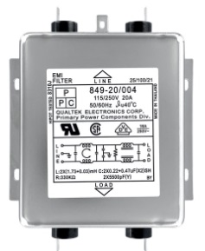
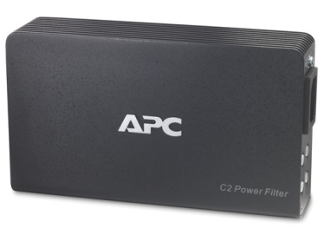
https://www.digikey.com/en/products/detail/qualtek/849-20%2F004/1680215
https://www.apc.com/us/en/product/C2/apc-av-c-type-2-outlet-wall-mount-power-filter-120v

Slide 40
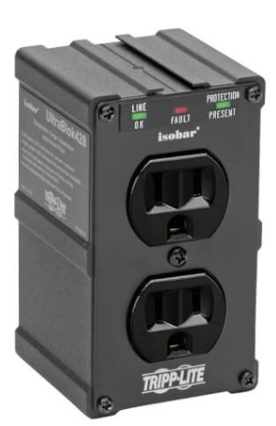
https://tripplite.eaton.com/isobar-2-outlet-surge-protector-direct-plug-in-1410-joules-3-leds-black-housing-5-in-height~ULTRABLOK

Slide 41
Consequences of failure to protect
Hampered communications at all times
Volunteers will be acutely aware
Facility will be judged substandard
Attrition of volunteers
Resulting loss of federal “match”
Lack of capability when needed

Slide 42
Questions / Comments?

Slide 43
Thank You!

