Slide 1
Creating A Calibrated Noise Monitoring Antenna & Using To Measure Baseline @ EOC Construction Site
Gordon Gibby KX4Z
February 2024
TECHCON 2024

Slide 2
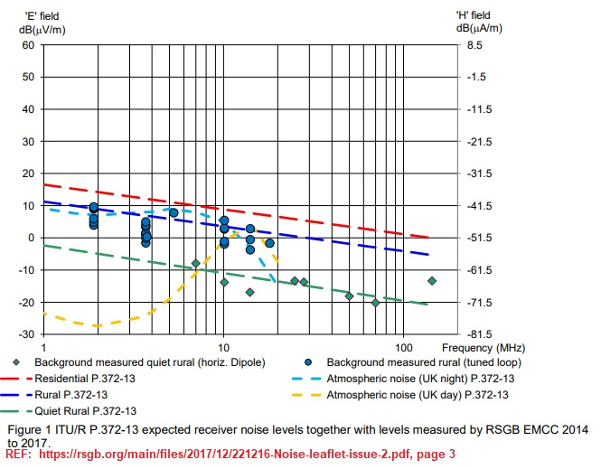
Industry uses dBuV/m (E-Field)
Reporting the E-Field makes the measurements independent of the type of antenna or gain.
“S-Units” quite unreliable.
Spectrum analyzer dBm only useful if same antenna.
Calibrated antennas much more useful.

Slide 3
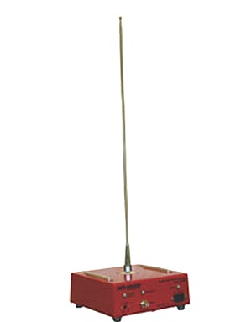
Commercial Calibrated EMC Antenna
Industry uses Vertical monopole, high impedance amp
$3000 used.
Calibrated with Antenna Factor, allows conversion from Spectrum Analyzer dBm directly to dBuV/m

Slide 4
Standards usually refer to a VERTICAL monopole….
But our EOC / inter-county communications are generally NVIS type comms, so I have used HORIZONTAL measurements to be more applicable to the real situation.

Slide 5
Conversion
Assumption of 50 ohm environment
Spectrum analyzer reports POWER in dBm
Converting to a voltage involves some squares & math
E dBμV/m = 107dB + dBm + AF (dB) (Eq. 1)
Universally agreed upon conversion.

Slide 6
My Procedure to Calibrate New Antenna
Measure likely isotropic noise with antenna whose AF can be known, calculate dBuV/m
Measure with antenna to be calibrated, get dBm on analyzer
Issue: not exactly in the same “field”: full size stretched tree to tree; test antenna out on porch roof….
Reverse the math to figure out AF for test antenna.

Slide 7
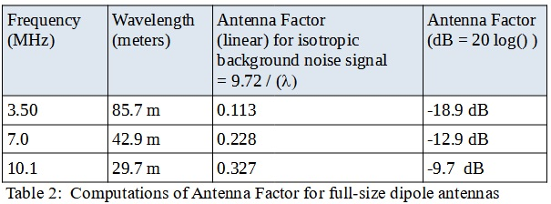
Antenna Factor for Full Size Dipole
Electromagnetic Theory allows obtaining the AF for a full sized dipole Noise (excluding point source nearby) has advantage of generally isotropic in azimuthal directions. .

Slide 8
Conversion to dBuV/m
Spectrum analyzer power measurements were then converted to E-field signal strength (dBμV/m) using Equation 1, which is derived from Ohm's Law in a 50 ohm system using the definitions of decibel for power and voltage as appropriate.
E dBμV/m = 107dB + dBm + AF (dB) (Equation 1)
where dBm is the power measured by the spectrum analyzer.
REF: A. H. Systems, Inc. "Useful Formulas for RF Related Conversions" [Online]. Available: https://www.ahsystems.com/EMC-formulas-equations/RFconversions.php Accessed 2/10/2024.

Slide 9
Noise = Noise
Whether measured by a full sized antenna or by a small 2-foot portable measurement antenna...the E-field of isotropic background noise is the same.
Allows for an equality equation that gives us the Antenna Factor for the small 2-foot antenna.

Slide 10
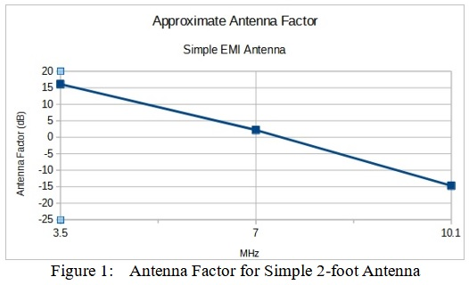
Resulting Calibration Curve Simple 2-foot Antenna

Slide 11
AF values at 7MHz/10MHz Suspect
During calibration, 2-foot antenna placed on porch roof limited by 10-foot coax.
May have been in higher noise field than comparison 100-foot dipole stretched in back yard.
Would result in inappropriately negative AF calibration results…..
3.5 MHz value may be reliable, and this by itself allows useful measurement of noise environment due to harmonics of 60Hz power systems...

Slide 12
Utilization for EOC Measurement
Alachua County, Florida is moving their EOC and Fire-Rescue Headquarters to a huge old WWII building
Building will be renovated.
Previous EOC beset with mega-dB RFI HASH presumably from backup power systems
Desire to avoid repeat.

Slide 13
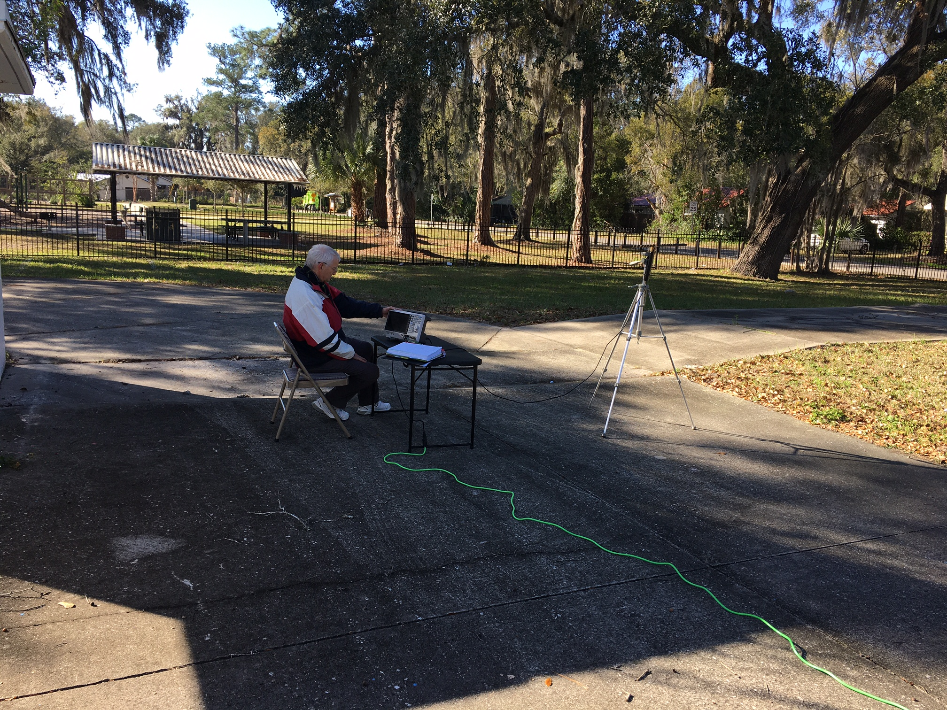
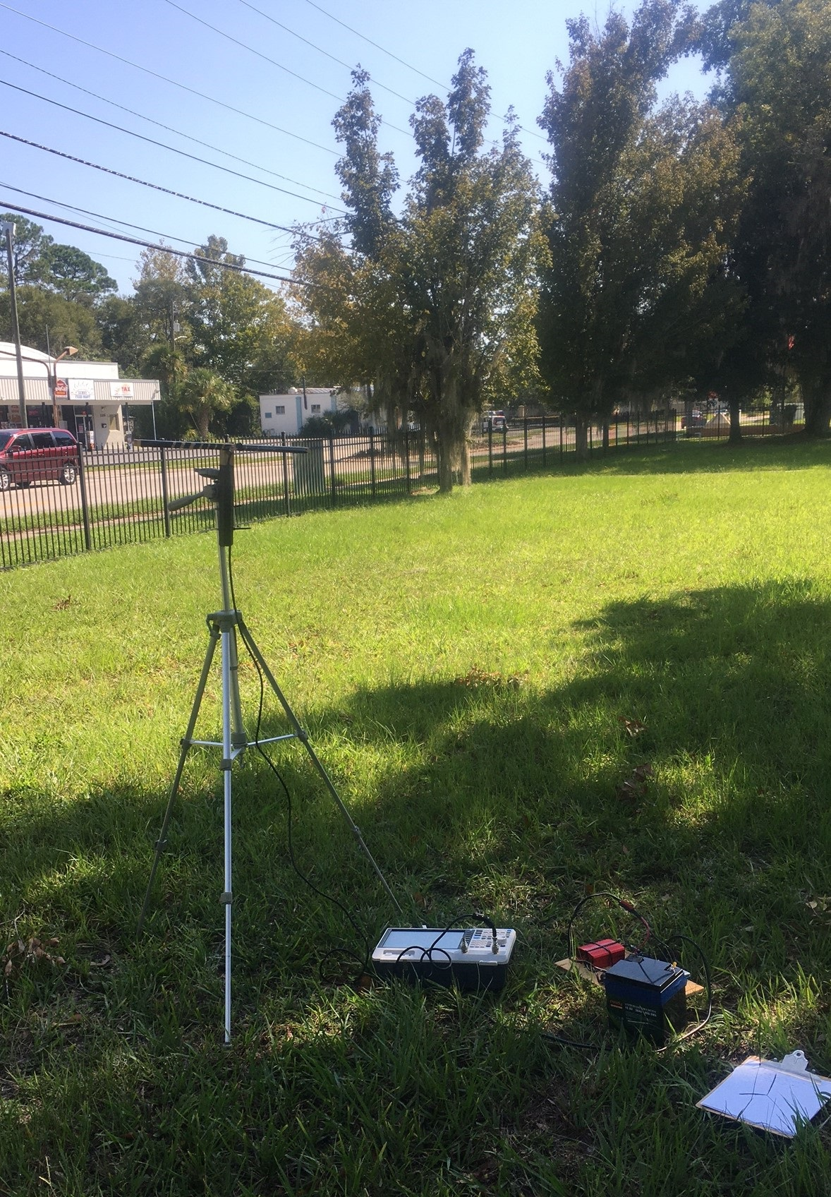
Monitoring Setups

Slide 14
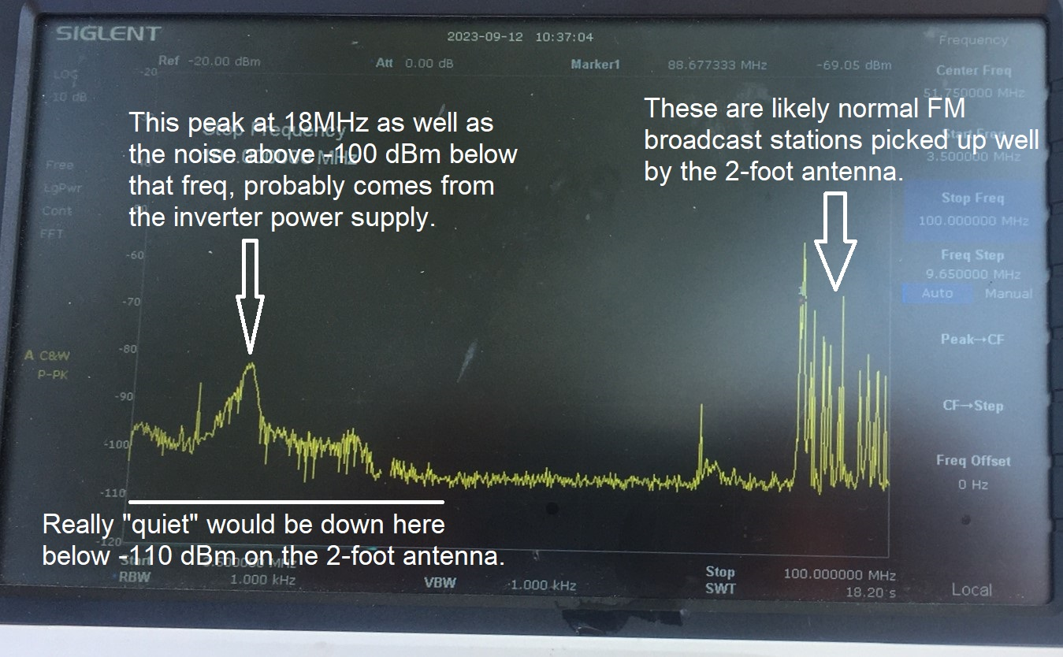
MUST have quiet power supply! (Embarrassing record of mea culpa.)

Slide 15
Sleuthing
Discovered when comparing measurements back home, powered by diesel generator (free wheeling alternating controlled only by mechanical governor) versus the filtered inverter
Utility power is also usually quiet.

Slide 16
Had to repeat entire measurement...
Back to the site
Utilized diesel generator
PLUS MIF23 filter
PLUS 100ft extension cord (laying on ground)
Compared to utility where possible
FAR quieter measurements discovered.

Slide 17
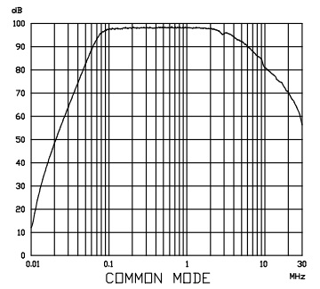
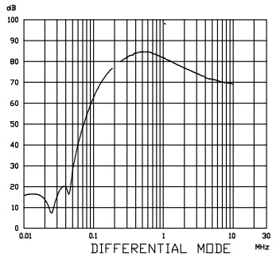
MIF23 Filter
REFERENCE: https://cdn.automationdirect.com/static/manuals/emifilters/MIF23.pdf
“Filter Insertion Loss Characteristics, CISPR 17 – 50 Ohm method”

Slide 18
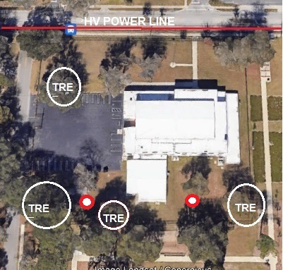
Measurement Locations Left = 1 Right = 2

Slide 19
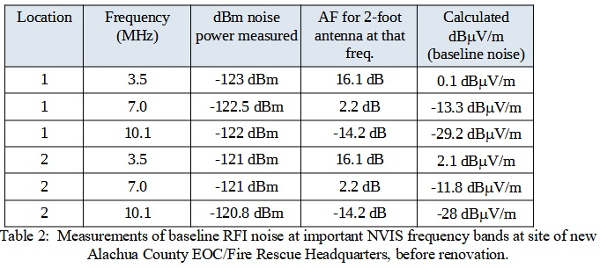
Final Result Baseline Measurement

Slide 20
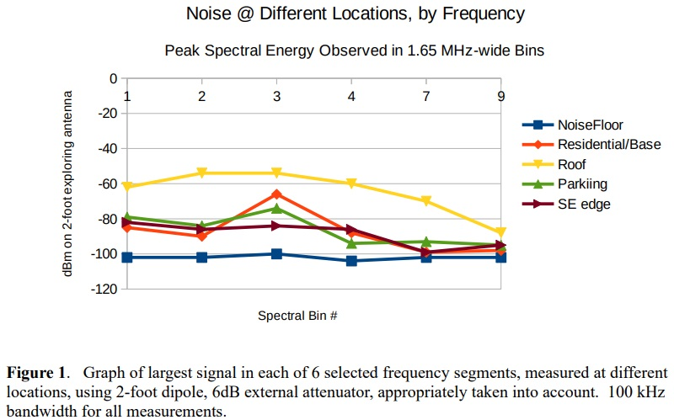
Spectrum Analyzer measurements comparison with existing EOC
Power measurements (same antenna) @ 10kHz BW at new EOC site:
3.5MHz -123 dBm
7 MHz -121 – 122.5 dBm
Old EOC roof is 40-50 dB more noisy.
Old EOC Parking Lot is still as much as 30dB more noisy...
To correct to 10kHz bandwidth, subtract 10dB for power measurements.

Slide 21
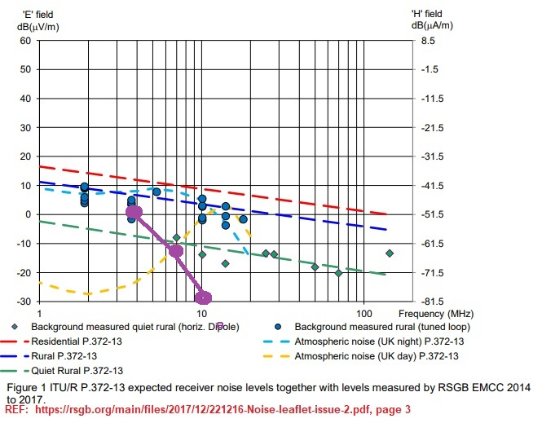
Plotted on RSGB Data dBuV/m
3.5 MHz data seem reasonable, but 7 is at low end of RSGB measurements and 10 MHz much lower.
Suggests AF calibration may be suspect for 10 MHz...so the dBuV/m measurements may need further refinement, but the spectrum analyzer dBm measurements with same antenna, versus older EOC are still quite relevant. .

Slide 22
Conclusions
Making accurate noise measurements is tricky, requires attention to inadvertent corruption due to power system noise in measurement setup
AF calibration for 7/10 MHz of simple antenna appear suspect.
New EOC site (when comparing dBm measurement, same antenna) is FAR quieter than built-out existing site.
When more accurate 7MH/10MHz AF values are available, retained dBm measurements can be re-converted (hence still useful)

Slide 23
Next: Improvement Steps
Improve AF for simple 2-foot antenna by creating individual full size dipoles for 3.5, 7 and 10 MHz – out in large 5-acre back yard
Place 2-foot antenna at center of full size dipoles for each comparison
Power either from filtered diesel or long extension cords.
Solar panel system off.

Slide 24
