Slide 1
KV0OOM (aka Mike)
RETIRED = Looking for a new hobby because 11 is not enuff.
Technician + General on 18 Nov 2015
Extra on 08 Jan 2016
Not that smart, 5 years as a classroom instructor for electronics.

Slide 2
Many Dialects of BASIC
Dartmoth BASICA
Applesoft Tiny
Sinclair Commodore
BBC Liberty
Microsoft GW-BASIC
Texas Instruments PowerBasic
QB64 QuickBasic
https://en.m.wikipedia.org/basic

Slide 3
Many Dialects of BASIC
Dartmoth BASICA
Applesoft Tiny
Sinclair Commodore
BBC Liberty
Microsoft GW-BASIC
Texas Instruments PowerBasic
QB64 QuickBasic
https://en.m.wikipedia.org/basic

Slide 4
Legacy BASIC (GW-BASIC)
IBM-PC Interpreted BASIC, used tokens (bytes) to store programs.
A tokenized BASIC program is a text file, but is not Person readable.
This was a form of “pre-compile” to improve execution speed.

Slide 5
Using Programs
No issue if you copy or create a program and type it in yourself (sucks).
ARRL Antenna Compendium Vol 2 & 3
Problem occurs when you get a text file tokenized (like from the Internet) and not person readable.

Slide 6
Legacy Program Applications
I am primarily working with antennas:
Loading Coils
Coax Traps
Phased Array Feeds
Yagi Beam Pattern Design
Polar Pattern Plotting
Smith Chart Z Matching

Slide 7
Converson Options
For Windows 10…
DOSBOX = Run DOS pgms in a Window
PC-BASIC Emulator
GW-BASIC executable compiled for Windows
Old PC running DOS 6.2 or Windows 3.1

Slide 8
Tokenized File Conversion
If using a DOS or Win 3.1 computer,
save the file (from GW-BASIC) using this command:
SAVE “FILENAME”, A
To save as a plaintext file.

Slide 9
Tools of Choice
GWBASIC.EXE on a Win XP machine
PowerBasic PBCC 4.04 command line compiler.
PowerBasic started as Turbo Basic by Borlund Software.

Slide 10
Step by Step 1
Compile the file and check for errors.
If Error 484 (requires procedure), you must add Function PBMAIN or WINMAIN at the start, and END FUNCTION at the end. This is a WINDOWS requirement.
If LPT1, PRN, or LPRINT is in the code, you need to add or modify using “XPRINT” code because these are DOS commands:

Slide 11
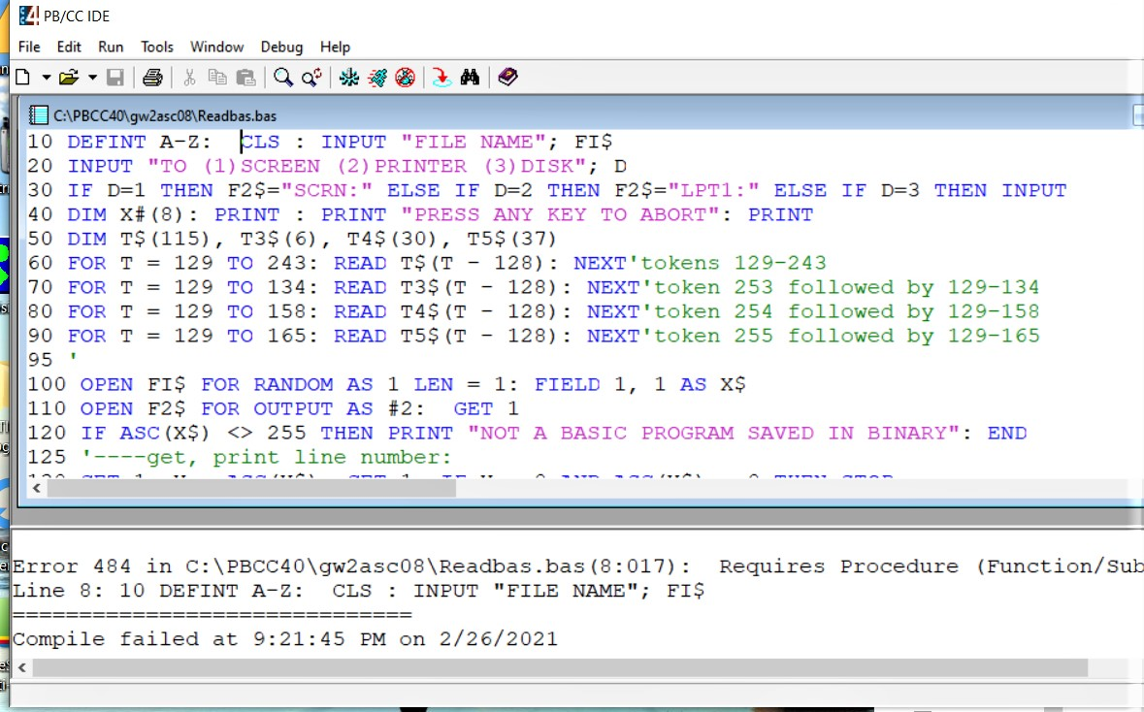

Slide 12
Step by Step 2
ERRCLEAR
XPRINT ATTACH DEFAULT
IF ERR = 0 AND LEN(XPRINT$)>0 THEN
‘ XPRINT “Printer working…”
‘ XPRINT FORMFEED ‘These two lines should occur just
‘ XPRINT CLOSE ‘ before the program exits.
ELSE
INPUT “No Windows printer found.”; ack$
END
END IF

Slide 14
Step by Step 3
READ – DATA takes the most work, most of the time, not counting error fixing…
READ T5$ (x-128) becomes T5$ = READ$ (X-128)
String and Numeric data can be mixed in the same DATA line, but you have to be VERY careful forming the READs in the LOOP statement.
Eventually, you will see, “Compile succeeded at…”,
but

Slide 17
Step by Step 4
YOU ARE NOT DONE.
You still have to run the program.
Double click or drag&drop on the EXE, it is a Windows program now.

Slide 18
Unfortunately…
The program filename parsing routines assumed the original 8.3 file name convention, which appear relevant when using file I/O operations.
Also, you may encounter a program where the programmer is showing off his newly learned keywords. For example, he/she may use MID$() where LEFT$() was more appropriate. Decoding what they intended can sometimes be very interesting.
This is where familiarity with BASIC comes in handy.

Slide 20
Quirks 1
Sometimes code does not work as expected, or desired. You have to decide if the effort to “clean it up” is worth it. Should you cut your losses and run?
For me, it becomes personal. I like to think I am smarter than a glorified calculator.

Slide 21
Quirks 2
For example, I eventually discovered COMMAND$ returns the file path with quotes (I suspect because it contained a blank space) when using Windows drag & drop (drag the .BAS and drop it on the new EXE). I missed 2 clues with LEN and PRINT, and it cost me 15-16 hours of debugging.

Slide 22
Cut Your Losses and Run, Away
The program was to convert tokenized BASIC to ASCII text. Once I got thru the file I/O issues, I learned the program was reporting token errors.
I had already created an ASCII copy of the program. I knew the .BAS program was error free (token-wise) and knew what the output should be.

Slide 23
Project Tabled
I may return to this project, but I know it will be a lot of work.
Locating the correct tokenization table for this version of BASIC.
Figuring out why the original programmer’s code does not work.
Outsmarted is a coding issue. Aggravation is a programmer’s code issue.

Slide 24
Pretend it Worked
We added PBMAIN or WINMAIN. Next are those pesky “LPRINT” statements.
LPRINT is a DOS function and we are in a Windows box. This means there will be some code edits required because DOS is deeply linked to the machine hardware. Windows is not.

Slide 25
LPRINT becomes XPRINT
First, we must tell the program how to connect to the Windows printer:
ERRCLEAR
XPRINT ATTACH DEFAULT
Then test for success…
IF ERR = 0 AND LEN (XPRINT$)>0 THEN
‘ XPRINT “Printer working…”
ELSE
INPUT “No Windows printer found.”; ack$
END
END IF

Slide 26
Editing for Printer Output
Now we are ready for the paper copy statements. If you change LPRINT or PRINT keywords to XPRINT, no other editing is normally needed.
I prefer to convert the LPRINTs to XPRINTs, and make a second copy of the PRINT statements. I turn those into XPRINTs and edit for a pretty printout.

Slide 27
Reading DATA Revisited
READ$ is a TEXT command. It is best to keep numeric DATA separate from string DATA. However, it is possible to read the data in groups of variables in each pass of the FOR-NEXT loop.
Once I got away from TRS-80 Level II BASIC, I rarely used DATA statements, so my experience here is limited.

Slide 28
The Last Code Part
These should be the last 3 lines of code if XPRINTing:
XPRINT FORMFEED
XPRINT CLOSE
END FUNCTION
Be sure to CLOSE the printer before ending the program.

Slide 29
GWBASIC.EXE
If you need a copy of GW-BASIC, you can download it from here:
https://hwiegman.home.xs4all.nl/gwbasit.html
This is where I got my copy because Win XP did not include it.

Slide 30
More Links
Detokenizers (Microsoft BASICs) Info
http://edmond.orignac.pagesperso-orange.fr/detokenizer.html
For Syntax:
http://www.antonis.de/qbebooks/gwbasicman
HEX editors: (UltraEdit and HdX)
http://ultraedit.freedownloadscenter.com/windows/free
https://mh-nexus.de/en/hxd/

Slide 31
HEX Editor?
The HEX editor is a special tool for looking at files other than with a text editor. GW-BASIC tokenized files start with “FF” hex as the first byte in the file. If the file is “protected”, the first byte will be “FE” hex.
And no…, you cannot change the first byte to something else so you can unlock the file.

Slide 32
PEEK - POKE
If you see either of these keywords in the code, FORGET IT. These commands are hardware specific and DOS connected. Windows does not allow random peeking and poking memory. You will get a memory violation or other dramatic end to your program.
If you can’t resist the need for speed, then learn Assembly Language for x86 processors. PowerBasic allows inline assembly embedded in the BASIC source code.

Slide 33
KV0OOM
This project was initiated by obtaining some files authored by A. C. Buxton, W8NX. If you delve into coax chokes and traps, you will see this name a lot.
kv0oom, Amateur Extra.
kv0oom.extra@gmail.com
Old, but not an Old Timer.
Google is your best friend.
RETIRED and hobby poor!

Slide 34
END
Questions?
Software demo is next…

