Slide 1
Introduction to NXDN Amateur Radio
Paul Toth-NB9X
West Central Florida Group, Inc.
Assistant Section Manager-Digital
ARRL-WCF Section

Slide 2
What Is NXDN?
It is a COMMON AIR INTERFACE (CAI), a technical protocol that defines a digital voice and data radio system
Technical Specification managed by NXDN Forum
Emission Designators: 4K00F1E, 4K00F9W, 8K00F1E, 8K00F9W
Type of Modulation FDMA
Channel Bandwidth 6.25 KHz & 12.5 KHz
Signaling 4 FSK
Speed: 4800 Baud for 6.25 KHz & 9600 baud for 12.5 KHz

Slide 3
HOW LONG HAS NXDN BEEN AROUND?
Created in 2005 by ICOM and Kenwood to FCC 2004 Narrowbanding R&O
Only true 6.25 KHz Radio Protocol

Slide 4
THREE FLAVORS OF NXDN
CONVENTIONAL MODE
TYPE C TRUNKING (uses Control Channel)
TYPE D TRUNKING (Distributed Control Model)

Slide 5
COTRAST AND COMPARE
Analog
NXDN Digital
VHF and UHF
25 KHz Channel
CTCSS or PL
One size fits all
VHF and UHF
6.25 KHz Channel
RAN Code (64)
TalkGroups
Individual Calling
Every radio has an ID

Slide 6
COTRAST AND COMPARE
Analog
NXDN Digital
Simplex Ops
Repeater Ops
Simplex Ops @ 6.25 KHz
Repeater Ops
Easy to Network
NXDN Simulcast
Superior Weak Signal operations
6

Slide 7
So, What About Coverage?

Slide 8
When ERP, Antenna Height and Terrain are equivalent …
NXDN outperforms 25 KHz Analog by up to Fifteen Percent.

Slide 9
NXDN Radios
Decode The Digital Stream Down To
-116 dBm

Slide 10
The West Central Florida Group, Inc. (NI4CE)
Put NXDN on the air in 2007!

Slide 11
NXDN REPEATERS IN
WEST CENTRAL FLORIDA
PASCO 442.6500
BOYETTE 442.0875
LAKELAND 444.6625
SEMINOLE 442.1500
VERNA 444.3125
CHARLOTTE1 442.0625
CHARLOTTE2 Proposed
BARTOW 442.1375
LAKE PLACID 442,1125
Ni4ce.org

Slide 12
WEST CENTRAL FLORIDA
TALKGROUPS
1 LOCAL
1200 FLORIDA
1201 WCF SECTION
1230 TACTICAL-1
1231 TACTICAL-2
1232 TACTICAL-3
1233 TACTICAL-4
1299 SKYWARN
12

Slide 13
HURRICANES IAN - NICOLE
&
NXDN

Slide 14
HOTSPOTS

Slide 15
NXDN RADIOS
NXDN is a LAND MOBILE RADIO Product Line

Slide 16
NX Series Portables and Mobiles
NX-5300 NX-5400
NX-5700

Slide 17
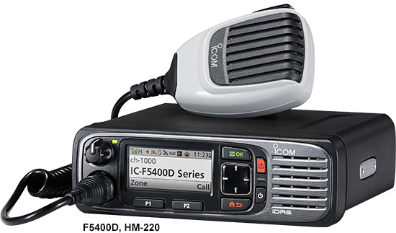
F4400DS 11
Ff62D 11
F2100DTL
INTRODUCING
F6130D
F6400D 01

Slide 18
INTRODUCING THE
ICOM F6130D NXDN MOBILE
5/25/45 WATTS
8 ZONES
128 MEMORY CHANNELS
OTAA & RX GROUP
MESSAGING
CALL ALERT
CRYSTAL CLEAR VOICE
AVAILABLE MARCH, 2023

Slide 19
ANTENNAS ARE IMPORTANT
MP Antenna 08-ANT-0864
¼ Wave UHF
Multi-polarized design to improve Bit Error Rate (BER)
Improve In-Building & Mobile Coverage
BASE STATION: 08-ANT-0891

Slide 20
AMATEUR RADIO OPERATIONS
CONVENTIONAL VOICE MODE
USE RAN or SEL Squelch
Announce Your TalkGroup ID When Calling
Newer Radios Support O-T-A-A
Register Your Callsign with RADIOID.NET

Slide 21
AMATEUR RADIO OPERATIONS
Crisp Clear Communications
Voice AF Response Tuned to the Human Ear
Excellent Noise Cancelling
No “Snap-Crackle-Pop”

Slide 22
Q & A

Slide 23
Thank You!
Paul Toth-NB9X
President
West Central Florida Group, Inc.
Assistant Section Manager-Digital
ARRL West Central Florida Section
NB9X@NI4CE.org
Ni4ce.org

